Slide 1


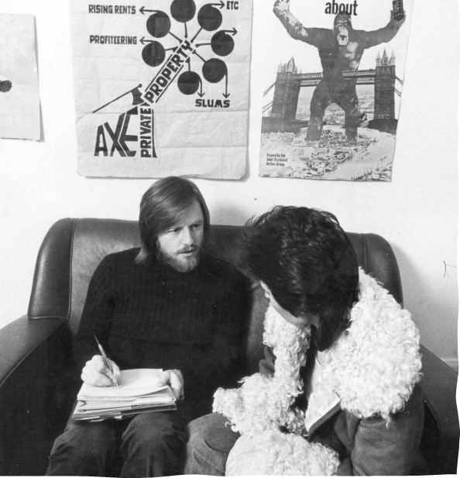
‘Everyone is interesting!’
North Kensington Law Centre 1970s
Steve Simpson: NKLC Annual Report 1983
Reflections on using life-story interviews in socio-legal research
Islington Community Law Centre 1970s
Marie Burton
(and Linda Mulcahy)

Slide 2
Overview
About the project
What is oral history?
What are life story interviews?
Using life story interviews: what I’ve learnt

Slide 3
About the project
“Enhancing democratic habits: an oral history of the Law Centres movement”
AHRC funded: April 2021 – now extended to March 2026
CSLS (Marie Burton, Linda Mulcahy) and QUB (Anna Bryson, Kieran McEvoy) with British Library and Law Centres Network
Document and audio archives created at British Library
  600+ Law Centre documents, Annual Reports and other materials
    BL contemporary archive
  65+ ‘life story’ interviews with Law Centre workers from 1970 onwards
    ‘National Life Stories’ oral history collection
North Islington Law Centre 1997/98

Slide 4
What is oral history?
  About capturing “unheard voices” in history – the people whose histories are not written down
    History from a bottom-up perspective
    Lives of ordinary people
  Radical origins – but whether they still maintain that radicalism is questioned (Gluck, 2011; Field, 2009)
  Become very mainstream – especially with the current focus on “lived experience”
  Preservation element – creation of archive

Slide 5
What is oral history?
Oral history interviews
  A form of narrative interviewing, open-ended
  The interviewee takes the lead
  The interviewer facilitates
  Less issue based than sociological semi-structured interviewing – more about the person than the topic, but the topic – as in our case – guides the choice of interviewee

Slide 6
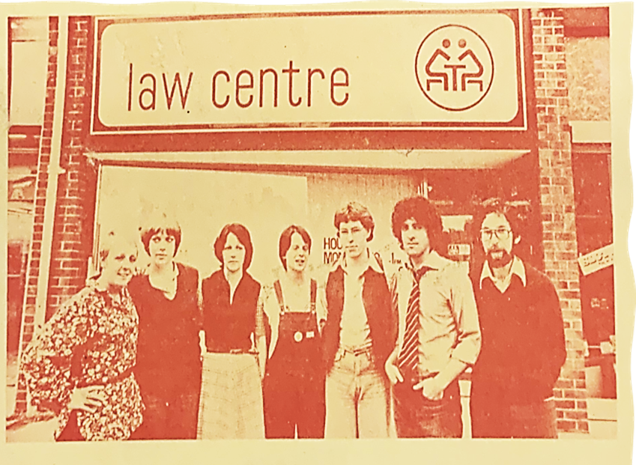
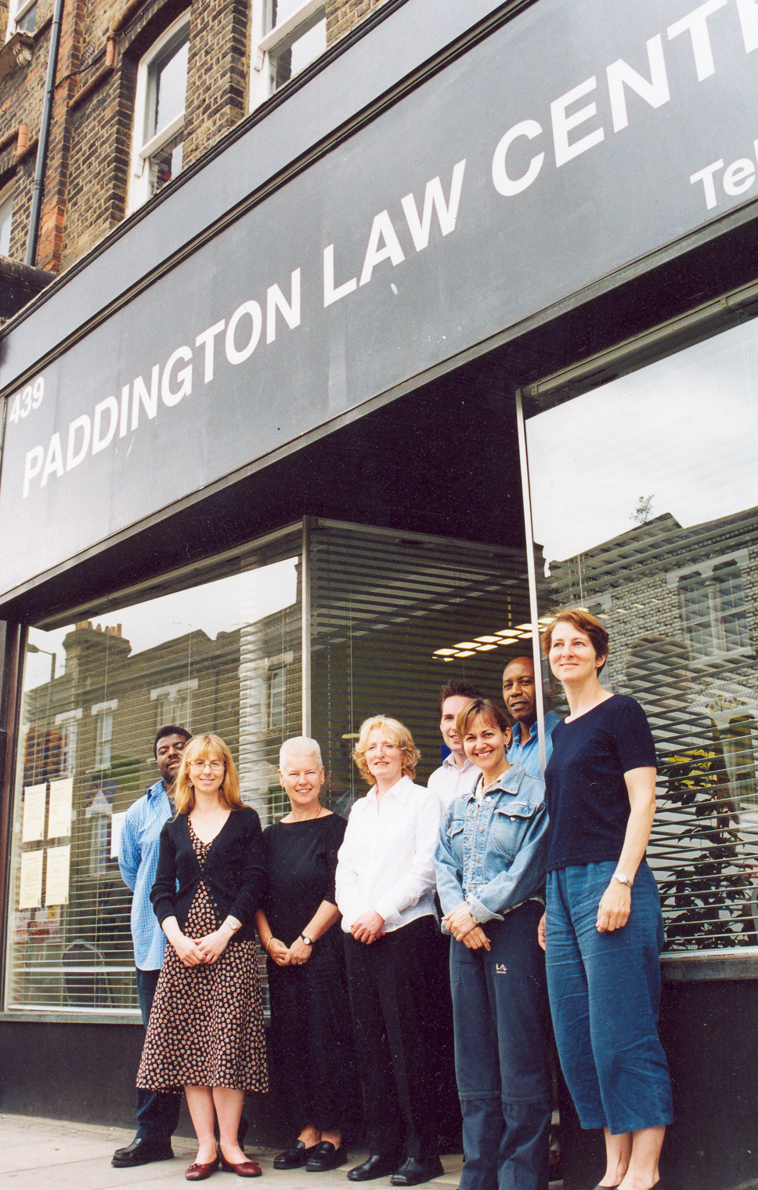
What are life story interviews?
Bringing the photos to life
Southwark Law Centre Annual Report 2024
Manchester Law Centre Annual Report 1977 to 1978
Paddington Law Centre staff 2000s
North Kensington Law Centre Annual Report 1995
Law Centre (NI) Annual Report 1999 – 2000

Slide 7
Life story interviews
Sub-branch of oral history interview
Oral history in its purest form
It is a person’s whole life story – or as much of it as they are willing to tell you
6 to 12 hours recording over several sessions
Very useful if looking at movements such as Law Centres
Link individual experiences with social phenomena (Leavy, 2011)
  Eg, Prague Spring, Paris 1968, Grunwick Strike, Greenham Common

Slide 8
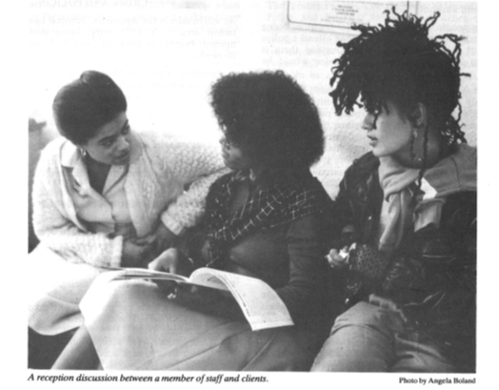
What I’ve learnt:
Everyone is interesting – defies the “great man” approach
  Pressure to interview key figures
  More difficult to get non-lawyers (often women and people of colour) to participate
Exceptional depth – greater insights
Relational quality – builds understanding
It can be very emotional
  Emotional work involved – be prepared and prepare interviewee
Brent Young People’s Law Centre Report 1982/1984

Slide 9
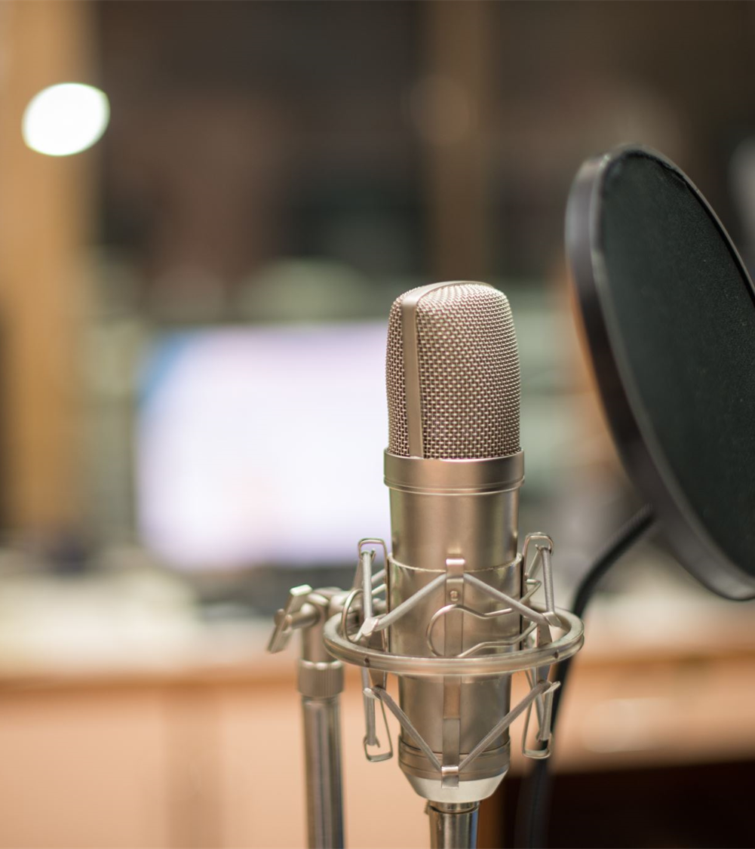
What I’ve learnt:
Time: depth rather than breadth – limits interviewees
Managing tension between individual’s life story and research topic - ‘bifocal’ nature of the interview (Bryson, 2021)
Practicalities: equipment, technical requirements, recordings, storage and preservation
“Contamination” issue - apparently strict requirements for a good quality recording
Demanding process – requires time commitment and private space from interviewee
  Adapt to be inclusive (eg shorter sessions, online, book rooms)

Slide 10
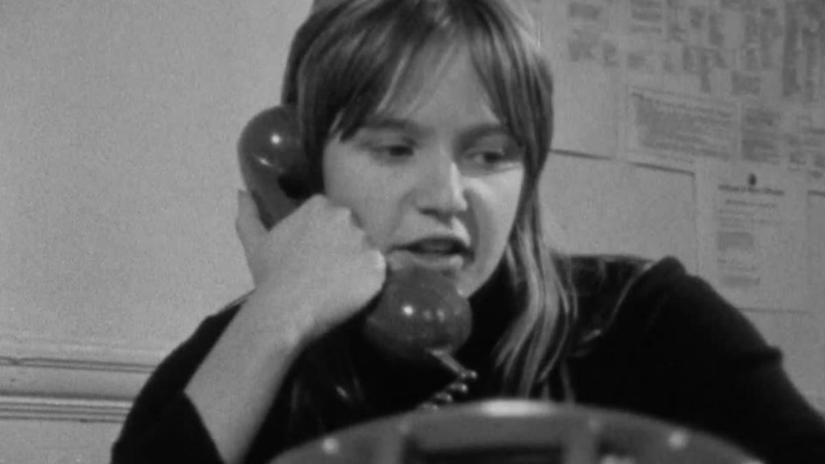
Finally…
Any questions?
Marie Burton: marie.burton@csls.ox.ac.uk
Linda Mulcahy
Linda.mulcahy@csls.ox.ac.uk
North Kensington Law Centre, BFI Free, https://player.bfi.org.uk/free/film/watch-north-kensington-law-centre-1973-online

