Slide 1
Access to legal advice: what do we know and how can we use it?
Jo Wilding
SCARE meeting 2025

Slide 2

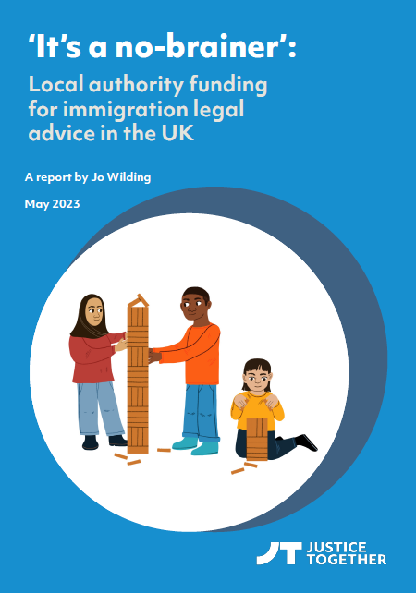

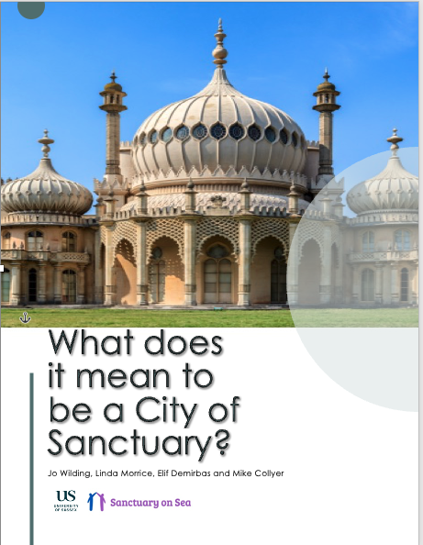
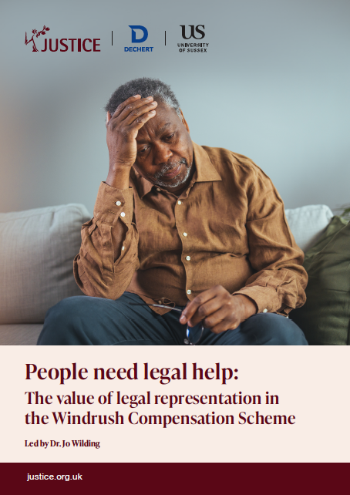
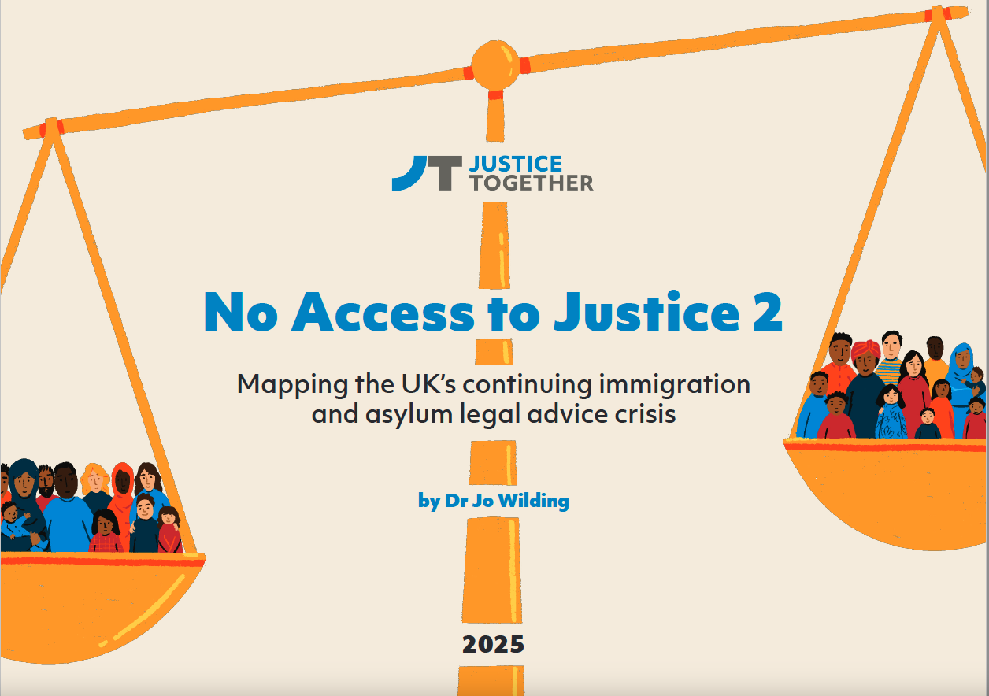

Slide 3
Themes
Analysis of ATJF data – new insights?
Mapping – immigration and asylum
Mapping – social welfare law
Value of mapping: what does it tell us?
Where do local authorities fit in?
Where do you find research and what’s useful?

Slide 4
Access to Justice Foundation data
4 grant rounds
560 applications
350 organisations
17-month period
Used like survey data
Is this a useful research approach?
What are the insights?

Slide 5
Funding source | Number receiving (n=156) | Mean percentage of income | Median percentage of income | Maximum
Legal aid | 44 | 16.8% | 13.5% | 61%
Local authority grants and contracts | 123 | 30.5% | 25.5% | 97%
Other contracts | 61 | 25.4% | 18.5% | 75%
Other funders and trusts | 154 | 48.3% | 46.5% | 100%
Earned income | 88 | 10.8% | 4% | 70%
Other sources | 113 | 9.4% | 3.8% | 90.6%

Slide 7
Immigration and asylum legal advice
57% deficit overall in asylum legal advice
Now a deficit in every region of England and Wales
Biggest deficits not necessarily where you’d expect
Data not yet available for last year
Middlesex Law Chambers – rise and fall
50% fee uplift for Northern Ireland

Slide 8
Mapping: social welfare legal aid

Slide 9
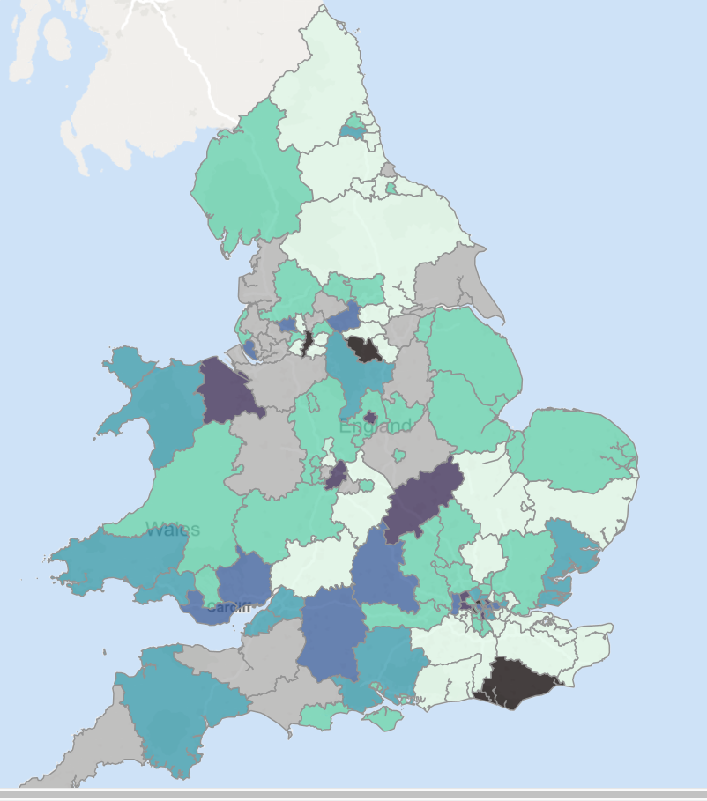
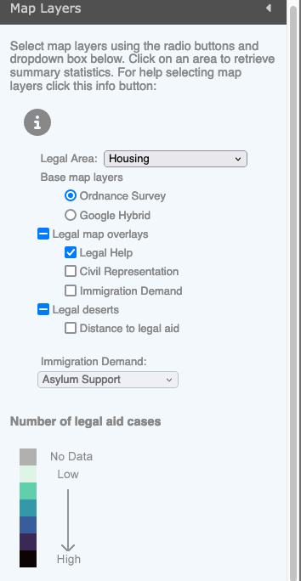
Housing –
Legal Help cases
2022-23
By procurement area

Slide 10
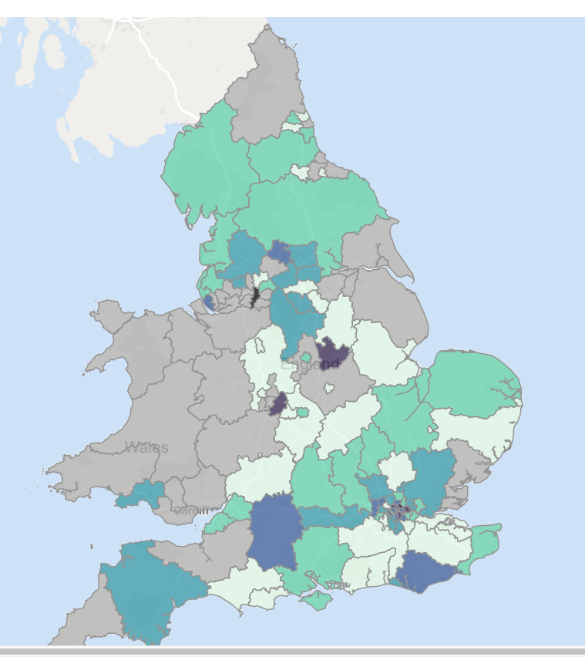
Housing – Legal Help
Housing – Civil Representation

Slide 11
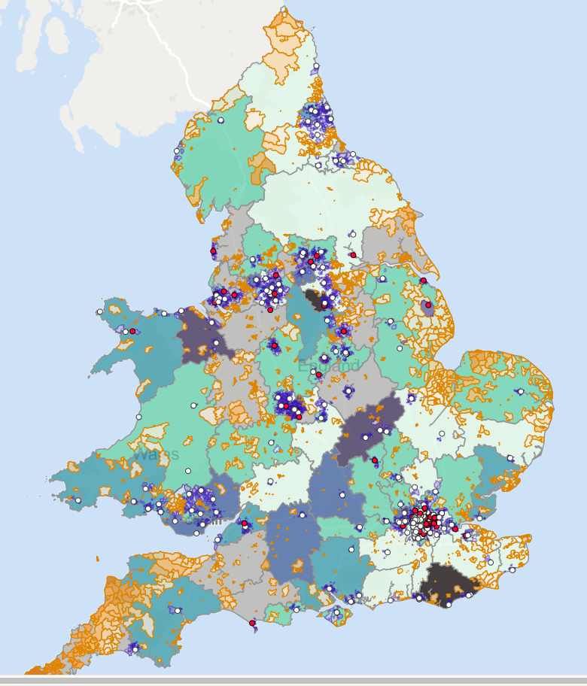
Housing –
Legal Help
Distance from legal aid layer
White dot = provider office
Red dot = provider office – dormant contract
Patches = most deprived 20% on IMD
Orange patches = further than average from provider office
Blue patches = closer than average to provider office

Slide 12
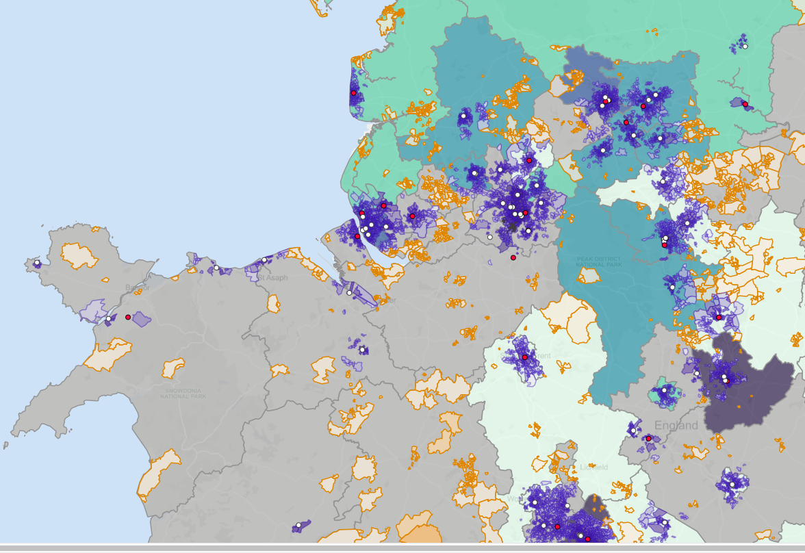

Slide 13
New IMD for England, 2025
Takes account of housing cost → new areas of severe deprivation.
73 areas where at least 99% of children deprived.
Advice as anti poverty strategy?

Slide 14
Questions
How do you find and use research evidence?
What have we got in un-analysed data? (Funding / membership applications?)
MoJ interest in legal support. What do we want that to mean?
How do we quantify unmet need?
What (if anything) do you think we need to know about ‘philanthropisation’?

