Slide 1
Dabbling into Researc
Three examples.
Gareth Morgan
Ferret

Slide 2
Differences in Pension Credit take-up - DWP
England – 63%
Wales – 64%
Scotland – 67%

Slide 3
A little more detail in the press release
England – 63%
Wales – 64%
Scotland – 67%
North East – 71%
North West – 67%
Yorkshire and The Humber – 64%
East Midlands – 61%
West Midlands – 65%
East of England – 58%
London – 69%
South East – 56%
South West – 55%

Slide 4
Isle of Anglesey
63%
Highest Eligible | Lowest Eligible
Neath Port Talbot 73% | Powys 49%
Flintshire
63%
Conwy
60%
Denbighshire
63%
Wrexham
66%
Gwynedd
58%
Highest in Payment | Lowest In Payment
Neath Port Talbot | Powys
80% | 58%
Max
0.7+
[0.65;0.7[
[0.6;0.65[
Powys
49%
[0.55;0.6[
[0.5;0.55[
Ceredigion
51%
[0.49;0.5[
Min
[0.49;0.49[
< 0.49
Merthyr Tydfil
71%
400+
400+
Pembrokeshire
56%
Carmarthenshire
59%
Blaeno Gwent
72%
Monmouthshire
55%
Torfaen
61%
Swansea 69%
Caerphilly
70%
Newport
70%
Neath Port Talbot
73%
Cardiff
68%
Bridgend
67%
The Vale of Glamorgan
71%
Rhondda Cynon Taf
69%

Slide 5
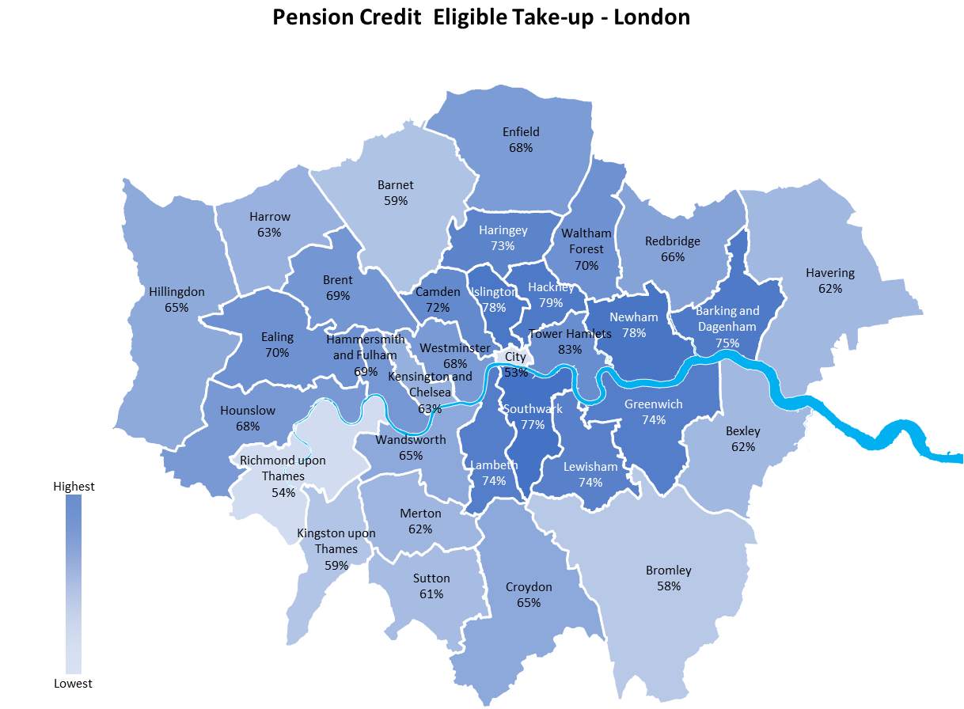
Highest Eligible | Lowest Eligible
Tower Hamlets | City of London
83% | 53%
Highest in Payment | Lowest In Payment
Tower Hamlets | City of London
89% | 64%

Slide 6
Changes to notional pension income hitting younger pensioners.
An unannounced change in the GAD tables in September
For most of those between 66 and 72 there have been substantial increases in the amount of notional income assessed, between a 4.5% increase and 0.92%.
For those 78 or over there is a reduction in the amount of notional income assessed between about 3% and 5%.
For those between 73 and 78 there is a mix of increases and reductions, depending upon age and the 15-year gilt rate applied. This ranges from an increase of 1.69% and a decrease of 3.81%.
At age 75, for example, a gilt rate of 2.25% will increase the notional income by 1.28%, a gilt rate of between 3% and 5.75% has no effect but a gilt rate of 6% means a decrease of 0.93%

Slide 7
75 year old with £30,000 pension pot
The notional income will vary by between an increase of £30 a month and a decrease of £1.81.
The benefit will reduce by £30 a month or increase by £1.81.
Depending upon what the Gilt market is doing that day.
If it’s revalued.

Slide 8
Who actually gains from minimum wage increases?
See Who actually gains from minimum wage increases? Some pre-budget comments – Benefits in the Future

Slide 9
Minimum wage & increases - 1
 | 2025 | 2026
35 hours gross @NLW | £427.35 | £444.50
Taxable | £186.11 | £203.26
NI’able | £186.11 | £203.26
Tax | £37.22 | £40.65
NI | £14.89 | £16.26
Net | £375.24 | £387.59
 | 2026 | 2026
Gross increase | £26.95 | £17.15
Net earnings increase | £22.59 | £12.35

Slide 10
Minimum wage increases - 2
HB & CTR | 2026
Gross increase | £17.15
Net earnings increase | £12.35
HB Reduction | £8.03
Typical CTR reduction | £2.47
Net Income increase | £1.85
UC & CTR | 2026
Gross increase | £17.15
Net earnings increase | £12.35
UC Reduction | £6.79
CTR reduction | £2.47
Net Income increase | £3.09
Notes:
Worse in many English LAs, and with banded schemes often worse still.

Slide 11
Minimum wage increases - 3
 | 2025 | 2026
Weekly Change
Employer pays | £45.52 | £19.72
Employee gets:
No benefits | £18.87 | £12.35
HB & CTR | £2.83 | £1.85
UC & CTR | £4.72 | £3.09
HB Only | £6.60 | £4.32
Government gets:
No benefits | £26.66 | £7.37
HB & CTR | £42.70 | £17.87
UC Only | £40.80 | £16.64
HB Only | £37.62 | £15.40
Who pays and who gains?
Notes:
Who pays and who gains

Slide 12
London Living Wage
LLW Annually |  | 2026
Employer pays |  | £1,988.35
Employee gets:
 | No benefits | £1,244.88
 | HB & CTR | £186.73
 | UC & CTR | £311.22
Government gets
 | No benefits | £743.47
 | HB & CTR | £1,801.62
 | UC & CTR | £1,677.13

Slide 13
Noticing these things – Who’s doing it?
Research groups and think tanks
Generally, look at effects on a macro basis
  Not individual impacts
It’s the individual variations that matter to advisers not the national economic impact
Local Authorities
  Targeting with their own data
Who does this ‘looking’ systematically – or should?

Slide 14
Is there a way of systemising these?
I see lots of ‘that could be worth a look’ things
  As do we all
I miss lots more
  As do we all
Does it depend on ‘networking’ to know who’s interested in what?
Could people add themselves to an informal topic interests list?s
Notes:
Now is the time to turn on the cameras and unmute, before we finish

Slide 15
It’s not just curiosity
Cherry picking the easier ones
Illustrating training and reports
Targeting campaign efforts

Slide 16
Campaigning
Blaenau Gwent | £130,827
Bridgend | £728,129
Caerphilly | £581,468
Cardiff | £1,314,253
Carmarthenshire | £3,305,242
Ceredigion | £2,046,695
Conwy | £2,159,386
Denbighshire | £1,269,837
Flintshire | £1,257,868
Gwynedd | £2,324,179
Isle of Anglesey | £1,051,955
Merthyr Tydfil | £178,170
Monmouthshire | £1,505,357
Neath Port Talbot | £0
Newport | £454,909
Pembrokeshire | £2,766,644
Powys | £4,180,264
Rhondda Cynon Taf | £827,786
Swansea | £905,312
Torfaen | £161,326
Vale of Glamorgan | £1,544,635
Wrexham | £814,968
We often talk about, ‘If we could get everyone to claim’
Unrealistic and a weak message
But say ‘If your LA did as well as the best in Wales’. That’s a target!
Now we can go to local politicians in Wales and say ‘your pensioners are paying the price for the LA’s underperformance’…
And this is how much!
£29.5 million!
You could do the same for London Boroughs or English LAs
Notes:
Talking about potential take-up results often means producing figures based on the unrealistic expectation of 100% take-up. We know we’re never going to achieve that but it’s often the only metric we have to work with. Now, we have the data to compare with a much more realistic target; what if we did as well as the best performing area?

