Slide 1


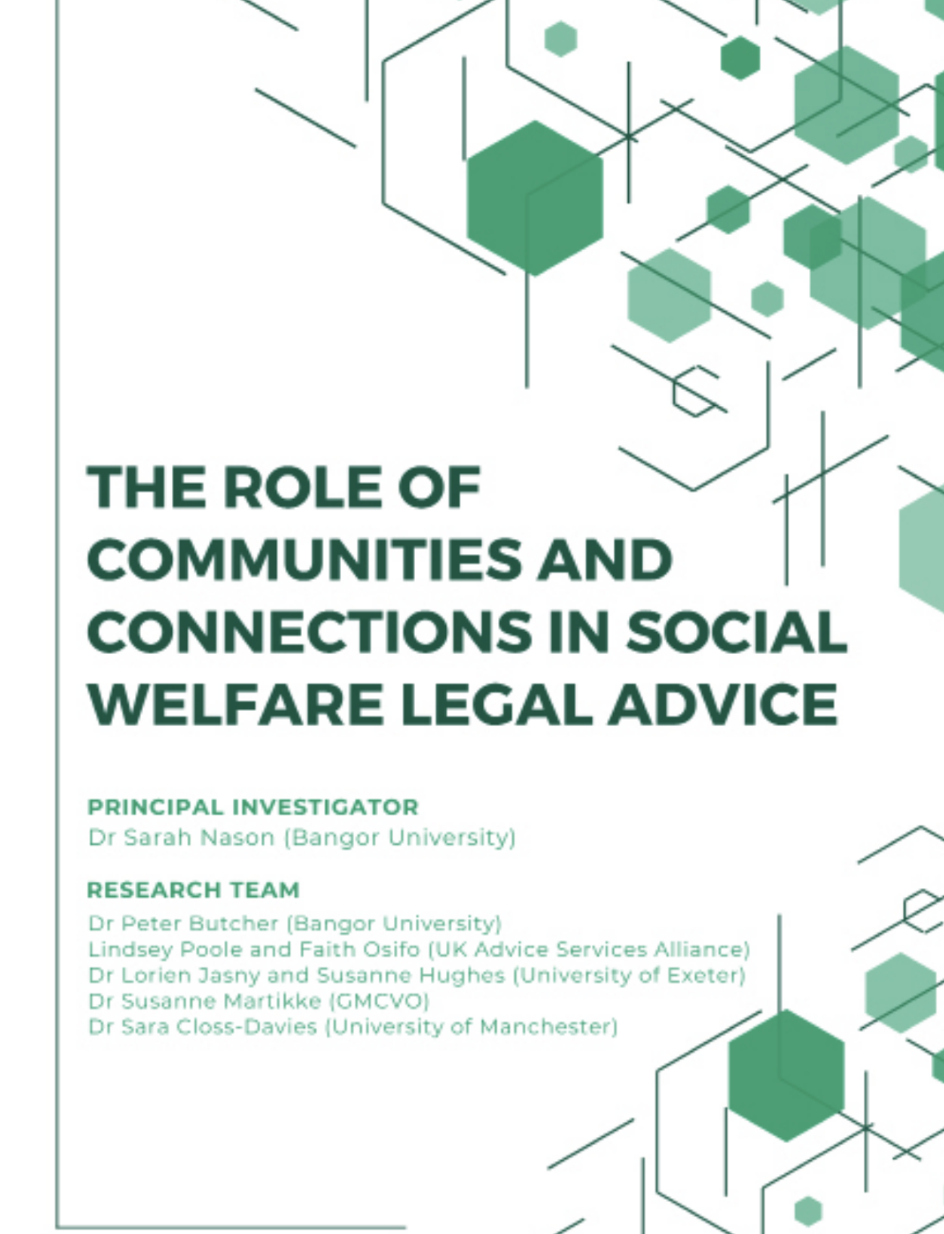
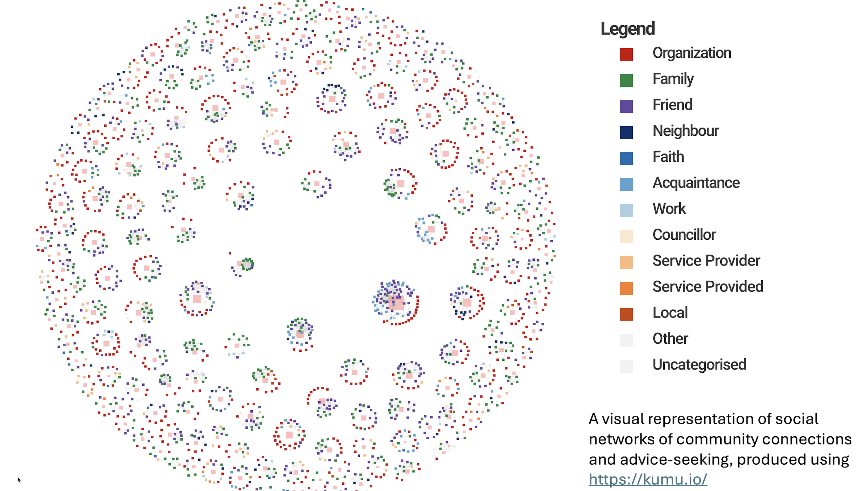

Slide 2

Research Aim – Understanding Communities
By comparing the SWL advice-seeking behaviours of people in four diverse case-study areas, their social networks, and their community facilities and characteristics, the research examined how access to advice interacts with community connectedness, (in)equality and wellbeing.

Slide 3
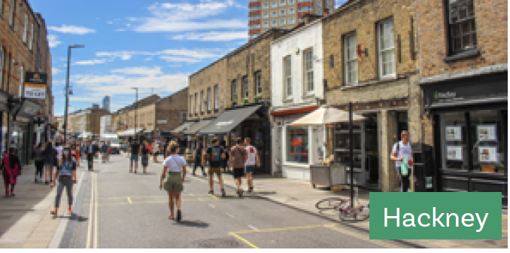
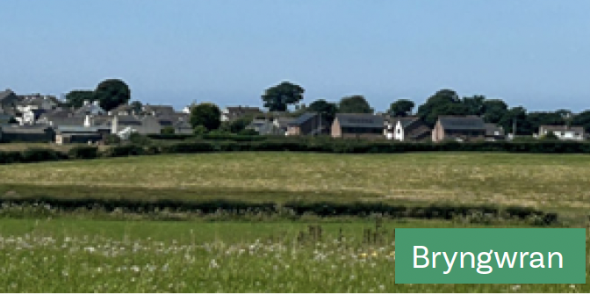

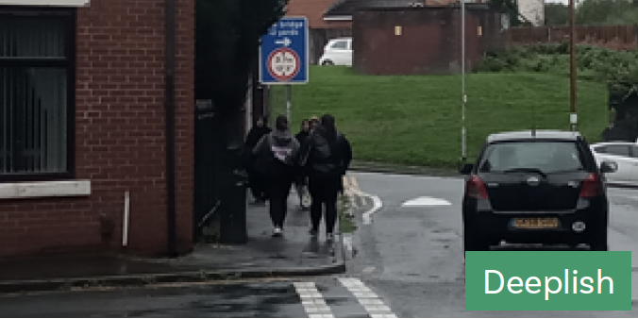
Case-studies

Slide 4
Method – in each area we:
Undertook desk top analysis of community characteristics and advice organisations;
Engaged with SWL advice providers, the community voluntary and social enterprise (CVSE) sector, and other key local individuals, through workshops and other activities to understand how they connect with communities and the challenges faced;
Conducted semi-structured interviews with local people, examining their social networks, the problems they had experienced, and their approaches to advice-seeking.

Slide 5
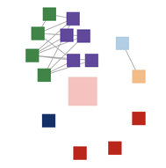
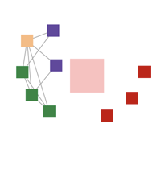
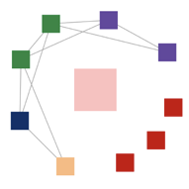
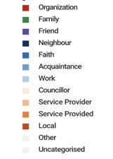
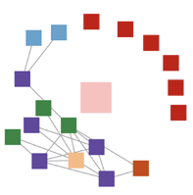
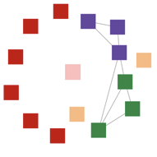
Bryngwran
Deeplish
Hackney Older
Dartmouth
Hackney Younger

Slide 7
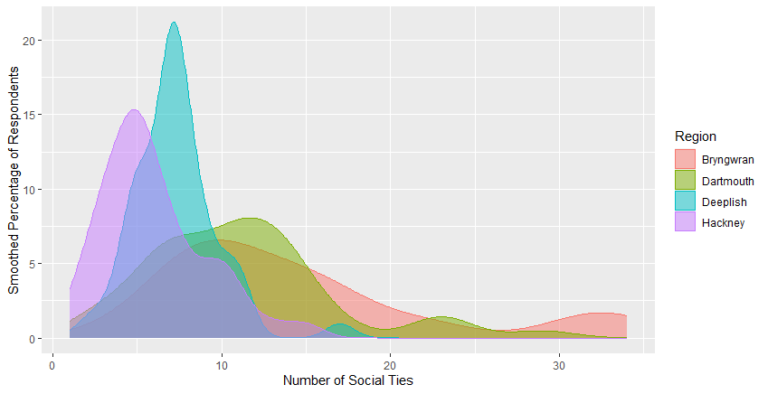
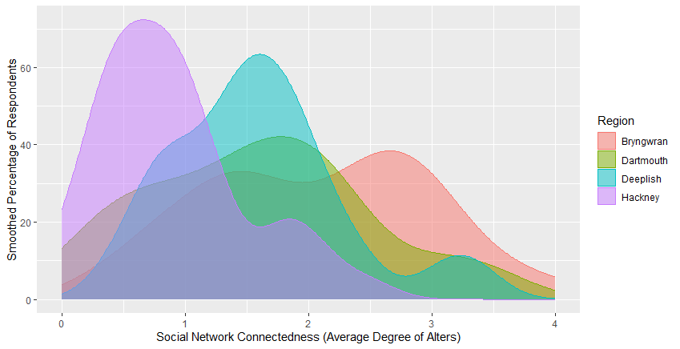
Size and Connectedness of Social Networks

Slide 8
Community versus individual characteristics in understanding social networks, advice-seeking behaviour and problem resolution
The characteristics of communities shape:
  the likelihood of people experiencing problems,
  the types of problems experienced, and
  how people use their social networks to seek help with social welfare law or related problems
This seems more significant than individual characteristics such as age, gender, employment status
However, our findings show that ethnicity is likely to be important in understanding social networks and social capital in communities, underscoring the importance of community-based, culturally sensitive services

Slide 9
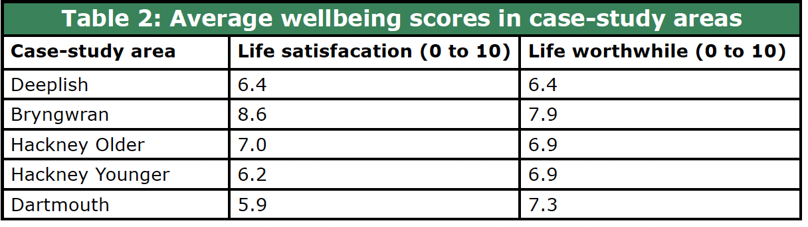
Social networks and wellbeing
Our data shows that, generally, interviewees with both larger and more connected social networks reported having higher levels of life satisfaction and higher levels of agreement that the things they do in their life are worthwhile.

Slide 10

Social networks and problem resolution
We found that the size and connectedness of people’s social networks made only a small difference to the likelihood of their social welfare legal problems being resolved;
Those with larger social networks were somewhat more likely to report that their problems had been at least partially resolved.
Connectedness also came very close to being significant.

Slide 11
Social networks and problem resolution
Many people don’t share their problems with anyone
Stigma and shame in having problems/sharing problems
People feel there is “always someone worse off” especially in close-knit communities
Where social networks were larger and more connected, people generally had better awareness of organisations/services offering help and advice, and were more likely to have contacted at least one organisation/service when they experienced a problem
However, more connected social networks can impede access to help and problem resolution, especially where negative experiences of services are shared / where the is mistrust of the state

Slide 12
A problem shared is not always a problem halved
The more a problem was shared, the less likely it was to have been resolved
Sharing widely was often coupled with frustration at not being able to resolve a problem even with help
If someone had contacted several potential sources of help the problem was likely to have been a difficult one to resolve and/or they had found it challenging to find the right adviser
It isn’t so much the size of networks or scope of sharing alone that matters, but the nature of the problem and the resources of the people and organisations with whom it is shared
Advice sector participants in all case-study areas highlighted the difficulties of managing client expectations around what resolution looks like and what can be achieved

Slide 13
Advice Sector…
Location matters
Medium matters
Workforce matters
Problems matter
Networks matter

Slide 14
Limits to the benefits of social networks, strong communities and effective advice provision for ensuring access to justice…
It is unlikely that greater levels of inter-community connectedness alone are the key to resolving SWL problems
Many of the problems people face stem from shrinking state provision and longer-term structural inequalities.
Communities provide substantial support in the form of food, goods, furniture, social support, and connections to advice, but this reaches a limit where three types of circumstance apply:
  Problems require more specialist advice from formal SWL advisers to address legal rights and entitlements;
  Problems arise from ‘failure demand’ (where another part of the system fails to do something or to do it right), especially in government decision-making;
  Problems are caused by cuts to local public services provision, compounded by cuts to advice sector funding.

Slide 15
Limits to the benefits of social networks, strong communities and effective advice provision for ensuring access to justice…
When service closures mean the loss of the very physical community spaces where people meet to build and develop their social networks, it is even harder for communities to make a difference.
While informal community and identity-based organisations can connect people to formal SWL advice services, if these formal services don’t receive proper funding, there may be access to help but no access to justice.

