Slide 1
The Quiet Power of the Document
in Housing Law Casework
Marie Burton

Slide 2
Overview
My research
Research findings
  The different roles of the document in the interview:
    the guide, the check, the prop, the anchor
  The document in telephone advising
Looking forward: future implications
Any questions or feedback

Slide 3
My research
Calling for Justice: comparing face-to-face and telephone advice in social welfare legal aid
Research* into shift to telephone-only legal aid introduced by LASPO 2012
Interviews and observations with clients and lawyers/advisers:
  40 interviews
  22 observations of interviews
Sites: 4 face-to-face local offices and Community Legal Aid telephone service
Housing and homelessness cases
  (includes eg community care, welfare benefits, immigration)
* funded by ESRC and LSE

Slide 4
Terminology
Telephone = telephone only – not possible to meet – remote location
Face-to-face = rarely face-to-face only – akin to “hybrid” or “blended”– mixture of face-to-face and telephone interactions

Slide 5

In law, documents are everywhere!
Find them in the court rules…
But NOT in lawyer-client research
Assumed to be there
Absence becomes apparent in remote advice

Slide 6
The different roles of the document
The guide
The check
The prop
The anchor

Slide 7

The guide
Helps advisers to understand the case from the outset
“A client will often tell you that they’ve got an eviction order and, in fact, it could be that they’ve got a Notice of Seeking Possession, which is the very start of proceedings…” (FL4)
And take instructions as the case progresses…
“You’re actually looking at numbers and figures and trying to identify…where arrears accrued…whether Housing Benefit has been stopped, all those kinds of things”

Slide 8

The check
Verify the client’s instructions
‘If they’re saying I’ve never heard about that before and I’m looking through the paperwork and I see eight unopened letters. You know, I’ve had that as well’ (FL4)

Slide 9

The prop
The document’s role in its physical form
Advisers physically pointing to passages when reading them out
Using the documents to steer the client through a complicated history
  Eg touching each report or letter in turn as the adviser went through the stages in a client’s account
This Photo by Unknown Author is licensed under CC BY

Slide 10
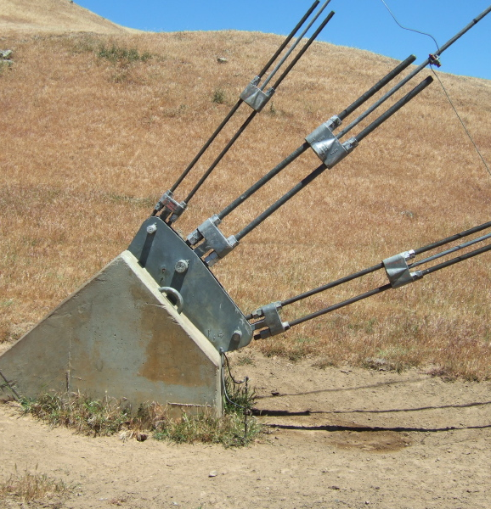
The anchor
Reassurance for clients:
when advisers read documents in their presence
that the document explained the situation more clearly than they did
something concrete to hold onto during abstract and bureaucratic legal process
This Photo by Unknown Author is licensed under CC BY-NC-ND

Slide 11
What happens in telephone advising?
Practically, I find the hardest thing [over the telephone] is looking at documents together (FA3)
“[I]n CLA [telephone service], it’s like, Well [s21 notice] doesn’t sound valid, but I’m not going to say for certain until I’ve seen it (TA3)
“One of the main things is lack of documentation.” (TA2)
Similar issues found in Mant et al (2023)

Slide 12
Work arounds
Getting clients to read out relevant parts of documents
  Literacy factors
Scanning and emailing documents
  Potential digital capability and cost issues
Conference (three-way) calls with third parties eg social landlord, local authority, court
  Time dependent

Slide 13
Looking forward: implications
Move to remoteness – “digital by default”:
Disadvantage for vulnerable groups
  Advice and casework: less effective and supportive (see also Mant et al, 2023)
  Hearings: Documentation always a struggle for LiPs in court and tribunal hearings (McKeever et al, 2018) – potential for even more disadvantage in remote hearings (eg Civil Justice and Family Justice Rapid Reviews)
  Control of the narrative – design of digital forms undermining rule of law – eg design of the UC system does not conform with legislation (Child Poverty Action Group, 2023) https://cpag.org.uk/news/digital-universal-credit-system-breaches-principles-law-and-stops-claimants-accessing-support )

Slide 14
Thank you
Any questions?
Feedback
Contact: marie.burton@csls.ox.ac.uk

