Slide 1
Introducing the Nuffield Foundation
ASA SCARE
29 November 2024

Slide 2

About the Nuffield Foundation
Independent charitable trust with mission to advance social well-being in a just and inclusive society
We fund research with the capacity to make a difference to people’s lives by influencing policy and practice
We fund research on all four UK nations

Slide 3
Freedom and independence
Rigour and quality
Our principles
Connecting perspectives
Building trust in evidence

Slide 4
Areas of development
Encouraging diverse applicants
Effectively communicating our interests and funding opportunities
Supporting early career researchers
New five-year strategy

Slide 5
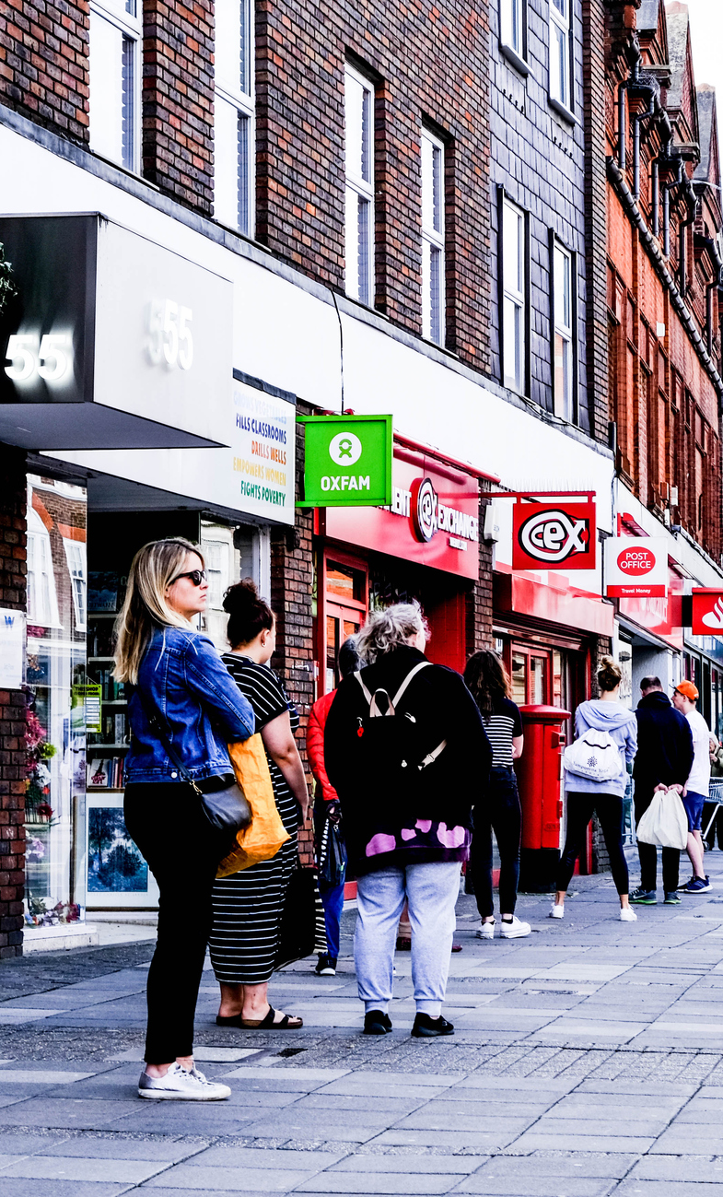
Our strategy: 5 big questions
How we can build a prosperous and fair society?
How we can build an inclusive society?
How we can ensure people and society benefit from rapid developments in science and technology?
How we can build a sustainable society – and sustainable places?
How we can rebuild and maintain the effective, accountable, and trustworthy institutions?

Slide 6



Our areas of research interest
Education
Welfare
Justice
New programme:
Racial Diversity UK

Slide 7


Justice
Improving justice in action
Nuffield Foundation
www.nuffieldfoundation.org

Slide 8

Society needs a fair and effective justice system
Examining critical challenges facing the justice system
Experiences and outcomes of justice system contact, incl impact on wider life chances
Broad view of justice and diverse research approaches encouraged
Nuffield Foundation
www.nuffieldfoundation.org

Slide 9
Key themes and topics in Justice
Family justice
Social welfare
Youth justice
Access | Fair decisions | Outcomes | Trust | Systems
Nuffield Foundation
www.nuffieldfoundation.org

Slide 10
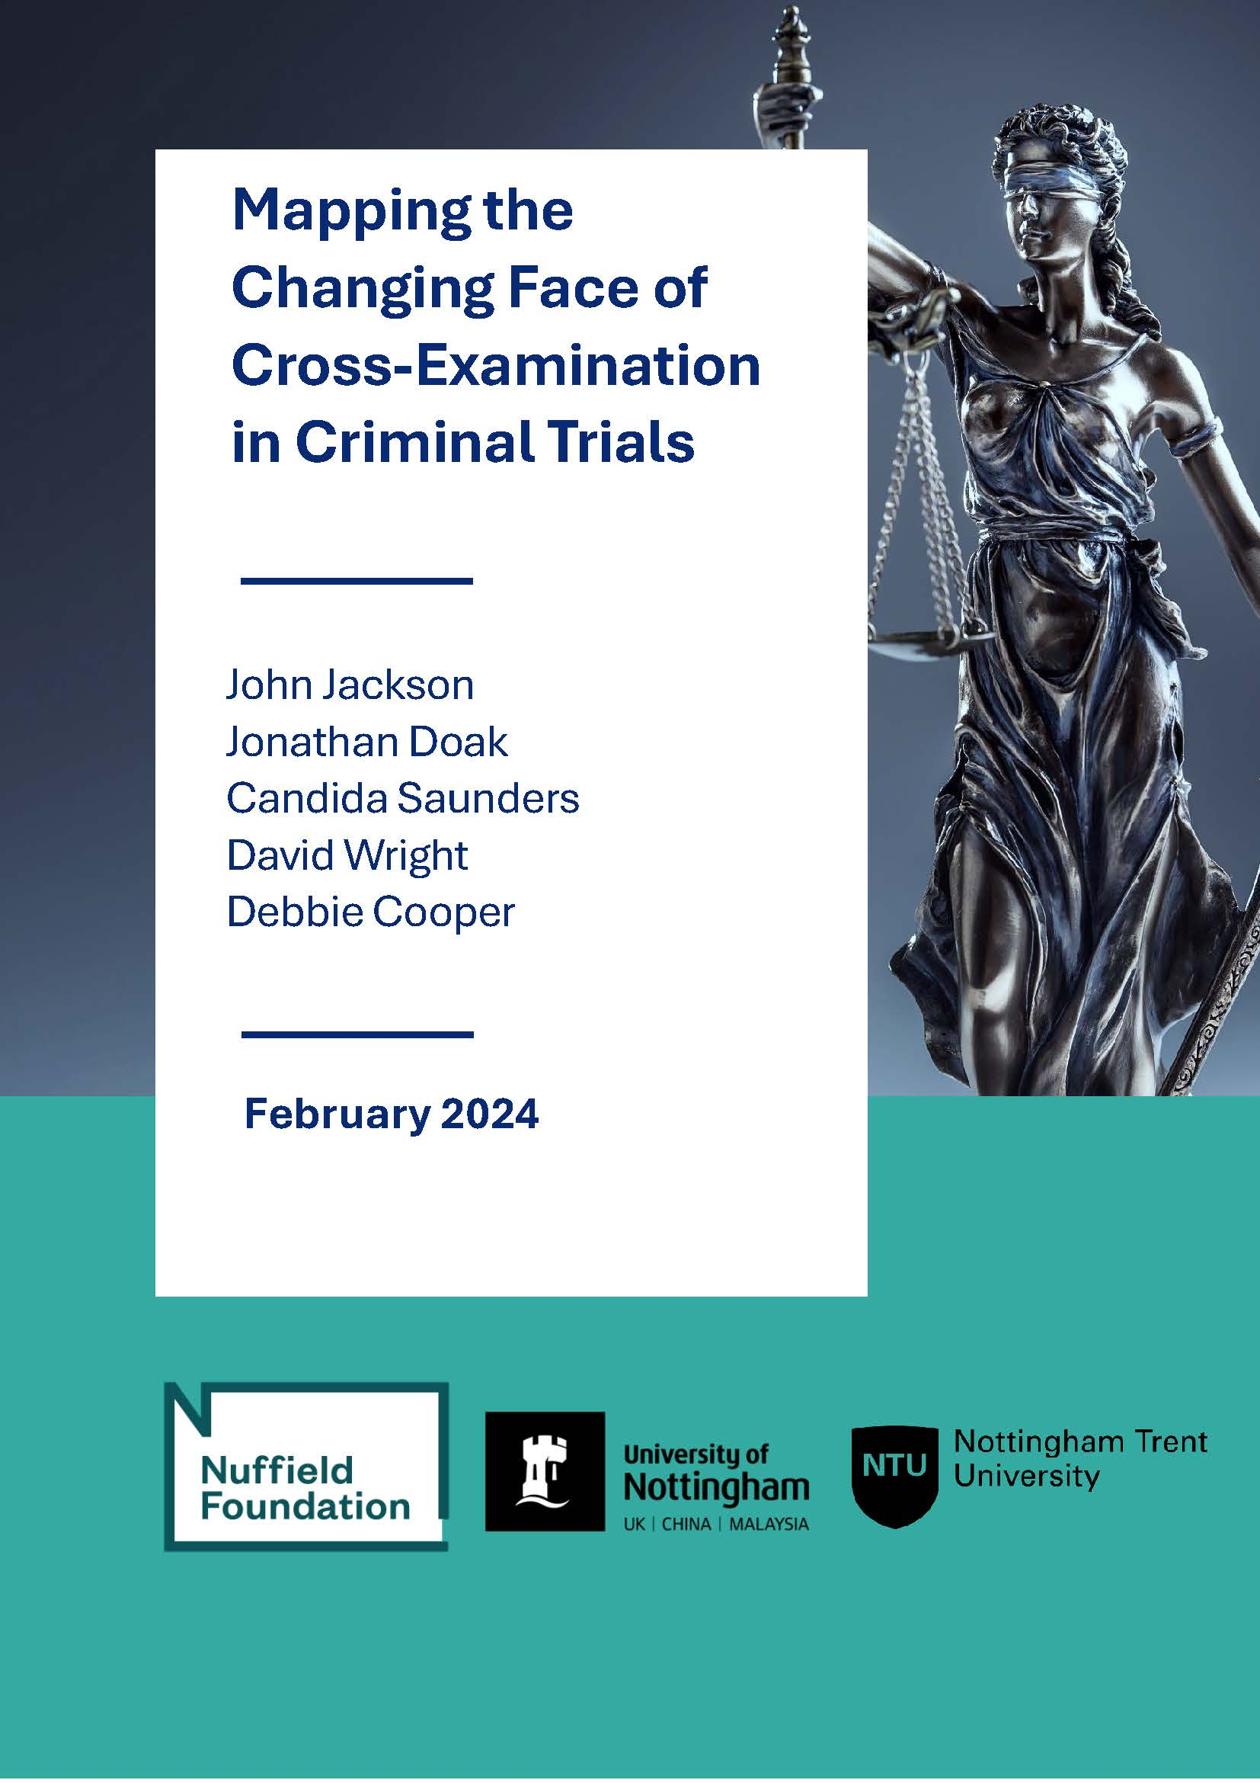
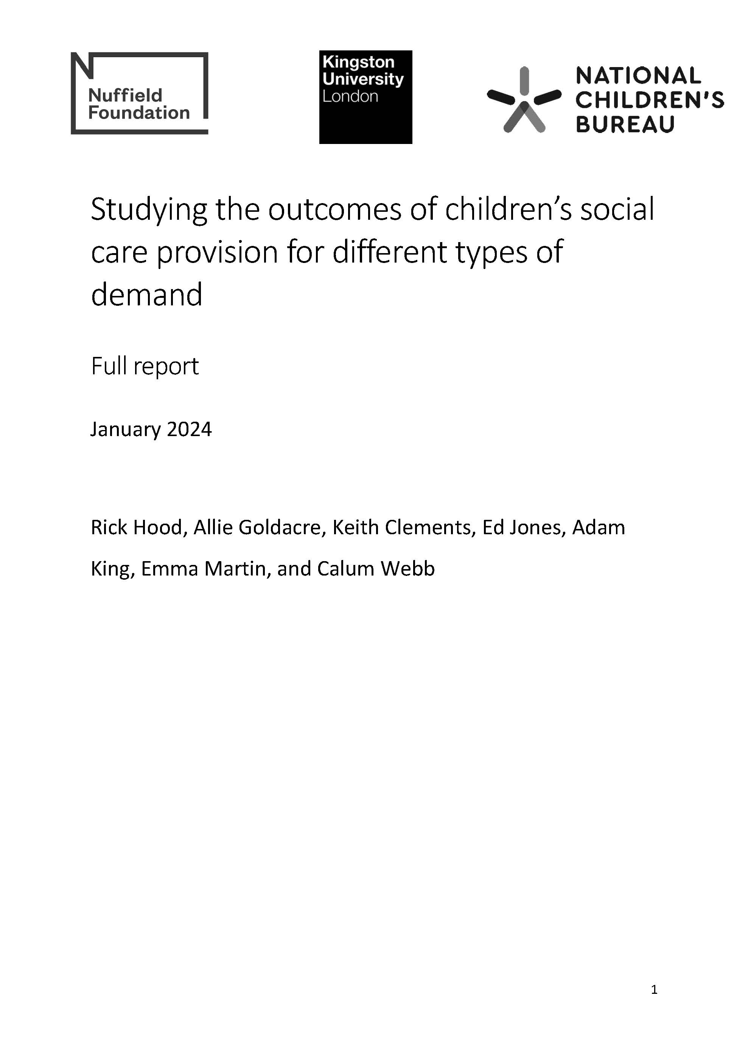

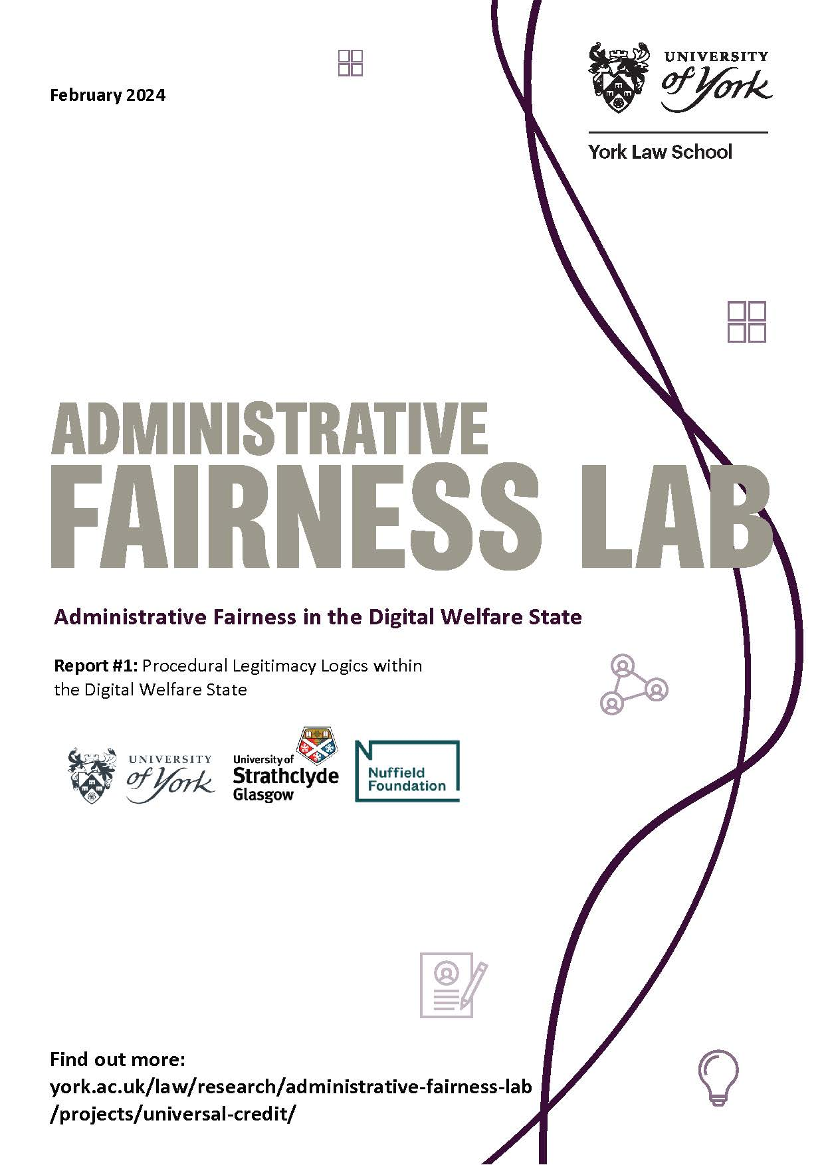

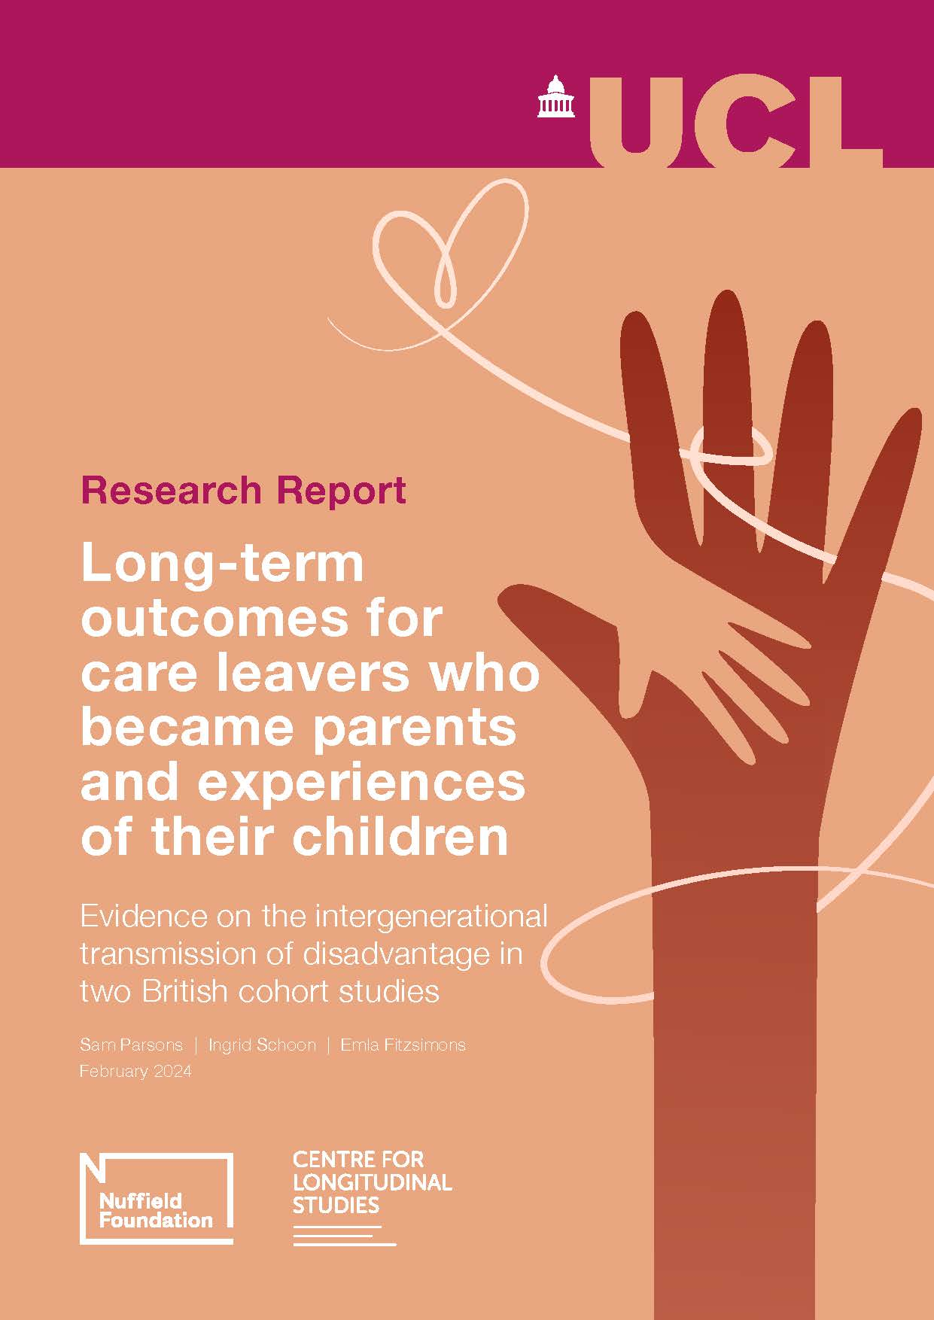
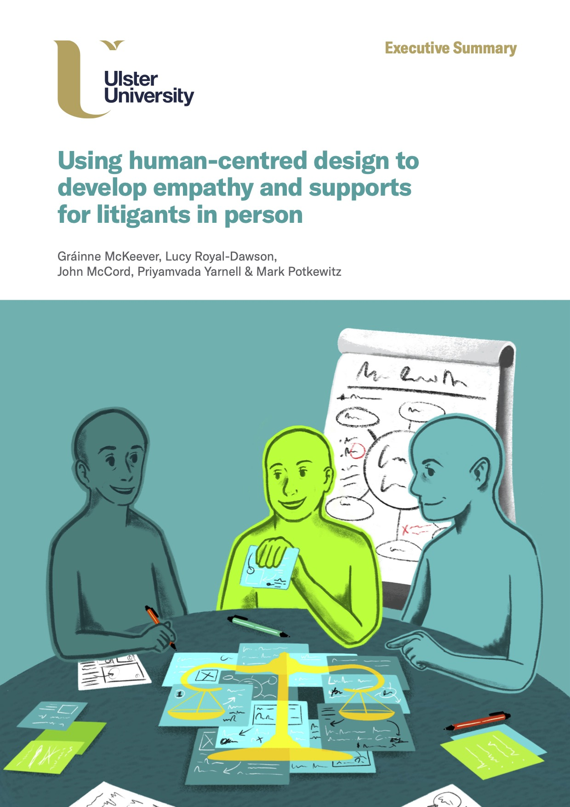
Recent Justice publications
Notes:
The consequences of legal processes and decisions can be life-changing
Outcomes are key – often unknown - but process matters: people want respectful treatment but don’t always get it
Structural and attitudinal factors can undermine fair and equal treatment
People not just cases: intersecting characteristics affect experiences and outcomes
Change is possible but slow, esp cultural change – but fairness for all must balance opposing positions

Slide 11
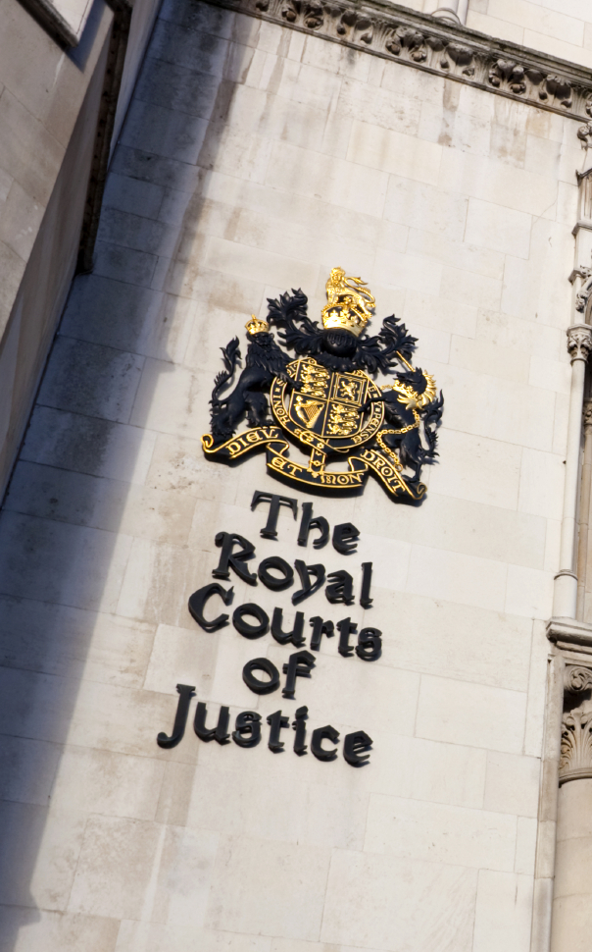
Strategic grant: Transforming justice
Led by Imran Rasul (IFS), Joe Tomlinson (York), and Abi Adams-Prassl (Oxford), in partnership with the Public Law Project
Will seek to explore both significant reductions in funding and a sequence of major procedural reforms to modernise the justice system over the last 15 years
Brings quantitative economic analysis to provide an understanding of what these changes have meant for access to justice

Slide 12

Public Right to Justice
In March we brought together a group of experts to critically examine the state of the justice system
The event (re)confirmed that system is under great strain
Raises questions: what does it mean if rights cannot be properly exercised? What are the implications, not only for individuals, but also for wider society?

Slide 13

What we look for in applications
Relevance
Clear conceptual framework
Rigorous methodology
Great team
Value for money
Route to impact

Slide 14
Impact – what we look for
Impact types
Influencing policy or practice
Shaping debates
Capacity building
Clarity - why this research now, what will it achieve, and who might benefit?
Credibility - rigorous and appropriate methodology
Planning - routes to potential impact
Engagement - who must do what for impact to happen and how to engage them?

Slide 15
Applying to us
Check our eligibility criteria
Read the Guide for Applicants
Make the case for your project’s importance
Explain your methodology well
Identify the key audiences for your research
Outline your pathway to impact
Nuffield Foundation
www.nuffieldfoundation.org

Slide 16
Research, Development and Analysis Fund
Two application rounds a year
Two stage application process:
Outline applications assessed in-house
Full applications peer reviewed
Final decisions are made by Nuffield Foundation staff and Trustees.
Most grants are between £200k - £300k.
October
Grants up to £750k
April
Grants up to £3m*
(*kept under review)

Slide 17

Supporting early career researchers​
Encourage support from grant holders and institutions​
Established a Nuffield Foundation Emerging Researcher Network​
- Regular newsletters ​
- LinkedIn group​
- Events and training opportunities​
ECRs can apply to our main grants fund​

Slide 18
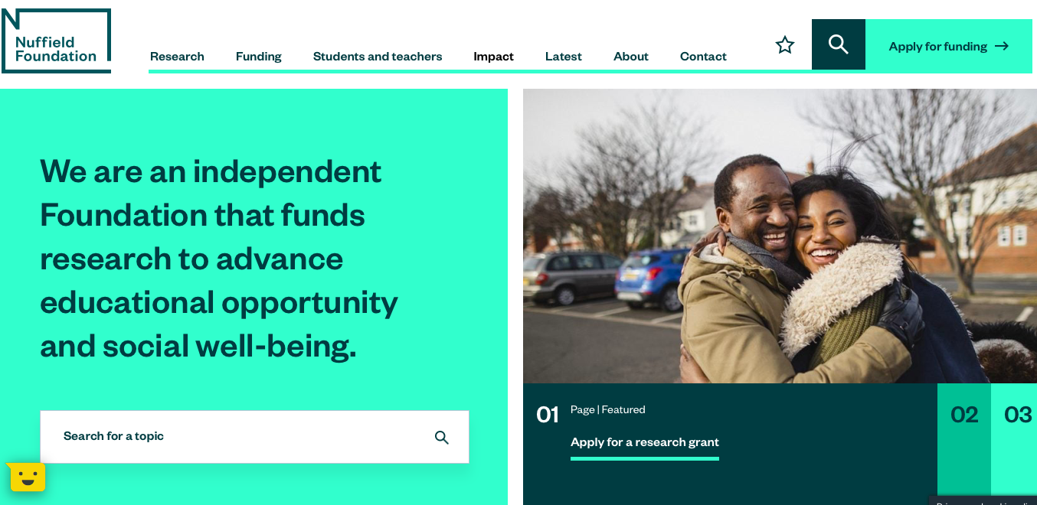
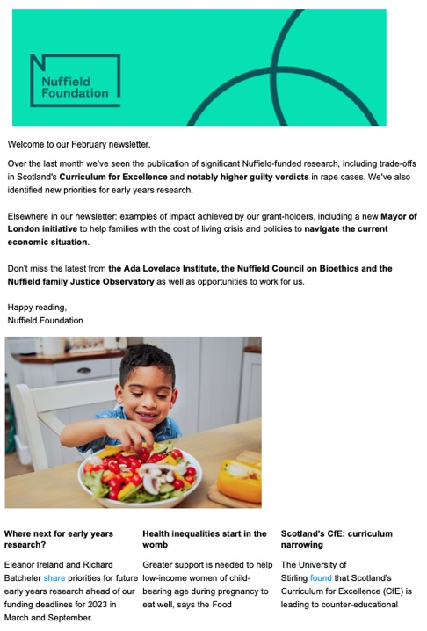



Keep in touch
Website: www.nuffieldfoundation.org
Email: applications@nuffieldfoundation.org
Twitter: @NuffieldFound
LinkedIn and YouTube
Subscribe to our newsletter
Webinar: How to get Nuffield Funding https://www.youtube.com/user/Nuffieldcc

Slide 19

Useful links
Guide for applicants
Eligibility criteria
Five big questions for the next five years
Our areas of interest
  Justice programme
  Public Right to Justice
  Racial diversity UK
Some recent events
  Where has my justice gone?
  Our insecure society risks across the life course
  Place & opportunity

