Slide 1

The problem with quality: does quality assurance matter?
Lindsey Poole, Director ASA

Slide 2
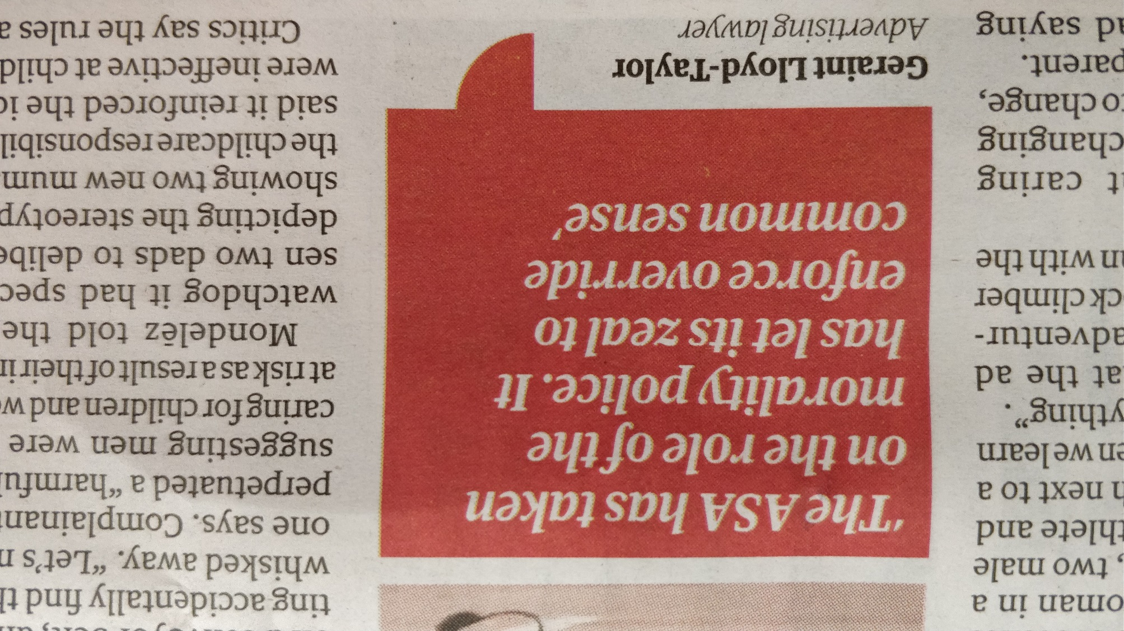
Just who do we think we are….
Guardian 14th August 2019

Slide 3
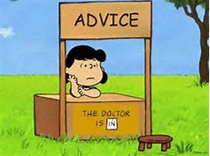
‘Social Welfare Legal Advice Services’
AQS is sector owned, defined and managed, but independent

Slide 4

The AQS: sector owned and sector managed
Specification of Quality Assurance Standards
Independent Audit to ensure standards are met and maintained
Continuous improvement in the service offered

Slide 5
But AQS is not everything
AQS is a ‘floor’, not a ‘ceiling’ standard
It is too easy/too hard
AQS is a MOT style standard-just tick boxes
Attention to quality follows assessment cycle
Overload for practitioners
Needs to be robust to be credible
Flexible for different types of advice services
Internal validity- actually measures quality
Doesn’t measure many important dimensions of quality

Slide 6

You still need plenty of these!

Slide 7



Make a paper plane

Slide 8
What do we mean by ‘quality’?
Process: ‘the way that they handled that complaint was so well done’
Outcome: ‘that service always gets really good results’
Perspective: ‘everything that they do is geared towards giving a good service’
Feeling: ‘they always make you feel so welcome and really seem to understand your problem’

Slide 9
Judgements about quality are based on……
Things that we personally value more or less
Things that we are most likely to excel in
What is important to us
What we think is important to other people
How we feel about something
Who was with us
Personal experience, good or bad, has undue influence
Essentially subjective so an objective framework helps

Slide 10

An example: Arts Based Evaluation
Aspiration
Inspiration
Innovation
Execution
Magic

Slide 11
Structure of the AQS Assessment
A. Access to Service Ensuring access to service
B. Seamless Service Referrals and case handling
C. Running the organisation Organisation well managed
D. People Management People are well managed
E. Running the Service Advice properly managed
F. Meeting client’s needs Clients receive good service
G. Commitment to Quality Maintain quality throughout

Slide 12
Some of the problems with QA
Quality assurance processes are not the same as quality
QA helps understand but doesn't solve issues with quality
Problems with validity of the measurement
Problems with falling into response sets (or 'tick boxing')
Definition of quality can become circular (AQS defines what is ‘good’ but ‘good’ is recognised by holding the AQS).
Need to take different approaches to looking at quality
Inter-rater reliability- do we measure the same things the same way?

Slide 13
Why ‘Quality Assurance’?
Best services focus on quality – critical practitioners
Assurance to the public and your clients
Statement of values to funders
Common language between organisations
Helps trustees govern more effectively
Focuses attention on issues that matter
(But it is tough, time consuming and can spotlight issues)

Slide 14

Our Goal

Slide 15
Thoughts on quality in advice
Focus on things that delivers quality
Need to build the evidence base
Rationalisation of standards, frameworks and practices
Less managerial and more informational
QA mechanisms for smaller services
Importance of training and learning and skills development
New things in quality: ‘reach one, teach one’, community engagement and net zero practice

Slide 16
Entry Level AQS- Proposed Pilot
Offer a pathway to the AQS over maximum of two years (not if held full AQS within 2 previous years)
Good advisers are the most fundamental requirement :
  well selected, inducted and trained in advice
  proper support and supervision
  subject to review of the advice given
Must be affordable and manageable, to adopt and to assess:
  Selected ‘people’ elements of the full AQS
  A progression checklist of processes and procedures
  Support package from Recognising Excellence

Slide 17
The aim of the pilot
straight forward for small services to implement and use,
provide some basic but vital independent measure of quality assurance,
enable small services to better link with the advice sector
improve the confidence to apply for the full Advice Quality Standard.
does not act as a substitute for the full AQS
become viewed as a ‘second rate’ QA mechanism
prove to be too onerous to implement or to assess

Slide 18
Likely Requirements of E-AQS
Business plan
Decision making
Risk Assessment and PI
Supervision
Regulation
Staff appraisal
Induction
Training and development
Up to date information
Equality, diversity and inclusion
Casework
Case files recording
Independent file review
Governing body involved

