Slide 1


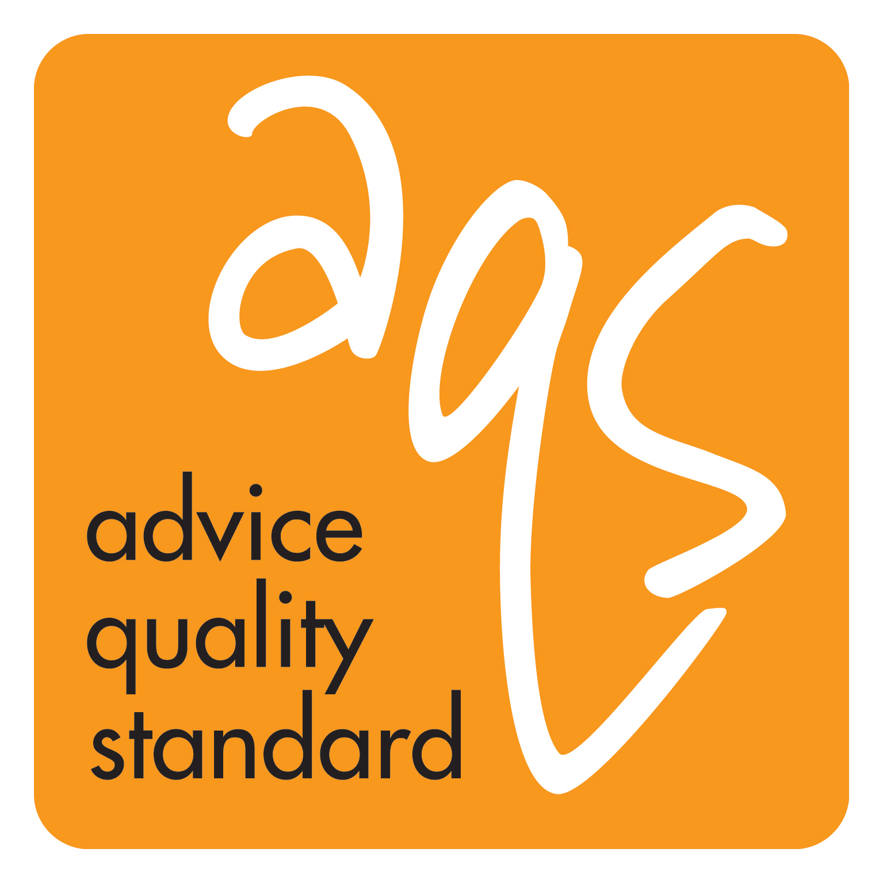
Dawn Draper Quality Manager Advice Services Alliance
AQS Overview
Advice Service Alliance Conference Oct 2022

Slide 2
What is the AQS?
Advice Quality Standard (AQS)
Owned by Advice Services Alliance (ASA)
  Umbrella body for independent advice services in the UK
  Our members are national networks of NFP organisation providing advice
Primarily an organisational standard
Applicable to any advice service operating at the Generalist level and above, defined as: ‘’being able to provide basic initial legal advice in most areas of law”
Independent assessment body
Continuous Improvement Tool
Notes:
ASA Owned since 2012
Previously known as the General Quality Mark, owned by the Legal Services Commission – part of the Community Legal Service – green man logo
ASA Members are national networks of not for profit organisations – Advice UK, Age UK, Youth Access, Shelter, Citizens Advice Bureau
AQS designed to give ensure legal advice organisations are well run and provide good client care. Can not be applied to an individual
Recognising Excellence. Assessment body for over 20 years. Investors in People, Lexcel, ISO 9001:2008, Sfedi, Money Advice Service
Team of auditors
Held AQS license since 2013 – personally worked with AQS since 2008 in previous roles. Work closely with ASA to develop the standard to ensure it remains fit for purpose, manage the team of Assessors and assessment process, and in spare time, undertake all of the desktop audits for new applications.

Slide 3

Benefits of the Advice Quality Standard
The AQS is beneficial because it gives a level of regulation and feedback on the quality of the advice service that their clients cannot give.
It provides an opportunity for advice organisations to adopt best practice, by establishing a quality floor that they can work up from.
Furthermore having a quality standard ensures that risks are managed and prevented, changing staff behaviour to be more due diligent to risks, thus mitigating the likelihood of poor quality advice being given.
Our standard provides advice organisations with an incentive to improve quality and as they strive to achieve it, they are setting in place systems, procedures and attitudes that will improve the quality of advice, benefit their clients and produce better outcomes.

Slide 4
The Benefits of holding AQS
Assurance of Quality
  External validation that your service is working according to the best practice for your clients demonstrating that the quality of service delivered is at the heart of your work and not an additional add-on
Access to funding and Competitive Advantage
  Many funders and commissioners insist on seeing quality standards in place, as do many advice sector partnerships
  Non commissioned services still need to demonstrate quality and strategic relevance in order to gain funding in the future

Slide 5
Benefits continued…
Better Client Outcomes
  Evidence from AQS holders has shown that the outcomes for clients using a quality marked service are greater than the outcomes from those without
Better Risk Assessment
  The discipline of the AQS ensures that services are keeping on top of the main areas of risk; knowing about and anticipating risk is a key factor in service sustainability
Accountability
  Board of Trustees (or equivalent) and senior management teams can use the report from the AQS to evidence good practice and to build a better understanding of the service
  Corrective actions and areas for improvement can help Trustees develop long term strategies and business plans

Slide 6
Benefits continued…
Benchmarking
  As one of 610 organisations which hold the AQS you have access to a range of organisations undertaking similar or comparable work to you
Opportunities for Referrals
  AQS holders refer to other AQS holders as their first choice – support network
  Partnerships built on the basis that the AQS is a common language across different services - stronger partnership working and enhanced credibility

Slide 7
AQS Fast Track Support Package
Developed and owned by Recognising Excellence in response to client feedback
Access to AQS template Quality Manual (includes a set of operational standards, policies and procedures that you can adapt to your own practice)
Access to AQS Webinar Suite (covering all sections of the AQS Standard and common pitfalls)
Document Review Telephone Appointment before Application (includes interpretation of the Standard)
On-going telephone Quality Manager support

Slide 8
Entry Level development
ASA are currently developing a ‘entry level’ assessment model for advice organisations who are staring out, feel they are not ready to undertake the AQS or are unsure to where they are in the quality assurance journey
By entry we mean entry to the full AQS so we would envisage that you would only be awarded this for a limited period.
ASA will run this initially as a pilot for testing before roll out.

Slide 9

Application and Assessment Process
Submit AQS Application Form and Supporting Documents
Assessor allocated to determine alignment against AQS requirements
Desktop Audit Report produced and On Site Assessment Date(s) agreed
On-site assessment activity:
  Staff/volunteer 1:1 discussions
  Assessor to conduct File Reviews from open /file list
  Assessor completes review of central records
Full Assessment Report produced
Corrective Action – 28 days
2 year anniversary monitoring review cycle

Slide 10

AQS Quality Framework
Section A - Access to Service
Section B - Seamless Service
Section C - Running the organisation
Section D - People Management
Section E - Running the Service
Section F - Meeting client’s needs
Section G - Commitment to Quality

Slide 11
Further Information
If you interested in finding out more about the scheme and options available to you please contact:
Liz Morris – Quality Manager Recognising Excellence Liz.morris@recognisingexcellence.co.uk 07394 563357
Dawn Draper – Quality Manager Advice Service Manager
dawn.draper@asauk.org.uk 07490 277285

