Slide 1



Agenda
Introduction
WAD: Who We Are
Welfare Services Delivered
HMCTS Digital Support Service
HMCTS DS Services
The Partnership Network
Referral & Delivery Partners
Support for Partners
End to End User Journey
Contact Us
Impact of WAD’s work
We Are Digital delivering the Digital Support Service in partnership with HM Courts and Tribunals Service.

Slide 2

Our Vision & Purpose
We aim for everyone to have easy access to the digital services, support, and advice they need to confidently live their lives to the full.

Slide 3






Who We Are
We Are Digital (WAD) is a social impact #tech4good company. Our vision is for everyone to access the digital and financial services and support they need to live their lives.
What We Believe
We believe in introducing everyone to the digital world - If we can get people online, show them a new way, train in digital skills and guide them towards advice - we know we can help them unlock a more secure future.
03300 16 00 51 – to refer partners@we-are-digital.co.uk www.linkedin.com/company/wearedigitaltraining @we_aredigital

Slide 4



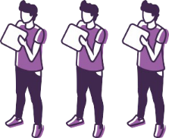




Our Model
Our Clients commission WAD
To Deliver
Via Our
Network
To Deliver Impact
to Our Users
WAD Platform
Handles
Referrals Triage Assessment Booking Support Supply Chain Management Funding Reporting Progression Impact
Across 400 Local Partner
Organisations
Central & Local Government
End User
Local
Centre
Remote
Video
Corporates
Housing Associations
Telephone
In-Home
03300 16 00 51 – to refer partners@we-are-digital.co.uk www.linkedin.com/company/wearedigitaltraining @we_aredigital

Slide 5

Welfare Services Delivered
Digital Inclusion – training to use technology better and get customers online.
489 people supported
Assisted Digital – transactional help for government, banking and corporate online services.
EU Settlement Scheme (EUSS) - Supported 656 people
UK Visas and Immigration (UKVI) – Supported 2333 people
Windrush Compensation Scheme – Supported 861 People
Financial Inclusion & Money Advice – support to manage money better and improve ﬁnancial capability.
Total impact over 3 years:​
8,494 people helped​
£29,011,447 of financial gains for residents
£29,684,665 of social value to people and the community
Future of Work – upskilling in digital themes such as digital marketing bootcamps.
Supported over 400 people in gaining digital marketing skills to get them into work via the DfE Programme - Skills for Life.
HMCTS Digital Support Service– digital support to complete online justice forms.
Over 1500 Referrals to the service and 90+ Partners have supported users to complete HMCTS forms e.g. PIP, UC, Help With Fees, Divorce, Probate.
03300 16 00 51 – to refer partners@we-are-digital.co.uk www.linkedin.com/company/wearedigitaltraining @we_aredigital

Slide 6
HMCTS Digital Support Service
The Service
HM Courts and Tribunal Service (HMCTS) is redesigning the way courts and tribunals services are provided.
A large part of the programme is moving justice services online.
The HMCTS Digital Support Service is for users who face barriers in accessing digital platforms to fill out online forms for HMCTS’s justice services.
The Partner Network
WAD is working in partnership with HMCTS to enable people to access the Digital Support Service through our national network of Partners.
We are working with Advice Centres, to encourage Referrals to the service and to provide payments for Delivering the service.
The project went live nationally with 6 services in June 2022.
03300 16 00 51 – to refer partners@we-are-digital.co.uk www.linkedin.com/company/wearedigitaltraining @we_aredigital

Slide 7
HMCTS Digital Support – The Services
Service | Description
Appeal a Benefit decision Social Security and Child Support (SSCS) | To submit and track appeal decisions from the Department for Work and Pensions (DWP) through the Courts and Tribunals Service.
Submit a Plea Single Justice Service (SJS) | For handling summary-only, non-imprisonable and victimless offences (such as speeding, fare evasion, or not having a TV licence).
Make a money claim Online Civil Money Claims (OCMC) | For people to resolve civil money claims online.
Help With Fees (HWF) | For users to apply for help with Court and Tribunal fees.
Apply for a Divorce | For individuals to make an application to legally end a marriage or civil partnership and resolve associated financial issues.
Apply for Probate | For users to apply for probate of an estate for a deceased individual in England and Wales.
Further information:
https://www.we-are-digital.co.uk/hmcts-partner
https://www.we-are-digital.co.uk/hmcts-user
03300 16 00 51 – to refer partners@we-are-digital.co.uk www.linkedin.com/company/wearedigitaltraining @we_aredigital

Slide 8
Referral & Delivery Partners
Referral Partners
Includes operational HMCTS Call Centres, Courts. Advice Services such as CAB’s, Local Councils, Charities, Libraries.
Be a Referral Partner
Refer your clients who need digital support with online justice forms to WAD.
You or your clients can phone 03300 160 051 and WAD will triage and direct them to a Partner for support.
Delivery Partners
Includes Advice Centres such as CAB’s, Law Clinics, Local Councils, Community Groups, Charities, Libraries.
Be a Delivery Partner
You can deliver the digital support for HMCTS online forms. It could be work that you are already doing and can get paid for it.
It is non-advisory and can be incorporated within your existing service.
03300 16 00 51 – to refer partners@we-are-digital.co.uk www.linkedin.com/company/wearedigitaltraining @we_aredigital

Slide 9
Support for Partners
Help for Partners with the Digital Support Service:
Training for Partners
On the 6 Online Forms.
On the WAD Appointment Booking system
Triage Users
WAD will triage eligible users, assess their needs and book them appointments with Partners.
If users comes directly to your Centre, you can still be paid – Call 03300 160 051, ‘refer’ them to us and we book them an appointment with you.
Payments to Partners
WAD will register both the user (applicant) and your Centre on the system to ensure that outcomes are registered, and the fee payment can be processed.
Marketing Materials for All Partners
Promotional materials such as leaflets, posters and a website landing page – to let people know about the service.
03300 16 00 51 – to refer partners@we-are-digital.co.uk www.linkedin.com/company/wearedigitaltraining @we_aredigital

Slide 10
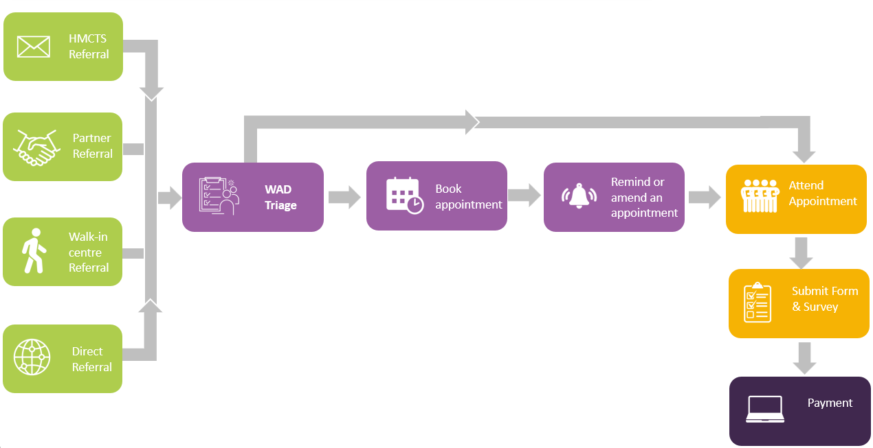
End to End User Journey
03300 16 00 51 – to refer partners@we-are-digital.co.uk www.linkedin.com/company/wearedigitaltraining @we_aredigital

Slide 11
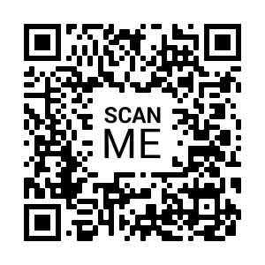
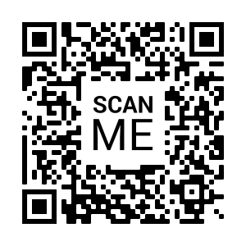
Contact Us
Referral to Digital Support
Phone: 03300 160 051
Text FORM to 60777
Email: Support@we-are-digital.co.uk
www.we-are-digital.co.uk/HMCTS-user
Delivering Digital Support
www.we-are-digital.co.uk/HMCTS-partner
www.we-are-digital.co.uk/hmcts-partner-asset-library
Marketing Assets for Referrals
Partner Page
03300 16 00 51 – to refer partners@we-are-digital.co.uk www.linkedin.com/company/wearedigitaltraining @we_aredigital

Slide 12
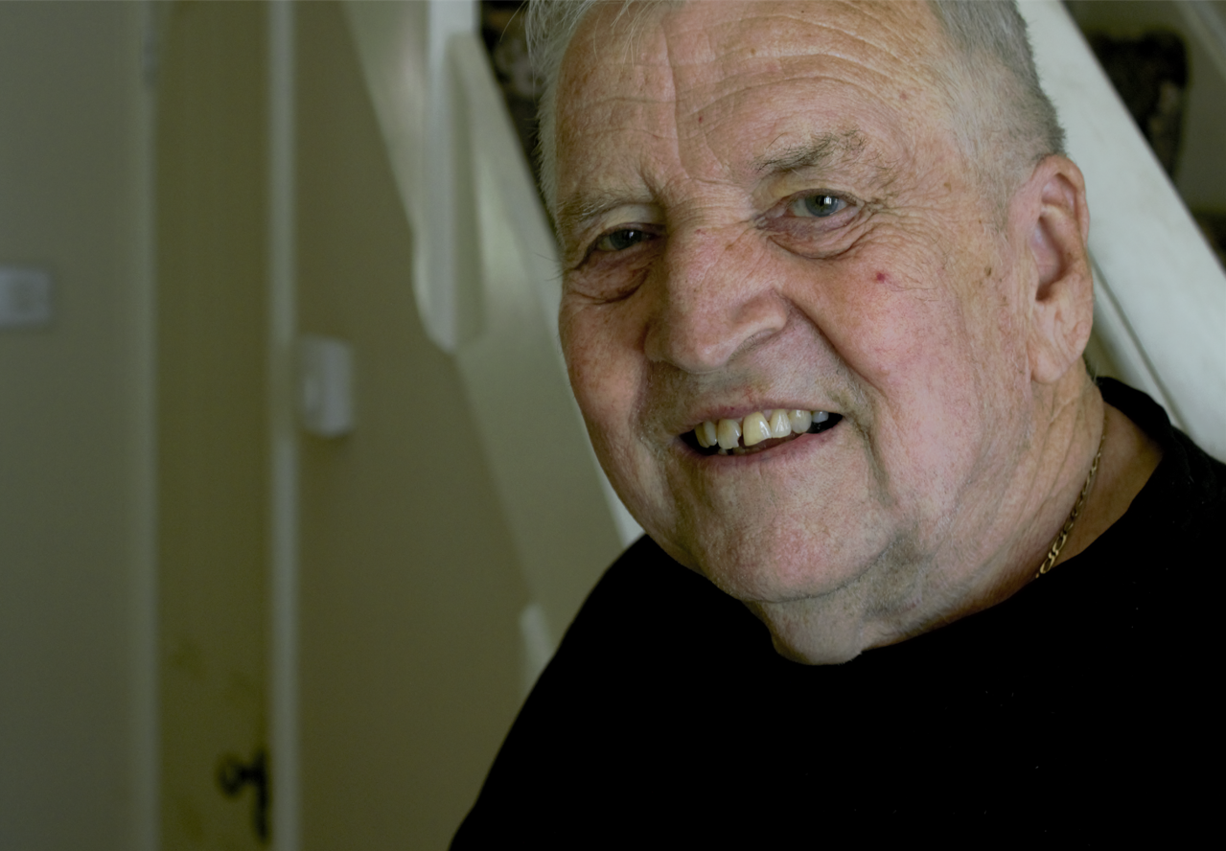
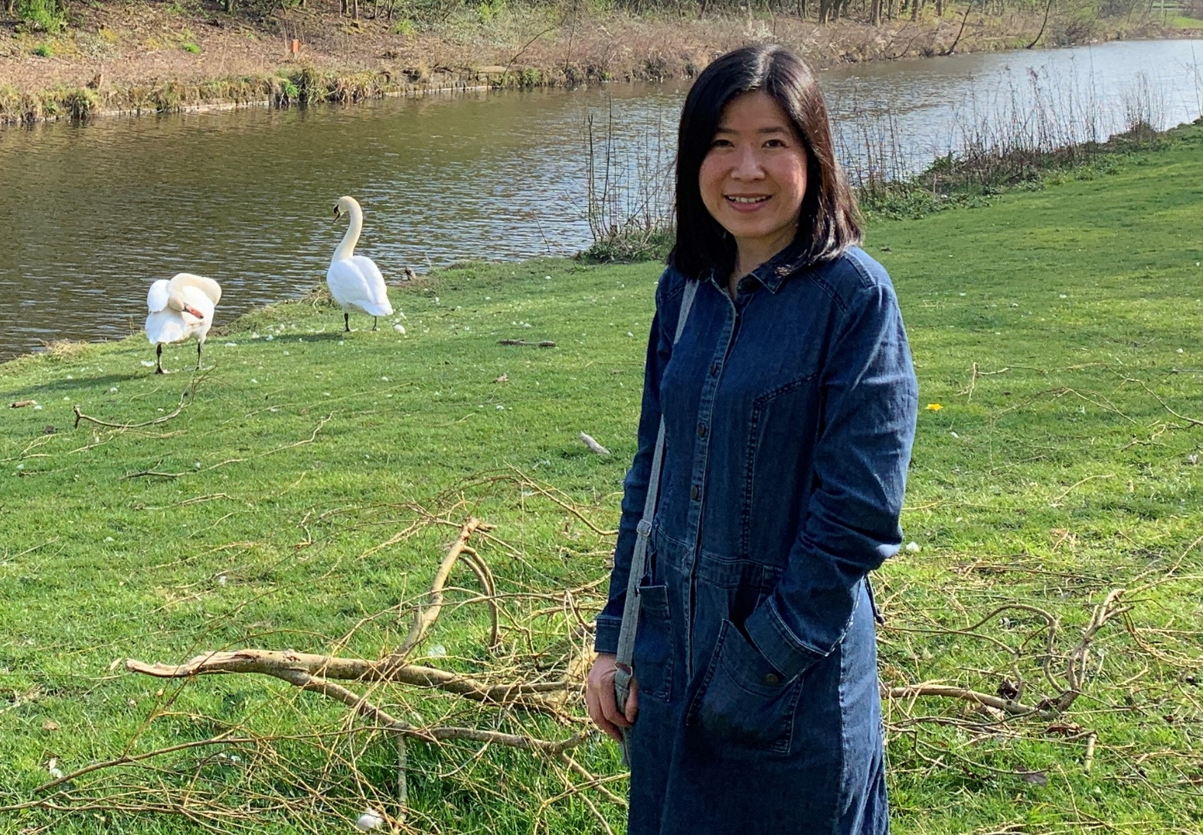
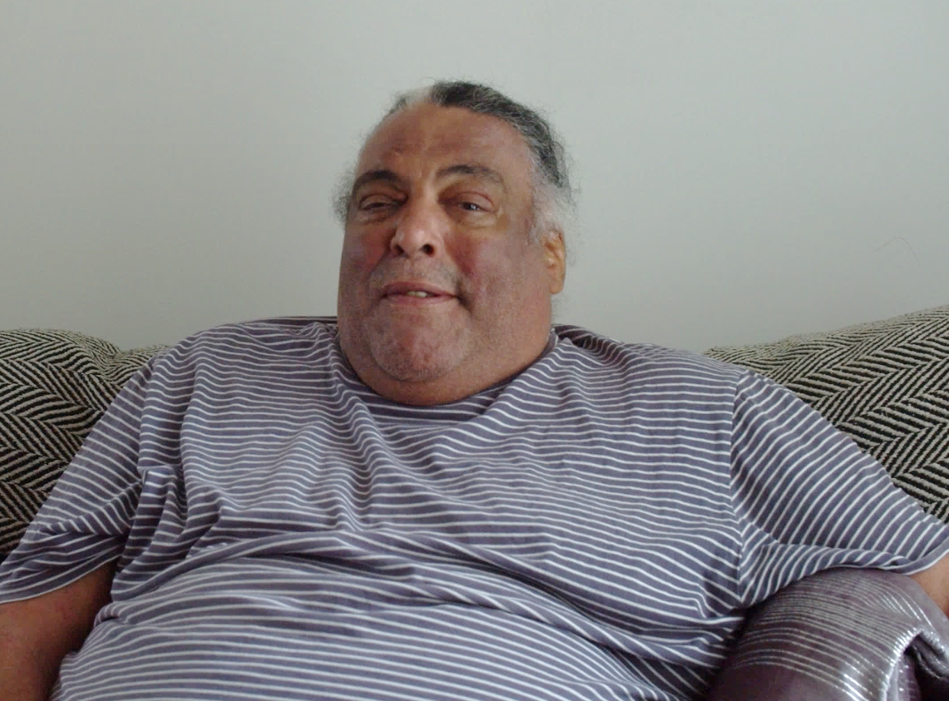
The impact we make…
“With depression, it is so hard to feel motivated and this service really helps me feel like I am doing something about it... I can now stay connected with my brother who lives abroad, and it makes me feel good to be back in touch with him”
Russell Johns
Lloyds Banking Group Customer
Digital Helpline
“We Are Digital’s Digital Marketing Skills Bootcamp is brilliant and very practical with very up-to-date business case studies and exercises. The additional learning resources provided at the end of each module are very informative for ongoing learning even after the course…. After moving to the UK from Hong Kong and being unemployed for almost a year, I started the Bootcamp in February, and I was offered a job last week.”
Sandy NG
Department for Education - Customer
Skills Bootcamps in Digital Marketing
“This service saved my life….and I have now taken my head out of the sand… This service has made it easier to live”
“I would not have gone to try and find this service had it not come to me, you think no one can help you, it was a waste of time… you think people won’t listen, no one can help you, you think you are in a hole and you can’t get out”
Barry Broderick
L&Q Customer
Debt Management Guidance
03300 16 00 51 – to refer partners@we-are-digital.co.uk www.linkedin.com/company/wearedigitaltraining @we_aredigital

Slide 13
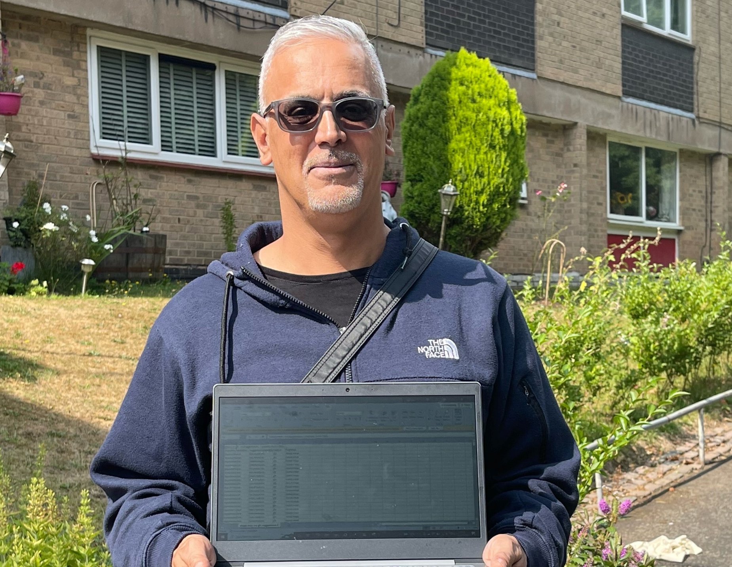
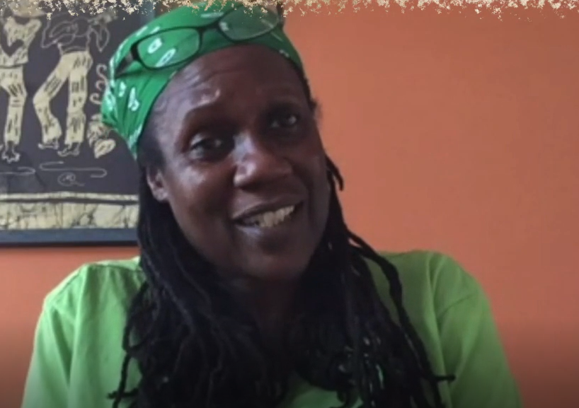
The impact we make…
“I didn't really know which direction I wanted to take, but I knew I had to work around my son
and this would be something I could do… The reason why I managed to do it is that I found it
really interesting and I was committed to it.
It’s believing in yourself as well. I'm the best at self-doubt. I still can't believe that managed to pass it.”
Mohammed Zaman
Department for Education – Customer Skills Bootcamps in Digital Marketing
“Don’t feel ashamed because you are in a situation… if it wasn’t for my housing association being in partnership with We Are Digital, I wouldn’t have known about the help”
Amanda Bernard
L&Q Customer
Debt Management Guidance
03300 16 00 51 – to refer partners@we-are-digital.co.uk www.linkedin.com/company/wearedigitaltraining @we_aredigital

Slide 14
Thank you for attending
If you have any further questions please email partners@we-are-digital.co.uk
03333 444 019 for partner enquiries
partners@we-are-digital.co.uk
www.we-are-digital.co.uk/hmcts-partner
03300 16 00 51 – to refer partners@we-are-digital.co.uk www.linkedin.com/company/wearedigitaltraining @we_aredigital

