Slide 1


Partnering to deliver Financial Inclusion Services.
Jo Woodcock
Financial inclusion Manager North west
jo.woodcock@trusselltrust.org.uk
www.trusselltrust.org
Notes:
Introduction
Thank you for asking me to speak at todays conference on behalf of the Trussell Trust. My name is Jo Woodcock and I am FI Manager for the Northwest.
I’ll start of my presentation with a bit of background about who Trussell Trust are and what we do, our vision and FI programme and then give you an update on our current partnerships and how important these are for the people we see at the foodbanks.
Local foodbanks have always worked hard to build good relationships with their local advice and other support services but over the last few years, with Covid and now the CoL crisis, TT have focussed more on developing national partnerships that can deliver projects that benefit people locally

Slide 2
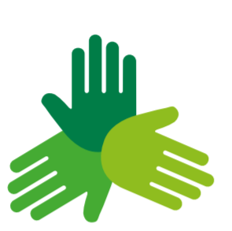
Background: Who we are
National charity supporting a nationwide network of food banks, with over 1,300 centres.
Independent Food Aid Network represents more than 500 independent food banks across the UK.
Together we provide emergency food and support to people locked in poverty.
We campaign for change to end the need for food banks in the UK.
Notes:
So Trussell Trust supports a nationwide network of food banks and together we provide emergency food and support to people locked in poverty, and campaign for change to end the need for food banks in the UK. The foodbanks are all independent charities. There are over 1,300 food bank centres in our network supported, by thousands of volunteers.
But we aren’t the only ones providing this sort of support. The Independent Food Aid Network (IFAN) represents more than 500 independent food banks operating across the UK. IFAN has identified at least 1,172 independent food banks across the UK in addition to food banks in the Trussell Trust network, Salvation Army, and school-based food banks. There are also thousands of other food aid providers including soup kitchens and social supermarkets.
Each provides emergency food to people in crisis, and additional support to help tackle the root causes of poverty and build people’s resilience, so they are less likely to need a food bank in the future.

Slide 3
Our Vision: a uk without the need for food banks
It isn’t right that anyone should be left hungry or living in poverty.
Whilst we work for long-term change, our network of food banks provides emergency food and compassionate, dignified support to people locked in crisis.
We know it takes more than food to end hunger. One major driver for food bank use is problems with the benefits system.
Notes:
Our vision is for a UK without the need for foodbanks. As a nation, we know it isn’t right that anyone should be left hungry or living in poverty. But whilst we work for long-term change, our network of food banks provides emergency food and compassionate, dignified support to people locked in crisis.

Slide 4
Increasing demand
Trussell Trust network distributed over 2.1 million food parcels in 2021/22.
This is an increase of 14% compared to the same period in 2019/20.
832,000 of these parcels went to children.
Notes:
But as I’m sure you are all aware demand for food is increasing. For the first time outside of the first year of the pandemic, food banks in the Trussell Trust network have distributed over 2.1 million food parcels in 2021-22
This is an increase of 14% compared to the same period in 2019/20.
832,000 of these parcels went to children.
And with rising energy costs and high inflation levels this is increasing further. More and more people asking for food parcels with food that can be prepared using just a kettle.

Slide 5

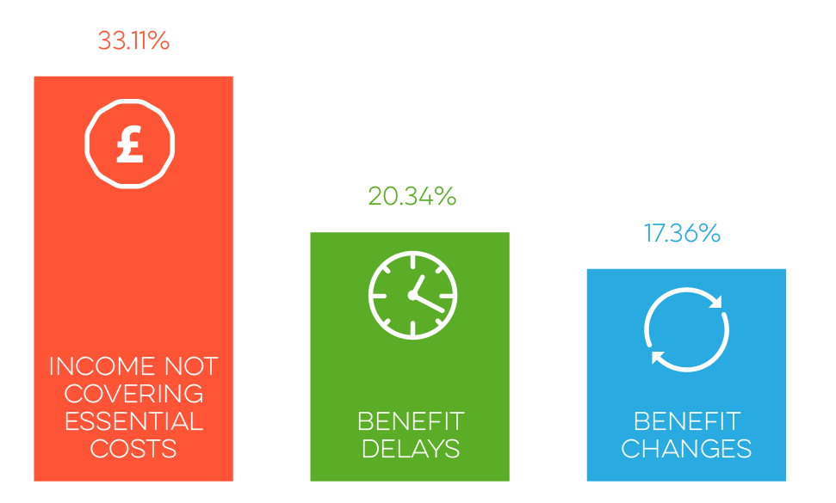


Key issues
Benefits and lack of formal or informal support
Cost of living, sudden illness
Some of the reasons for referral to food banks in the Trussell Trust network
In-work poverty
Notes:
What we are seeing and I’m sure some of you are too, is that more and more people are finding themselves in extreme poverty and these are some of the key reasons.
Benefit problems, UC not stretching from month to month, repaying advance payments and the rate of recovery of other debts from UC, being subject to benefit sanctions. The benefits freeze and cuts to local welfare assistance schemes in some areas are also having an impact.
The cost of living is rising and benefits are not keeping up. People’s income doesn’t cover the costs they need to meet. 85% in benefits And for those in work, many are finding that low-paid and insecure jobs aren’t paying the bills and there are estimated to be around four million people in work who are living in poverty. Our three-year research project, State of Hunger, which is being carried out by Heriot-Watt University. reveals the extreme poverty faced by people at food banks going into the pandemic, with just £248 a month on average to survive on after housing costs. That money needs to cover energy and water costs, council tax, food, and other essentials.
The reality is that Hunger in the UK isn't about food. Its about poverty and that’s why TTs FI Programme has been developed to work to ensure people have enough money their pockets for the basics.

Slide 6




HOW WILL WE GET THERE?
CHANGING COMMUNITIES
CHANGING MINDS
CHANGING POLICY
Local support available for all
A society where everyone can thrive, free from stigma
National policy change
Notes:
So how will we achieve our vision of a UK without the need for foodbanks? We know it is an ambitious target and we know we can’t do it alone.
But we don’t want to exist. Because we don’t believe that a charity can replace the dignity of buying your own food at a time and a place convenient to you.
So, our strategy, put together with our network, works to end the need for food banks in 3 ways:
Firstly, working with other providers, putting in place financial inclusion practices within foodbanks to tackle the underlying drivers of poverty.
Secondly, challenging the acceptance of foodbanks as ‘normal’ and the lack of willingness to do anything about it. We want to a move from sympathy to empathy where people understand that food banks should not exist and will do something about it.
Thirdly, working for policy change which benefits those who are in poverty at national level and supporting local governments to work towards improving local welfare schemes, considering cash first approaches and bolstering advice services.
Ultimately, we believe we need to change the conversation around poverty and take action together to build a hunger free future.

Slide 7
Aims of our financial inclusion programme
Address the root causes of financial crisis.
Connect people to the right support at the right time.
Prevent anyone needing to access emergency food or support on an ongoing basis or (if possible) at all.
Notes:
The Trussell Trust’s approach to financial inclusion is focused on addressing the root causes of the crisis and striving to ensure that people are able to reach a point where their income meets their needs, and they no longer have to access emergency food.
This means connecting people with support at the right time before they reach crisis point.

Slide 8


Our financial inclusion programme
Network – FI grant funding programme, FI Managers and
FI Toolkit.
Helpline services – providing advice first to those
seeking emergency food.
Cross-cutting approaches – developing new, national partnerships with
other advice providers.
Notes:
There are a number of strands to our programme:
Providing grants to our network to enable them to commission advice services in foodbanks.
Helpline services – set up the HtH helpline at the outset of Covid – partly as a route for people to get food vouchers but also to provide advice to maximise their income.
We recognize the current scale of the problem and know we can't solve it alone. Vital to work with colleagues across the anti poverty sector to promote access to advice for all who need it and to campaign for change.
For this presentation I will now talk a bit more the partnerships TT have developed over the last few years.

Slide 9

Partnerships
  Citizens Advice and Mind
  Aims to facilitate partnership working at a local level.
  Referral and relationship pilots between Mind, CA and Trussell Trust.
  Help through Hardship local – led by Mind
Notes:
Mind, the Trussell Trust and Citizens Advice (CA) have been working since Autumn 2020 and have developed a number of different innovative ways of working.
Help through Hardship Local – partnership between Mind, CA and Trussell Trust.
The purpose of the project is to facilitate partnership working at a local level looking to pilot the development of referral relationships between local Citizens Advice offices, local Minds and TT food banks..

Slide 10
Partnerships
  Mind
  Aims to tackle intersectionality between mental health and poverty, by ensuring people can get holistic support.
  Transferring calls from Help through Hardship to Mind's Infoline
Notes:
Mind
Our partnership with Mind aims to help tackle the intersectionality we often see between mental health and poverty, by ensuring people can get holistic support. An early evaluation of the Help through Hardship helpline showed that 1 in 2 callers described themselves as having poor mental health. We know that one of the biggest barriers to accessing support services is often the feeling of being passed from pillar to post when discussing sensitive or personal information.
So, after a successful pilot the option for a call to the Help through Hardship helpline to be transferred to Mind’s Infoline now means people can receive info on local mental health support, treatment options and advocacy services.
This service is now available to everyone who calls the Help through Hardship line, and if a call is transferred there is no cost for speaking to Infoline.
To assess the effectiveness of transferring calls to Mind’s Infoline, mini-depth interviews took place with three callers that were transferred across from the Help through Hardship line to Mind’s Infoline.
“[The Adviser] obviously could tell I needed the help and I'm happy she passed me through to [Mind]. I ended up getting some help from my GP but without talking to the helpline and Mind I don't think I would have done that or at least I wouldn't have done it for a long time or until it got really bad.”

Slide 11
Partnerships
  Child Poverty Action Group (CPAG)
  Second tier support, training and resources to financial
  inclusion advisers in foodbanks
Notes:
CPAG - We’ve recently partnered with Child Poverty Action Group (CPAG) to offer specialist advice, support and resources tailored towards financial inclusion advisers, both working in and with food banks. This will mean advisers can access immediate support with complex enquiries and also enable TT to gain a deeper understanding of the benefit issues people coming to foodbanks present with enabling us to use this insight to influence policy change.

Slide 12
Partnerships
  Greater Manchester Poverty Action
  Money Advice Referral Tool
  Similar to IFANs 'Worrying About Money?' cash first referral leaflets
Notes:
We have been working with GMPA – developing a referral tool for fb referral agencies in Greater Manchester to use to with clients they are looking to refer for a food voucher to ensure they also refer to services offering advice and support the person really requires and not just a food voucher.

Slide 13
Partnerships
  Stepchange Debt Charity
  2 Pilots for referrals
  Warm referrals in
  Stepchange issuing food vouchers
Notes:
We are running 2 pilots with Stepchange
FBs that sign up to the pilot can make referrals to Stepchange and provide clients details and Stepchange will call the client at a prearranged time
Stepchange can also check if callers need food and issue a food voucher for a local FB.

Slide 14



Any questions

Slide 15
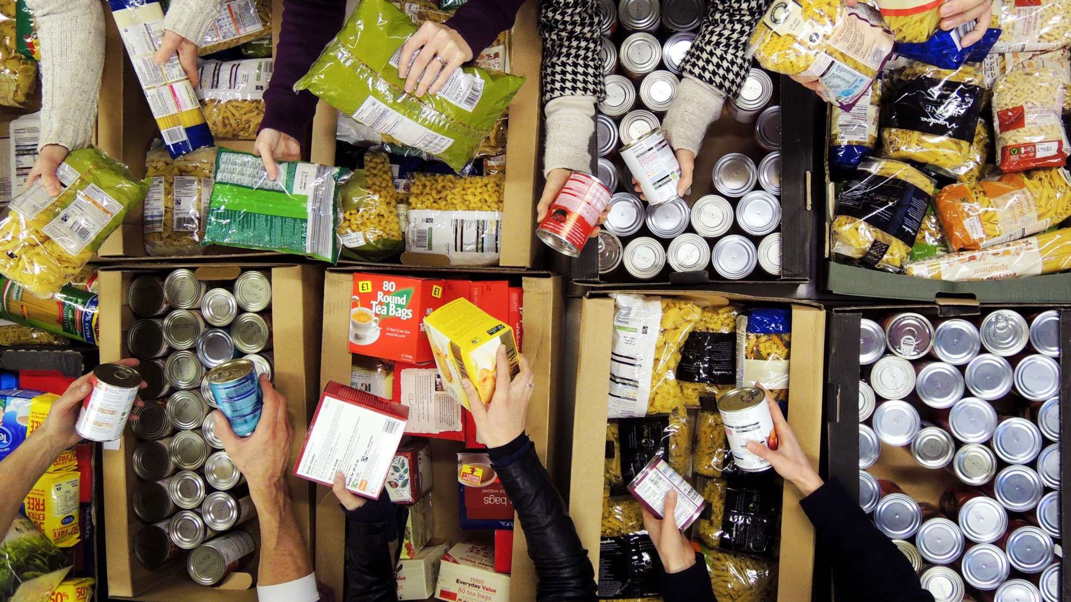



www.trusselltrust.org
@trusselltrust
Notes:
End Slide

