Slide 1

Towards an economic evaluation of social welfare advice in hospital settings
Standing Committee on Advice Research and Evaluation
Friday 26th November 2021
Prof Naomi Creutzfeldt, University of Westminster

Slide 2
Problem context
Among the OECD the UK has one of the smallest numbers of hospital beds per 1000 people
Whilst the number of delayed discharges is relatively small, they are steadily increasing and have serious implications for resource use
Throughout 2019 between 12-30% of NHS bed capacity was provided through “temporary” escalation beds and wards
Hospitals are unable to discharge patients where there is no suitable accommodation for their post operative recovery
In addition to bed blocking, knowing that there is no suitable discharge destination may delay or cause the postponement of operations
Discharge without the provision of welfare advice or appropriate benefit payments may impact long-term wellbeing and recovery

Slide 3
Observations
The UK welfare advice service consists of wide range of organisations covering income, housing, debt and disability…
At the same time, the application and appeals process is seen as complex and exhibits several challenges (rethink 2019; AgeUk 2021; and Joseph Rountree Foundation 2015).
Following a report in 2006 by the Public Accounts Committee into the complexity of the benefits system there has been an ongoing effort to simplify the claims and appeals process.
Given their unique position and that several benefit schemes require medical evidence to support claims, integrated hospital advice services appear best placed to offer advice and support for welfare needs arising due to accident, illness or disability.
Previous research has focused on advice delivered in the community setting. Less emphasis has been placed on the impact to hospitals or the longer-term wellbeing outcomes.

Slide 4

Research Team
Lola Afolabi and Heidi Bancroft (AJC / JUSTICE)
Diane Sechi (Senior Pro Bono Lawyer, Simmons & Simmons)
Naomi Creutzfeldt (Professor in Socio-Legal Studies, University of Westminster)
Philip Worrall (Research Fellow, University of Westminster)
With special thanks to
    Nick Wright, Manager, Citizens Advice Bureau at Great Ormond Street Hospital (GOSH)
    Marie Copple, East Midlands Haemoglobinopathy Network Lead Nurse, Leicester Royal Infirmary Hospital
    Rachel Flagg, Interim Joint Director of Transformation and Commissioning, South West Croydon Health Care Services.
    Michael Bell, Director, Chairman at Croydon Health Services and Barking, Havering and Redbridge University Hospitals NHS Trust

Slide 5
Access to social welfare advice in hospital settings: integration of services
This pilot project explores the operation and impact of integrated welfare advice centres in the acute hospital setting.
Our goal is to shed light on a longstanding problem the NHS has been facing for many years: namely patients staying longer in hospital due to a variety of unresolved social welfare issues.
Method: Qualitative interviews held with welfare advisors and HCP across five hospitals in the UK and a review of related literature. Application of soft-systems methodology and cost-consequence analysis to map out a generic service model and highlight benefits and outcomes.
Results: Co-location has the potential to deliver a range of benefits for multiple stakeholders, contributing to reducing the cost of delayed discharge and postponed operations. For patients, a key benefit relates to reducing stress and anxiety. Scope for lessening time spent processing incomplete/invalid welfare applications and appeals by DWP. Cost of providing advice circa £141- £211 per patient.
https://ajc-justice.co.uk/wp-content/uploads/2021/06/AJC-Health-Justice-Report-Final.pdf

Slide 6
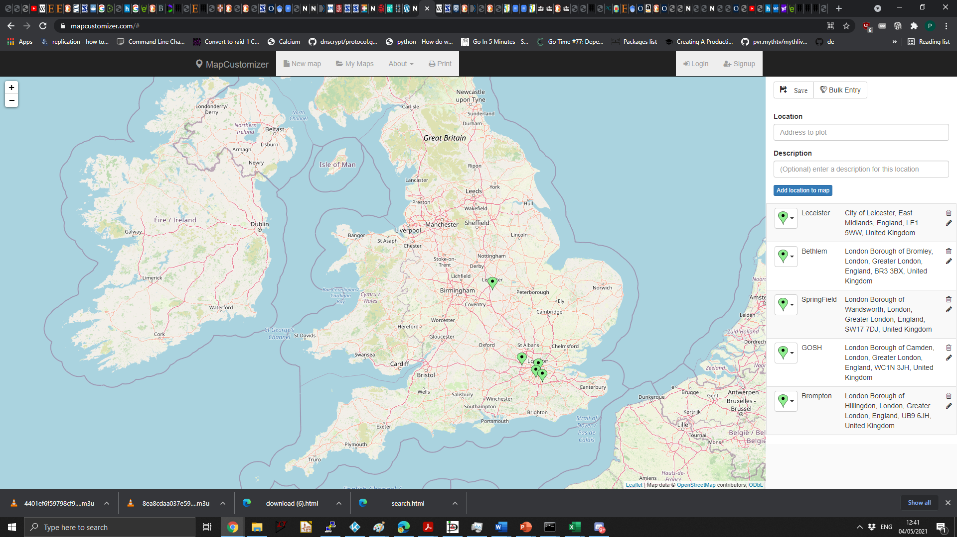
Research Objectives and Methodology
The main aims of the pilot
To explore the role and operation of integrated advice centres within secondary or tertiary healthcare settings, highlighting different service models and configurations.
To identify the potential economic benefits and wellbeing outcomes for patients, hospitals, government and external organisations.
Methodology
Brief literature review
10 semi-structured interviews lasting between 1-1.5 hours across 5 hospital trusts (4 welfare advisors, 1 senior manager, and 5 HCPs)
Application of soft-systems methodology (SSM*) and cost-consequence analysis of a generic integrated advice service
*SSM is a methodology developed by Peter Checkland (1981) to aid problem structuring and analysis of organisational processes

Slide 7
Key findings from the literature review (UK)
Multiple studies identify clinicians as being better able to spot legal and social welfare issues. Increased awareness of legal issues and the wider social determinants of health can also encourage clinicians to dig deeper into why patients may not comply with medical treatments.
Beardon and Genn (2018) identified more than 380 services in the UK which encompass national and local charities, local authorities, healthcare services, independent organisations and partnerships of providers.
The majority of studies in the UK have focused on health justice partnerships within GP settings and the majority of ongoing research involves the use of social prescribing. This is the process by which clinicians such as GPs and nurses refer patients on for services outside of the hospital to deal with social welfare issues presenting amongst patients.
The most common advice organisations working with healthcare services were Citizens Advice (CAB) and Macmillan Cancer Support. CABs make up 43% of the services identified as working in healthcare settings, whilst Macmillan Cancer Support came in as the second most common provider, making up 25% of the identified services.
A key challenge relates to measuring and demonstrating impact for funders due to fewer tangible outcomes and the reality that physical health benefits may take longer to show up following advice intervention.

Slide 8
Key findings from the literature review (excl. UK)
Medical-legal partnerships (MLPs) have existed in the USA for almost 30 years.
Health Justice Partnerships (HJPs) system in Australia came into inception in the early 2010s and has since rapidly expanded into almost 100 sites across the country.
MLPs and HJPs are both collaborations between legal and healthcare services, whereby legal advice is provided in healthcare settings.
Co-location of MLPs focus on preventative rather than reactive care. For example, having lawyers and advice workers embedded in the setting means they can prevent an eviction rather than react to an eviction Used interchangeably.
HCP professionals working in healthcare settings, such as social workers, are also able to gain confidence in understanding the legal/advice services and thereafter assist patients due to exposure through co-location and reduce their stress levels in the long-term.
A study from Australia found that receiving advice reduced stress for patients and reduced readmissions to hospital. Patients were better able to take control of their financial problems, reduce stress and improve their health outcomes in the process.

Slide 9
Details of Patient Demand and Service Characteristics
NHS Trust | Patient Demand* (monthly ex. casework) | Patient/Family Characteristics | Service Time | Lead Time
South London and Maudsley NHS Foundation Trust | 180 | A wide range of Mental Health illness | 1h consultation + 3h casework | Urgent: within 1week Non-urgent: 1-2 weeks
Great Ormond St Hospital for Children | 30-35 | Deprived Families, Children with Life Changing Medical conditions | 1h – days per family (significant variability) | Urgent: aim for same day Non-urgent: Max 2 weeks
Leicester Royal Infirmary |  | Sickle Cell Patients, those unable to work due to health
Royal Brompton & Harefield hospitals | 50 | Patients with transplant surgery, Lack of money for food and/or heating. Cystic Fibrosis Patients, young adults with complex health needs, and low income individuals and families | 1h – half day per patient | Urgent: within 2 working days Non-urgent: within 7 working days
Springfield University Hospital | 400 | Mental Health Patients, Low Income Groups, Carers, All Ages | Up to 1.5h appointments | Urgent: within 24h
*Patient demand is based on data obtained through interviews and is not directly comparable due to differences in advice service availability

Slide 10
Fundamental activities to measure time spent
Training for other members of staff
Raising awareness of eligibility of different benefit schemes
Keeping up to date with relevant changes in local and national government welfare policy
Help with the preparation and completion of welfare applications
Support in the appeals process and attendance at tribunal hearings
Coordination of medical and non-medical evidence to support welfare applications
Drafting letters of support for housing applications
Liaising with external organisations offering specialist support (e.g., debt welfare or immigration advisors)
Conducting annual or semi-annual post-advice surveys as part of overall monitoring and reporting
Following up referrals with HCPs

Slide 11
SSM Catwoe Analysis
C | Customers | Patients and Families (deprived, low income households, life changing medical conditions, unable to work, carers)
A | Actors | Welfare advisors, complex discharge team, specialist nurses and other HCPs
T | Transformation Process | [1] No social welfare benefits in place ➔ welfare benefits in place [2] Unmanageable debt burden ➔ manageable debt burden [3] Stressed and worried patients ➔ less stressed patients [4] Patients unable to be discharged ➔ patients able to be discharged
W | World View | HCPs Worried about giving incorrect advice Welfare Advisors Concerned about long-term funding, capacity challenges
O | Owners | NHS hospital management, NHS England, DWP
E | Environmental Constraints | Local budgets, need to demonstrate value for money, availability of benevolent funding, no national budget, reliance on charitable organisations

Slide 12
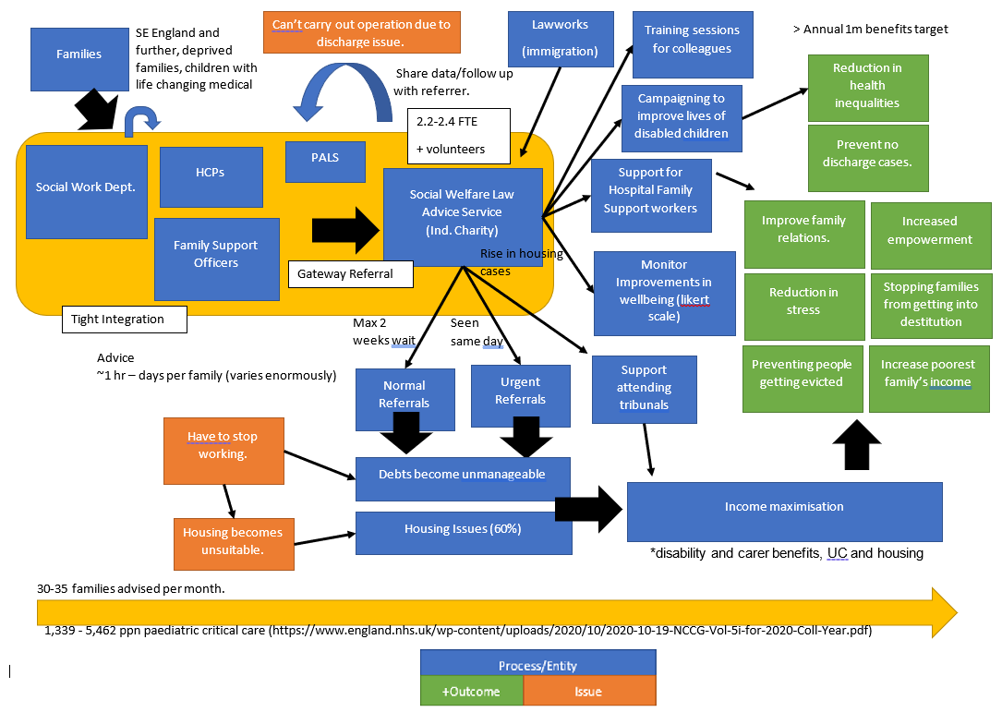
SSM Rich Picture

Slide 13
Generic service model (separate PDF/Dia)

Slide 14
Economic evaluation
Evaluation Method | Description
Cost Benefit Analysis | Where there is a choice between different capital investment decisions. All costs and benefits converted to monetary values. Decisions ranked according to the ROI (return on investment) for a given budget
Cost Utility Analysis | Where quantity and quality of life improvements are derived from an investment decision. Calculate the cost of an intervention and compare the incremental QALYs (Quality adjusted life-years). Currently £20-30k per 1 additional year of life in excellent health
Cost Consequence Analysis | Summary of different costs and effects grouped by stakeholder. Broad approach looking at the impact across several stakeholders. Costs may be unclear or outcomes more qualitative in nature
Cost Effective Analysis | To evaluate the costs of different investment decisions that lead to a target increase or decrease in one or more specific outcomes. For example, to reduce the incidence of strokes by 10%. The decisions can then be ranked to identify the method that is most cost effective

Slide 15
Costs, benefits and outcomes
Hospital Trusts
  Reduction in bed blocking. This includes cases where the hospital is unable to discharge a patient due to lack of housing or housing that is unsuitable (£400-500 per night, £1339 per night for paediatric critical care beds).
  Reduction in costs associated with the cancellation or postponement of operations in cases where there is uncertainty surrounding the ability to safely discharge a patient to their home (~£15k for cancelled operation).
  Reduction in the amount of time taken by HCPs in providing informal advice and freeing up time for clinical activities (Nurse time estimated at £92-£113 per hour).

Slide 16
Costs, benefits and outcomes
Costs, benefits and outcomes
Patients
  Successful award of one or more social welfare payments, including back-payments and increases in existing benefits. This can include Personal Independence Payments (PIP), Universal Credit (UC) and Disability Living Allowance for Children (DLA).
  The amount awarded under these schemes varies considerably according to various factors including level of disability, age, employment status and the level of existing savings E.g. PIP £1k-£8k per year.
  Reduction in fees associated with debt collection and interest payments .
  Fewer rejected and appealed claims.
  Prevent homelessness (£24k-30k per year) and eviction, afford basic medical necessities, and raise the quality of their diet.
  Increased awareness of charities or local schemes.

Slide 17
Costs, benefits and outcomes
Local and national government
  Reduction of court and legal costs associated with the appeals process. This would arise because of the increase in quality of submitted welfare benefits applications, including those that are supported by valid medical and non-medical evidence.
  A secondary financial benefit for the government could relate to the reduction in time spent processing incomplete or invalid welfare benefits applications.
External advice centres and hubs
  Reduction in the demand for advice from patient cohorts that are advised internally by hospital trusts. This would include a reduction in the number of appointments handled and time spent following up welfare applications requiring input from the hospital.
  Reduction in the amount of time spent on each case due to the hospital advice service helping to initially progress or bootstrap the application process.

Slide 18

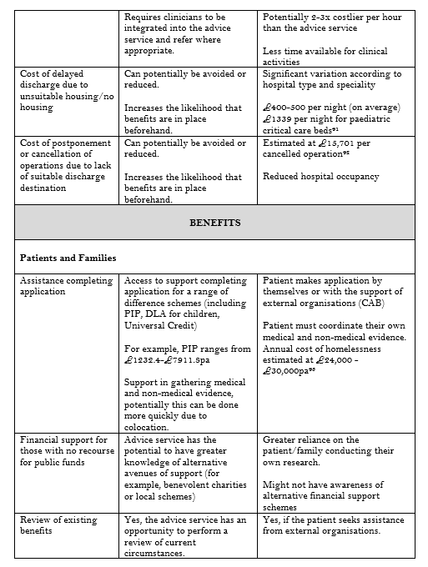
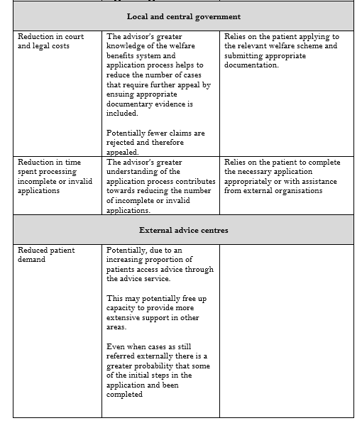
These are sample screenshots taken from the report published by the AJC

Slide 19
Perspectives and next steps
Integrated advice services within hospital settings can assist at the juncture of people’s lives when they are most in need.
Patients are treated holistically which has the potential to lead to improved health and wellbeing outcomes.
There are also clear benefits for hospitals, local government and the wider UK advice service.
We plan to carry out a larger evaluation across the UK of the provision of onsite services. Our pilot was only able to consider five sites and it was abundantly clear that the Royal Leicester, where there is no onsite advice service, would greatly benefit from those advice services found in our other pilot sites.
In order to fully understand the landscape, and to assess the long-term cost savings of onsite advice services, we would need to interrogate the NHS hospital landscape to identify how many onsite services already exist and the extent to which, they mirror the main findings in our pilot study. This could begin with a UK wide hospital census.
THANKS FOR LISTENING!

