Slide 1

Reflecting on “The cost of not getting Personal Independence Payment decisions right first time”
Jon Franklin
November 2021

Slide 2
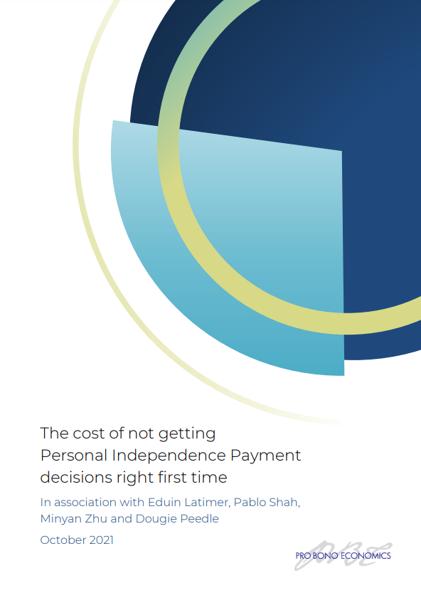
A system not fit for purpose
1 in 5
PIP claimants in 2019/20 had their decision overturned at Mandatory Reconsideration or Appeal
Notes:
Each year, the UK government provides around £12 billion of support to disabled people and people with health conditions through Personal Independence Payments (PIPs). After the Employment & Support Allowance, PIPs are the second biggest source of welfare benefit provided by the Department of Work and Pensions (DWP) to this group of individuals, distributing additional payments to 2.7 million people to help them with their higher costs of living.
781k initial decisions, 315k reviewed at Mandatory Reconsideration – 29% successful (92,000).
78k go to appeal of which 59k are successful (76%).

Slide 3
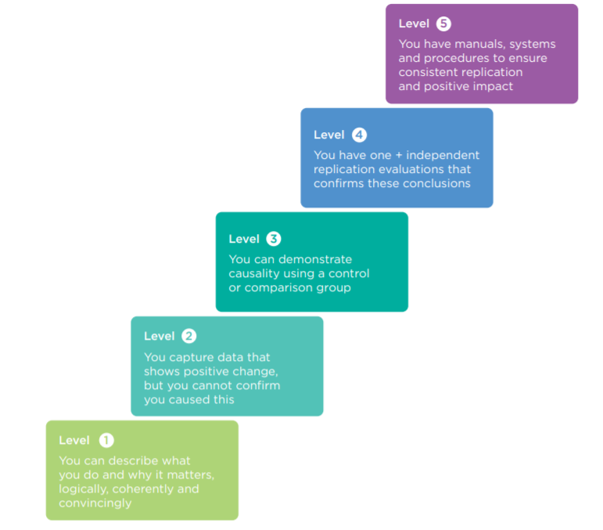
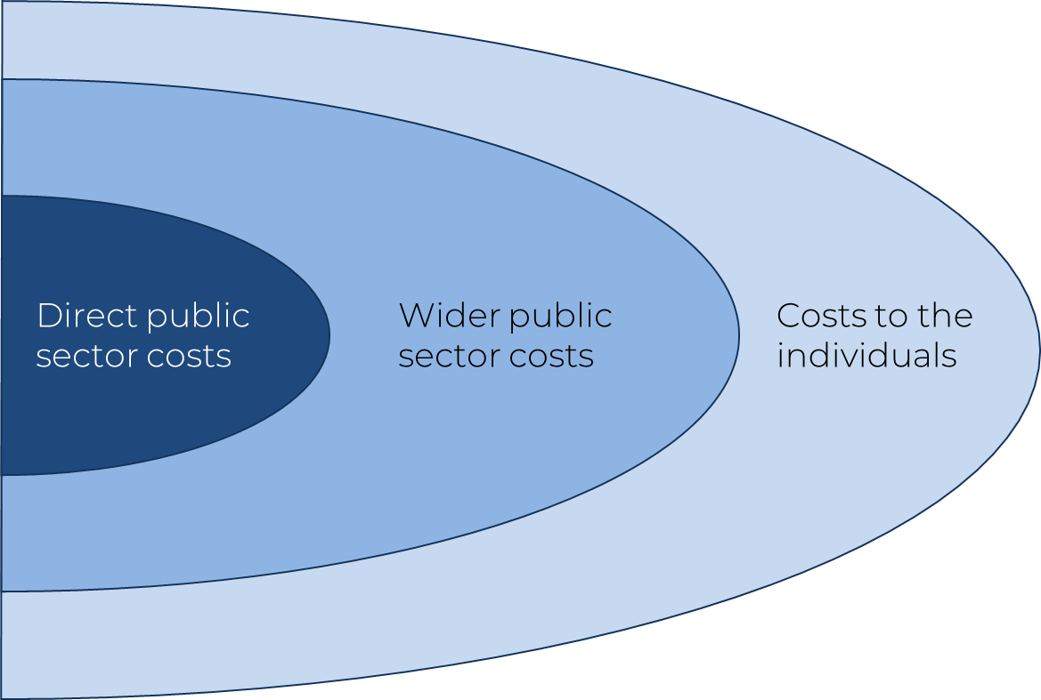
What are the costs of this problem?
Nesta standards of evidence
Direct public sector costs
Wider public sector costs
Costs to the individuals
Source: Nesta (2013)

Slide 4
The direct public sector costs
Average cost to DWP of a case that reaches appeal
£351-£491
59,000
PIP appeal cases that overturned an initial decision in 2019/20
The total cost to DWP of administering appeal cases
£23-£29m
in 2019/20

Slide 5



The wider public sector costs
Scenario analysis:
If 1 in 10 claimants who successfully had their decision changed in 2019/20 have to pay one additional visit to the GP, then it would cost the NHS an additional 2,300 GP hours, at a cost of around £600,000 per annum.
If 1 in 20 of those who successfully had their decision changed in 2019/20 have to pay one more visit to A&E, for example, then it would cost around £1.1 million per annum.
If 1 in every 100 people who successfully had their decision changed in 2019/20 required statutory homelessness support whilst they await the outcome of their MR or appeal, it could cost an additional £4.4 million.
If 1 in 200 of those who successfully had their decision changed in 2019/20 require community social care in the interim, then it could cost an additional £9.9 million.

Slide 6



The costs to the individual
Evidence review
Case studies
Analysis of survey data
“ The vast majority of people who went through the PIP assessment process had a negative experience ”
“ D is completely overwhelmed by the situation and struggles to manage her health needs ”
“ among the group that transitioned from DLA to neither DLA or PIP there was a significant deterioration in mental wellbeing ”

Slide 7
The recipe for economic analysis…
Baseline for beneficiary supported by the charity
Follow-up outcome for beneficiary supported by the charity
Difference in outcomes we can value
Evidence pathway
Follow-up outcome for a control group
Baseline for a control group

Slide 8
The challenges for economic analysis…
1) Difficult to reliably capture outcomes for beneficiaries
Baseline for beneficiary supported by the charity
Follow-up outcome for beneficiary supported by the charity
Difference in outcomes we can value
Evidence pathway
Follow-up outcome for a control group
Baseline for a control group

Slide 9
The challenges for economic analysis…
2) “Fragmented” outcomes
Baseline for beneficiary supported by the charity
Follow-up outcome for beneficiary supported by the charity
Baseline for beneficiary supported by the charity
Follow-up outcome for beneficiary supported by the charity
Baseline for beneficiary supported by the charity
Follow-up outcome for beneficiary supported by the charity
Baseline for beneficiary supported by the charity
Follow-up outcome for beneficiary supported by the charity
Baseline for beneficiary supported by the charity
Follow-up outcome for beneficiary supported by the charity
Baseline for beneficiary supported by the charity
Follow-up outcome for beneficiary supported by the charity
Difference in outcomes we can value
Evidence pathway
Difference in outcomes we can value
Evidence pathway
Difference in outcomes we can value
Evidence pathway
Difference in outcomes we can value
Evidence pathway
Difference in outcomes we can value
Evidence pathway
Difference in outcomes we can value
Evidence pathway
Follow-up outcome for a control group
Baseline for a control group
Follow-up outcome for a control group
Baseline for a control group
Follow-up outcome for a control group
Baseline for a control group
Follow-up outcome for a control group
Baseline for a control group
Follow-up outcome for a control group
Baseline for a control group
Follow-up outcome for a control group
Baseline for a control group

Slide 10
The challenges for economic analysis…
3) Moral, ethical, logistical challenges with finding a “control group”
Baseline for beneficiary supported by the charity
Follow-up outcome for beneficiary supported by the charity
Difference in outcomes we can value
Evidence pathway
Follow-up outcome for a control group
Baseline for a control group

Slide 11

The challenges for economic analysis…
4) Long gap to economic benefits?
Baseline for beneficiary supported by the charity
Follow-up outcome for beneficiary supported by the charity
Difference in outcomes we can value
Follow-up outcome for a control group
Baseline for a control group

Slide 12

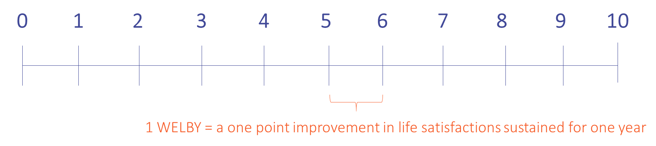
Do wellbeing measures offer a solution?
The “ONS 4”
Overall, how satisfied are you with your life nowadays?
Overall, to what extent do you feel the things you do in your life are worthwhile?
Overall, how happy did you feel yesterday?
Overall, how anxious did you feel yesterday?
Notes:
Cantril’s ladder

Slide 13
Do wellbeing measures offer a solution?
Simple short, standardised questions across service lines
Baseline for beneficiary supported by the charity
Follow-up outcome for beneficiary supported by the charity
Can value directly with no evidence pathway
Difference in outcomes we can value
Evidence pathway
Control groups available from national surveys
Follow-up outcome for a control group
Baseline for a control group
See new HM Treasury guidance: https://www.gov.uk/government/publications/green-book-supplementary-guidance-wellbeing

