Slide 1

Standing Committee on Advice Research and Evaluation
The value of advice
26th November 2021

Slide 2
What is SCARE?
An annual get-together of people who commission, undertake and utilise research in the field of social welfare advice….
With the aim of doing more and doing it better!

Slide 3
Today’s agenda
Looking at two current areas of research activity
The use of economic research in the advice sector
Mapping of advice services and other access to justice services
Followed by
Round up of other developments and useful research
Opportunities to discuss and breaks

Slide 4

Introduction to mapping advice services

Slide 5
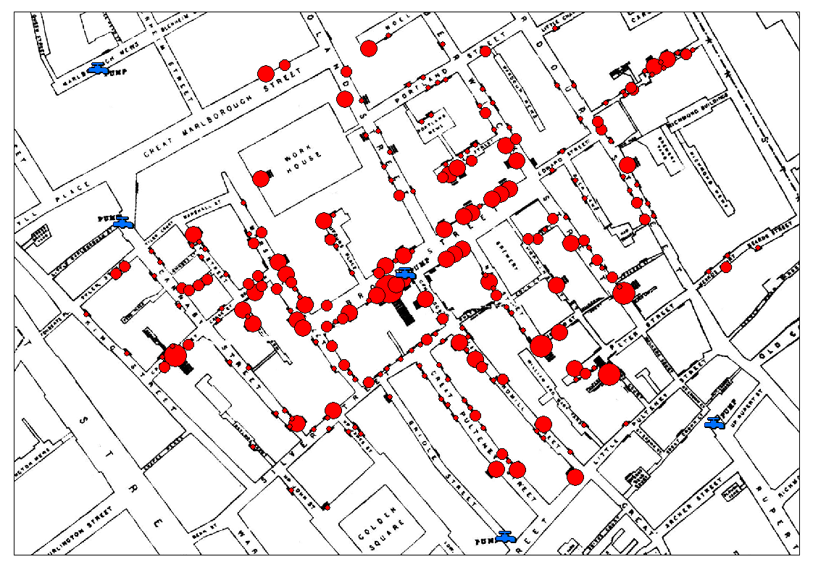
Mapping is imprinted in research thinking

Slide 6
Key questions which are difficult to answer
How big is the advice sector?
How has the size and the shape of the sector changed?
Where are the gaps in advice provision?
Does the advice provision meet advice need?
How do different localities compare?

Slide 7
Brave attempts
Surveys: Not for Profit Legal Advice Providers in England and Wales Ipsos-Mori 2015
Combining databases: ASA and Get the Data, Money and Pensions Service
Charity Commission Database: Advising Londoners and pilot project with Disability Rights, now Charity Classification Project (advice and individual advocacy)
Scraping the net: Etic Lab Heuristics based model
Hand search and snowball techniques: i.e. LB Newham and ASA Black, Asian and Minority Ethnic network

Slide 8
Challenges…
Constantly changing and seismic shifts at particular points in time
Counting issues still exist; clients verses visits verses issues
Definitions of advice vary widely as does use of the term
Move to remote delivery and on line less tied to locality
Postcodes don’t represent where services deliver- head office verses outreach
Different delivery boundaries- geographic and client group
Funder commissioning can influence delivery

Slide 9
Key questions…
Why do we think this is so important? What do we want to find out and what will we do with this information?
What level of tolerance for accuracy of the exercises?
Are the results worth the input (energy, funding etc)?
Is there a compromise solution which will be good enough?
Can we harness the power of advice communities to answer this?
What difference will it make?

