Slide 1

Supporting Advice Organisations in Ethnically Diverse Communities

Slide 2
Presentation Outline
About this Investigation
Methodology
Terminology
About Respondents
Findings
Recommendations
Discussion
Q&A

Slide 3
About this Investigation
Research carried out between January - March 2021
Housed with Advice Services Alliance, with funding from Trust for London and support from London Legal Support Trust
Guided by Advisory Group formed of members from London’s former Black and Minority Ethnic Advice Network (BAN)
Researched by Tessa Awe and Anita Sangha

Slide 4
Aims &
Objectives
Identify key challenges faced by smaller organisations that provide advice and support to diverse communities experiencing racial inequality
Identify the support needs of these organisations
Consider what the most effective way of addressing these support needs and developing the sustainability of these organisations
Produce clear recommendations for stakeholders on how to meet these needs
Amplify the voices and experiences of these organisations at the strategic level

Slide 5
Methodology
Brought together an advisory group of former BAN members to guide and influence this project
Online survey disseminated via ASA’s main communication channels
Interviews with organisations across London who provide advice and support to specific communities
Additional engagements
  National Association of Welfare Rights Advisors (NAWRA)
Desk research
Notes:
BAN brought in to ensure the research was shaped and informed by the very organisations it seeks to empower and serve
Ensured they had multiple opportunities to shape the work and the final report
Thanks again to Barbara for speaking today

Slide 6
Terminology
BAMER Organisations
  Provide support specifically to Black, Asian, Minority Ethnic and Refugee communities, including people seeking asylum and migrants
Mainstream Organisations
  Provide support to general population and wider range of communities, including BAMER communities
‘Small’ Organisations
  Small Charities Coalition definition: any charitable organisation with an annual income of under £1 million
Notes:
So just before we get into it, this is also included in the report but for clarity’s sake
BAMER - organisations working with BAME and Refugees and aslyum seekers, and migrants
Mainstream - work with general community, non specific
Small - we used Small charities coalition definition because it’s a bit broader compared to the NCVO standard
In terms of BAME/BAMER - we want to be clear that we don’t view the separate groups as one homogenous beige and really there needs to be further exploration of the specific challenges facing different communities, but given the constraints on this project in terms of time - we are focusing on BAMER organsiations as a collective and hopefully engagement with unique challenges can be explored in subsequent research

Slide 7
Topics Covered
Methods of Advice Provision
Workforce Retention & Recruitment
Training Needs
Funding & Sustainability
Policy & Advocacy
Networking
Quality
Notes:
So, we asked interviewees and survey respondents about their support needs in regards to the following topics

Slide 8
Profile of Survey Respondents
Engaged with organisations based in both inner and outer London boroughs
Areas of Provision
  Housing, welfare and benefits, employment, legal representation, domestic violence, and practical support such as food provision
Annual Turnover
  Ranges varied between less than £50,000 and over £1 million
Sources of Funding
  Legal aid contracts, donations, grants

Slide 9
Findings

Slide 10
Breaking down the ‘BAMER’ Organisations
Main Beneficiaries
  64% supported ‘BAME’
  71% supported women, compared to 57% who supported men
  37% supported young people
  20% supported the LGBTQ community
  Almost two-thirds supported those with mental and physical health conditions
True figure of respondents supporting BAMER Communities was closer to 54%
  Over a third supported migrants, refugees and asylum seekers
  10% supported Black African and Carribean, European, and multiple diverse communities respectively
  5% supported Asian communities, including people from Indian, Pakistani, Bangladeshi, and Chinese backgrounds
Notes:
So there’s a slight gap between those who reported to support BAMER communities and those who supported them specifically - so they may provide support to all communities, or work in diverse boroughs, rather than specifically support different ethnic and cultural groups

Slide 11
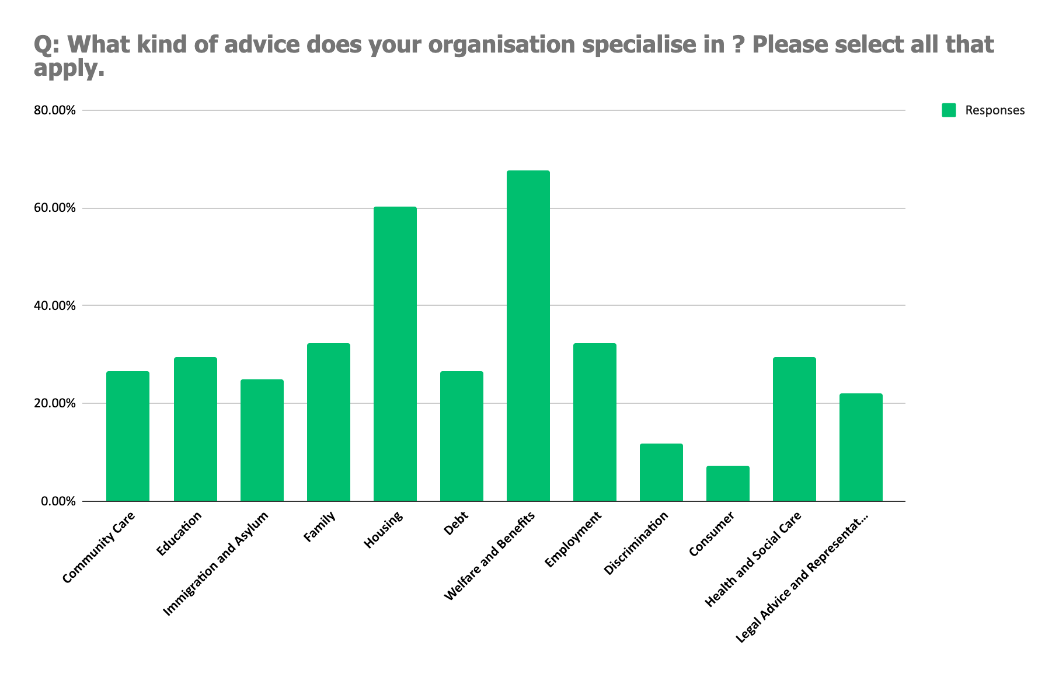
Areas of Specialist Advice Provision in Survey Respondents
Notes:
Overall, we have a generalist sample of respondents. However, as we can see, most specialise in welfare and benefits, housing, health and social care advice.

Slide 12
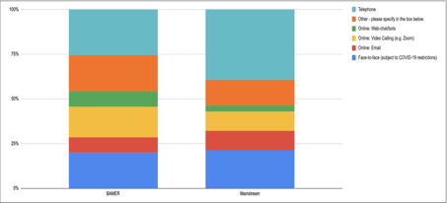
Main Methods of Advice Delivery
Main Methods of Provision
  One-third using telephone-methods
  Email - 10%
  Video-calling - 15%
  Web-chat/bots - 6%
  Face--to-face - 20%
Comparison of main methods of advice delivery between BAMER and mainstream organisations (Left)
Notes:
Overall, telephone services most commonly used for advice, followed by face to face, video calling, and then email/webchat
Makes sense given digital deficits within the sector and digital exclusion in the communities served- which we’ll get onto shortly

Slide 13
Challenges Facing Respondents
Notes:
So, with a clearer idea of respondents, let’s discuss the challenges facing them
Meeting demand - transitioning to remote services, digital exclusion, complex needs and wellbeing support for staff.
Access to funding - criteria, undervalued, time, evidence of need, sustainability.
Networking and Support - network membership, one to one, online.
Quality assurance and standards - membership, lack of funding.
Workforce development and training - digital, workforce size, communication, specialist knowledge and change,

Slide 14
Meeting Demand & Transitioning to Remote Services
Challenges Associated with Remote Service Delivery
  Lack of digital skills and resources within organisations
  Difficulties accessing funding required to address digital deficits internally
  Over half of survey respondents found did not find it easier to us remote services to support users
  Remote methods are not always viable depending on support required and complexity of needs
Notes:
Main challenges around meeting demand associated with doing so remotely - lack of skills, funding, capacity; methods aren’t always suitable,
Digital doesn’t always equal better - what about for people with disabilities? Children and young people? Langauge barriers? Is it necessarily equitable, or just efficient ?

Slide 15
“to increase funding to support the new use of digital media and IT technology required to offer services as well as training users how to use digital media and IT technology”
Survey Respondent on Recommendations to Address Difficulties Meeting Demand

Slide 16
Digital Exclusion
20% of respondents cited digital exclusion as a barrier to advice provision
10% mentioned a lack of digital skills amongst beneficiaries
Interviewees highlighted the role of other key factors that make remote service provision impractical, e.g. for those with disabilities, using telephone or computer-based advice may not be suitable

Slide 17
Complex Needs & Wellbeing Support for Staff
Almost 75% saw an increase in demand for services from new users, such as
  Refugees and asylum seekers
  Unemployed or furloughed
  People suffering from domestic violence
  Diverse communities
User needs had also become more complex over the pandemic
  More skills and expertise required - but again, financial barriers limit this
As user needs become more complex, wellbeing of staff was also reported to become more important
  Emotional impact of dealing with people in crisis and experiencing very traumatic circumstances
  Stress and anxiety
  Burnout

Slide 18
“We can’t just look away” – Interviewee

Slide 19
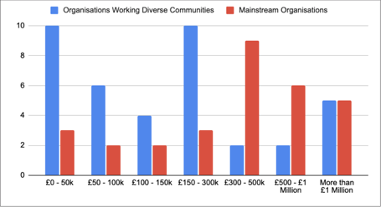
Funding
Access to Funding
82% of respondents are ‘small’ (turnover of less than £1m)
80% had funding and sustainability support needs
BAMER organisations had lower annual turnovers compared to mainstream organisations

Slide 20
Perception of Funders
Access to funding for smaller diverse organisations perceived to be limited by lack of trust in smaller groups to deliver quality services to users
50% of interviewees felt their work was valued by direct beneficiaries, but not by funders
25% thought their work was overlooked in favour of larger organisations
‘Second tier’ organisations
Funders may not understand challenges facing smaller organisations

Slide 21
Applying for Funding
Criteria
Strict and unrealistic for smaller organisations
Hard to identify projects organisations are suited for and applying for funding opportunities out of necessity
New projects are not always ‘better’
Reporting impact and evidencing need
Time taken to apply
Lack of management capacity
Made more complicated due to specificity
Multiple applications for multiple income streams
Notes:
Multiple barriers to applying for funding
Criteria - unrealistic as we’ll discuss with reference to quality accreditation, impact reporting, evidencing the need for projects/core services when you have minimal funding and capacity already
Identifying projects you are suitable for - applying for things to gain some funding
Time taken to apply
Multiple components, complex, demanding
Not accessible for time and resource poor organisations
Multiple income streams = going through this process constantly

Slide 22
Funding & Sustainability
Impact of funding cuts to advice work over the last 10 years
Multiple income streams
  60% of those who relied on multiple streams of income were BAMER organisations
Impact of short-term contracts
  Staff recruitment and retention
  50% relied on volunteers to meet demand, with 70% seeing the need to recruit more volunteers to continue to provide services
  More frequent applications and less time to engage in strategic planning

Slide 23
“[Our] sustainability strategy was affected by Covid-19. We were effective at securing short-term emergency funds but it limited our capacity to apply for multi-year grants as was planned for 2020. Also, many funders focused on supporting current grantees – which was welcomed but again limited our ability to attract new funders.”
Survey Respondent
Notes:
Quote from a survey respondent on funding and sustainability challenges - emergency funds can only go so far, hence ‘emergency’, but we need to consider how to develop sustainability

Slide 24
Networking
The majority of respondents were involved in at least one network, compared to 15% who were not involved in any
Of this 15%, they were split evenly across mainstream and BAMER organisations, but all had an income of £500,000 or less.
Barriers to engagement with networks included
  Lack of funding for membership
  Lack of capacity to engage
  Focus on ‘crisis management’
Benefits of networks were recognised, but not accessible
Notes:
People like networks where they can feasibly join
Sharing best practice, accessing support, connecting with colleagues, learning new skills etc
However, again, funding and capacity constraints restrict smaller groups from engaging
Crisis management > strategic planning or engagement
Fuels exclusion

Slide 25
Barriers to Accessing Support
Requires time to be taken away from service delivery
Unclear value-proposition
“Networking – Identifying the best networks/partnerships to focus limited resources on and introductions/access to those partnerships” – Survey respondent
Membership to networks as a prerequisite
  Funding
Digital deficits
  If support is delivered and accessed online - how can the organisations who lack the funding and resources to get online make the most of digital opportunities?
Notes:
Need to take time from actual service delivery
Lack of clear value proposition or awareness of what support is right for them - more guidance
Membership to networks is required, but if you don’t have the time to join a network, you won’t have time to use their resources either…
Requires digital skills too
Funding

Slide 26
Quality
Increasing importance of quality accreditation in funding applications
Most commonly held standards included
  AQS - 40%
  OISC Level 1
  NCVO’s Trust Charity Mark
  London Legal Support Trust Centre of Excellence
However, almost 25% held no form of quality accreditation
Where respondents were also not members of any networks, they also did not have quality accreditation and had support needs surrounding funding
Notes:
Time and funding intensive endeavour for organisations to undertake - if you’re smaller, have less funding, smaller staff teams.. How are you meant to achieve these standards? Or feed into the wider conversation around quality accreditation and its role in funding applications
Important for funding applications - eg.london community response fund

Slide 27
Workforce and Training Needs
Digital Skills
  Skills training
  Resource procurement
  Training communities served
Team Working
  Impact of working from home on team communication
  Smaller teams of paid staff
  Reliance of volunteers still requires extensive investment
Areas of Specialist Knowledge & Policy Change
  45% had support needs relating to developing knowledge of specific areas of law
  20% reported their work had been negatively impacted by Brexit, and 50% reported the same in relation to COVID-19

Slide 28
“The question is how far the challenges of racism, assumptions, and cognitive bias that perpetuate the disadvantage experienced by beneficiaries are also experienced by the organisations that are seeking to help and support them.”
Notes:
Given everything we’ve just discussed - the question really is then how far the impact of racial bias extends within the sector

Slide 29
Recommendations
Notes:
How can we effectively support smaller organisations working with diverse communities to develop their sustainability?
How can we tackle the inequalities in the sector and society that perpetuate the disparities between these groups and mainstream organisations?

Slide 30
“...respondents strongly felt that the value of smaller organisations in providing targeted support to diverse communities was not recognised by funders or by other parts of the voluntary sector. … occupy a ‘second tier’ position within the advice sector as a whole.”
Notes:
This is what underpins a lot of the struggles with funding so let’s review how we can tackle this inequality and development of a ‘second tier’ position for smaller, diverse organisations compared to larger, more mainstream groups

Slide 31
Funding Catch-Up & Sustainable Streams
Addressing the relationship between funders and smaller organisations through constructive, direct engagement with leaders and frontline staff
  Facilitate meaningful and impactful communication between organisations and funders
  Develop understandings of constraints and challenges on both sides
  Clear demonstration of the value of smaller organisations working with diverse communities
  Restoring trust between funders and organizations
Notes:
Through constructive and direct dialogue, organisations could show funders the nature of the challenges they face in terms of funding and sustainability, meeting demand, workforce development and any other issues.
As a result, this would allow funders to observe smaller organisations’ skills and strengths, and enable these groups to demonstrate their expertise in working with vulnerable and diverse communities outside of the funding application process
More direct engagement will go a long way to demonstrate the value of smaller organisations and restore trust in this relationship overall

Slide 32
Funding Catch-Up & Sustainable Streams
Reduce complexities and demands associated with applications
Support to develop fundraising and strategic plans
Streamline application process
Reduce criteria, and/or support to achieve , e.g. quality standards
Provide longer-term opportunities
Funding opportunities should reflect the nature of work actually carried out for beneficiaries based on their actual needs, rather than focusing on new projects every one to two years
Funding opportunities should be at least 3 - 5 years
Increase number of opportunities available, but

Slide 33
Meeting Client Demand Sustainably
Provide adequate funding to cover core costs over the long-term
Support organisations with strategic planning and financial sustainability
& capacity building initiatives
Promote and protect staff wellbeing
Notes:
How do we ensure smaller organisations are actually equipped to continue to support communities served?
Firstly, ensuring they have the financial backing to continue to provide core services - basic functionality needs protecting
Second, we then need to ensure they have more support with strategic planning over the long term and can build their own sustainability and resilience
Third, making sure that their workforces are well looked after and not burnt out given the impact of frontline work during the pandemic

Slide 34
Digital Deficits
Support digital skills training and resource procurement for organisations so they can use their skills to support clients
Double-sided deficit: within organisations and within communities services
Support organisations to support clients
Low to no-cost rates, covering basic computer skills and key skills for successful remote-working
Tackling digital poverty at the policy level
Funders to work with a variety of stakeholders to tackle systemic inequalities that leave vulnerable communities in London and nationally digitally excluded
Notes:
Next, as noted, we need to address the digital deficit within organisations and communities served
Give organisations the resources to upskill and procure digital devices
Via networks, specific funding opportunities, but ultimately needs to be cost effective for smaller, underfunded groups
If we do this, then we can help tackle digital poverty in the communities served
Have the resources to help them - procuring devices or training how to use
Collaborating with funders to advocate and influence at the policy level the need to tackle digital poverty nationally

Slide 35
Increasing Access to Specialist Services & Support
Statutory bodies, networks and partnerships to work with advice organisations of all sizes and specialism to establish clear, effective referral routes
Share skills, knowledge and capacity at the local level
Demonstrate value and expertise of smaller organisations
Funders, networks, and statutory bodies can provide support for specific areas of training
Funding bodies to offer longer-term funding to cover longer-term staff contracts
Promote staff retention and employment security
Co-design funding opportunities to address specific workforce needs, e.g. immigration advisors

Slide 36
Increasing Access to Specialist Services & Support
Statutory bodies, networks and partnerships to work with advice organisations of all sizes and specialism to establish clear, effective referral routes
Share skills, knowledge and capacity at the local level
Demonstrate value and expertise of smaller organisations
Funders, networks, and statutory bodies can provide support for specific areas of training
Funding bodies to offer longer-term funding to cover longer-term staff contracts
Promote staff retention and employment security
Co-design funding opportunities to address specific workforce needs, e.g. immigration advisors

Slide 37
Networking & Developing A Voice Within the Sector
Existing networks to reduce or eliminate membership fees for smaller organisations
Promote engagement with network and other members
Smaller organisations reap benefits of membership
  Online training, webinars, share best practice
Provide opportunities to shape network aims and activities
What Makes A Good Network?
Democratic
Responsive
Well-funded
Notes:
Criteria - farrah rainfly, director of life after hummus/interviewee

Slide 38
Final Takeaways
Trusts, Foundations & Other Funders
Examine criteria and application processes for funding to ensure accessibility for all
Consider allocating additional funding for organisations left behind through previous funding arrangements
Consider funding networks for advice services working with diverse communities
Research
Explore beneficiary needs and challenges in more depth
Understand the role of organisations in addressing these and their own support needs
Explore these issues outside of London

Slide 39
Final Takeaways
The Advice Sector
Re-assess relationships with groups working with diverse communities & recognise value for ensuring access to justice for those most impacted by austerity and COVID-19
Re-examine referral routes to provide mutual exchange of knowledge, skills, and capacity
ASA to re-examine the role of the AQS in excluding some services and explore how to best support smaller organisations to gain accreditation

Slide 40
Question & Answers

Slide 41
***

Slide 42


A Slice of Advice
AN ADVICE SERVICES ALLIANCE PRODUCTION
Notes:
Exciting announcement! This is just a placeholder for now
So, part of the overall strategic direction of ASA is being the voice and champion of the advice sector and a key part of this means making sure we facilitate conversation and opportunities to learn from each other across the country regarding the challenges we’re all facing, ways we can help each other, learn from each other, and think about the path forward through the pandemic and how we can work together to increase access to justice for the most marginalised, at risk and vulnerable groups in society
We’ll be looking at a whole range of issues, like workforce development, funding, policy work, and other key areas of advice work and research. So many things to discuss and ways for us to use this as a platform to educate & influence
We’ll be having guests on the podcast - if you’d like to get involved just drop us an email or keep an eye on ASA’s social media channels for other ways to get involved
Why ‘a slice of advice’ ? - Rachel’s idea! Each week, slicing into a key issue facing the sector together over a tea. Cake not necessary, but highly recommended. WFH - promoting the connection and collaboration we’ve missed over the last year or so now, and reinforcing the view that we are colleagues, not competitors in this space.
And hey, who doesn’t love cake
Email me, Lindsey, or fill out post event survey with any suggestions and watch this space!

Slide 43

Suggestions?
If you have any thoughts or ideas about things you'd like covered on the podcast, please let us know by emailing anita.sangha47@gmail.com or filling in the post-event survey

