Slide 1

Advising Londoners
An evaluation of the provision of social welfare advice across London
A report commissioned by the Greater London Authority, Equalities and Fairness Team

Slide 2

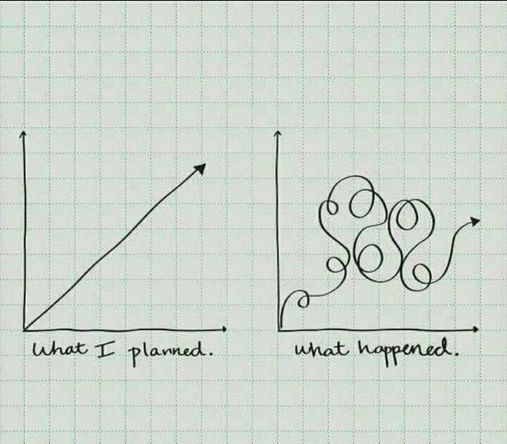
A1.1: You must have a strategy

Slide 3
What we found
A range of agencies provide advice, but NFP agencies provide the structural core and deal with by far the highest volumes
Provision now includes on-line, web chat, telephone and face to face services
Estimated 870 NFP agencies providing some form of SW advice – most as a secondary activity. Just under 500 are members of advice networks. Most are very small.
Map of NFP providers shows shortages, particularly in outer-London
Pro bono is important and has grown, but access is not consistent
On-line and self-help information and advice has grown

Slide 4
Gaps and shortages
Most acute where professional legal advice, casework and representation is required: immigration, welfare benefits and housing
Gaps in outer-London boroughs as profile of population shifts
Shortages in advice for young Londoners (16-25), BAME Londoners and disabled Londoners
Role of small community based organisations in filling the gap
Role of self help, on-line, Facebook groups etc

Slide 5
Strategic challenges
Funding – shortfall £13m? (based on Low Commission)
Workforce: recruitment, training, retention: initiatives are small-scale
Infrastructure: little pan-London capacity for networks of agencies, practitioners/advisers
Filling gaps and shortages: young people, disabled people, BAME
Systemic failure- preventable problems

Slide 6
Recommendations for London
Develop a shared vision of increasing access to advice
Target services at those who are most excluded and in need
Facilitate pan-London networking and strategic action across the range of policy areas
Major push to support and engage BAME organisations, particularly in strategic bodies where voice is not heard
More user research, engagement of users in design and delivery

Slide 7
More recommendations for London
Funding action (via new London Funders advice group and Low Commission National Advice and Legal Support Fund?)
Action to reduce preventable failure through Administrative Justice
GLA engagement with Legal Support Action Plan: e.g. testing holistic legal support hubs
Workforce action to ensure skills developed and retained and that career path defined

Slide 8
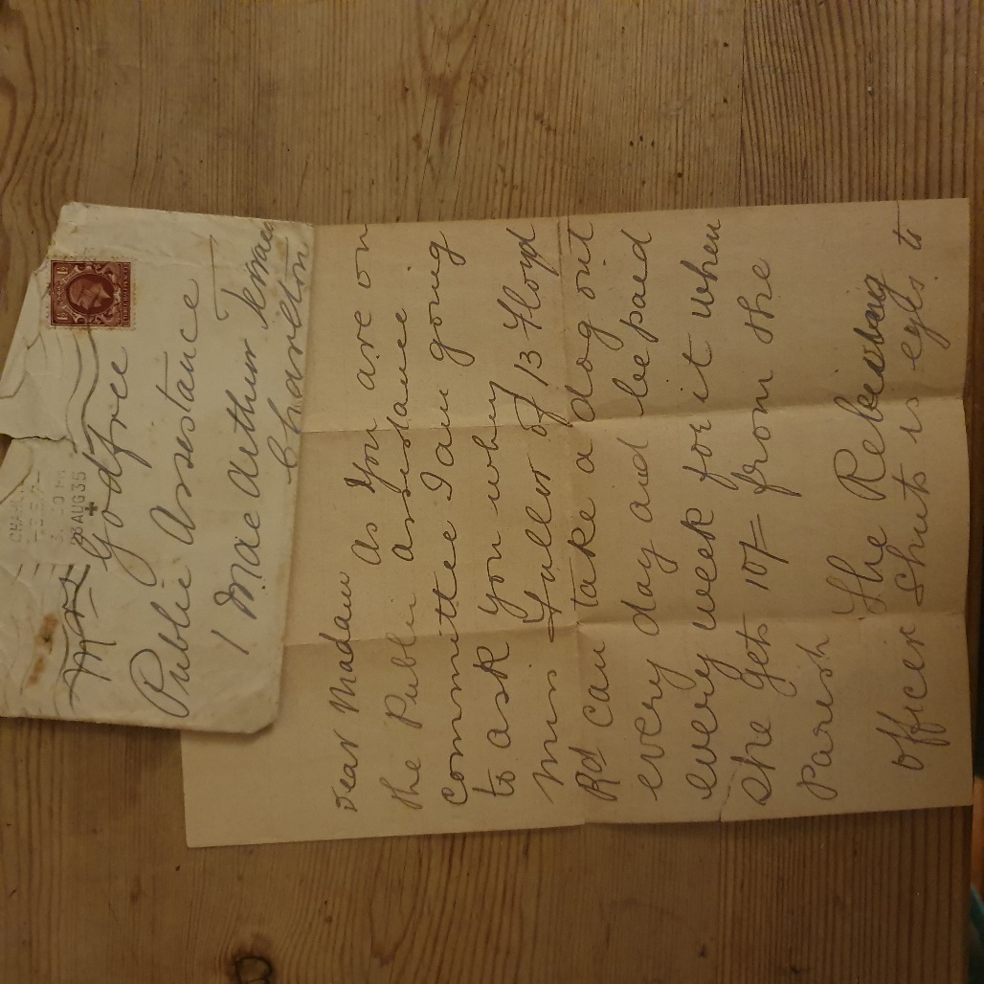
Need for advice not new…..nor is demonising poverty
“As you are on the Public Assistance Committee I am going to ask you why Miss F can take a dog out every day and be paid every week for it when she gets 10/- from the Parish.” 1935

