Slide 1

Individual Legal Needs Survey and Legal capability
Standing Committee on Research and Evaluation,
28 November 2019

Slide 2
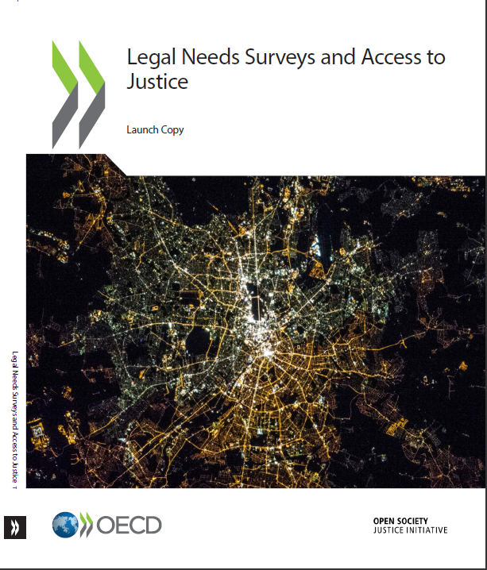
About the research
LSB and Law Society research to understand consumer needs and experiences of legal services in England and Wales
YouGov online survey of 28k adults - biggest ever run in England and Wales
Covers 34 legal issues
Uses OECD guidance
Calculates levels of met vs unmet legal needs
Includes standardised scales measuring three aspects of legal capability
Legal Services Board
Notes:
Scale and robustness gives us unprecedented insights into access to legal services
To inform strategy development , PLE policy development and the health justice strategy.
28,000+ adults, 3000 variables incredibly rich dataset which we can breakdown by 34 different types of legal issue and a large range of demographic and other factors. (fieldwork 2019)
OECD’s new guidance on conducting legal needs surveys, includes a new way of estimating the amount of unmet legal need.

Slide 3

3 (of 5) Measures of legal capability
Legal self-efficacy - self-efficacy in context of legal issues
(Legal anxiety – anxiety over legal dispute resolution)
Legal confidence – that could personally achieve a fair and positive outcome in different legal scenarios
Inaccessibility of justice – perceived ease of access to justice
(Perceived inequality of justice –perceived equality of justice process and outcomes)
Legal Services Board
Notes:
Scale and robustness gives us unprecedented insights into access to legal services
To inform strategy development , PLE policy development and the health justice strategy.
28,000+ adults, 3000 variables incredibly rich dataset which we can breakdown by 34 different types of legal issue and a large range of demographic and other factors. (fieldwork 2019)
OECD’s new guidance on conducting legal needs surveys, includes a new way of estimating the amount of unmet legal need.

Slide 4
Legal confidence
If you found yourself facing a significant legal dispute – such as being unreasonably sacked by your employer, injured as a result of someone else’s negligence, involved in a dispute over money as part of a divorce, or facing eviction from your home – how confident are you that you could achieve an outcome that is fair and you would be happy with in the following situations?
1. Disagreement is substantial and tensions are running high.
2. The other side says they ‘will not rest until justice is done’.
3. The other side refuses to speak to you except through their solicitor.
4. A notice from court says you must complete certain forms, including setting out your case.
5. The problem goes to court, a barrister represents the other side, and you are on your own.
6. The court makes a judgement against you, which you see as unfair. You are told you have a right to appeal.
Options: very confident [3]; quite confident [2]; not very confident [1]; not confident at all [0]
Legal Services Board
Notes:
Scale and robustness gives us unprecedented insights into access to legal services
To inform strategy development , PLE policy development and the health justice strategy.
28,000+ adults, 3000 variables incredibly rich dataset which we can breakdown by 34 different types of legal issue and a large range of demographic and other factors. (fieldwork 2019)
OECD’s new guidance on conducting legal needs surveys, includes a new way of estimating the amount of unmet legal need.

Slide 5
Tom May tom.may@legalservicesboard.org.uk

