Slide 1

Implementation of
Health-Justice Partnerships
Sarah Beardon
Supervision team:
Professor Rosalind Raine
Professor Dame Hazel Genn
Doctor Charlotte Woodhead
Doctor Silvie Cooper

Slide 2

Health-Justice Partnership
Combines medical and legal expertise
Targets root causes of poor health and inequality
Addresses:
Access to justice
Health inequalities

Slide 3

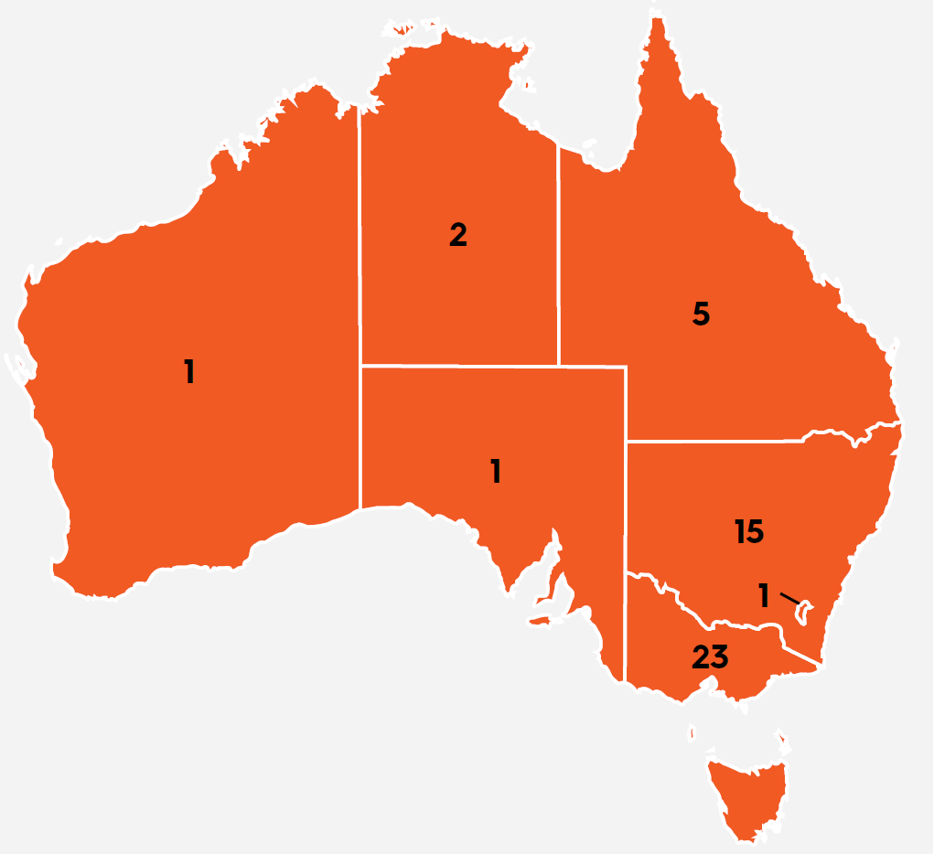



Slide 4
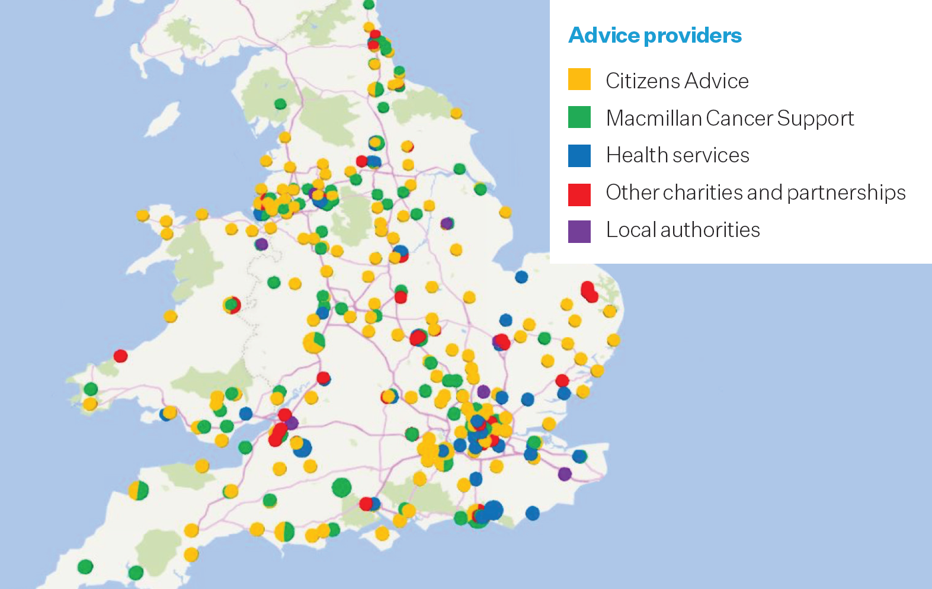

Slide 5
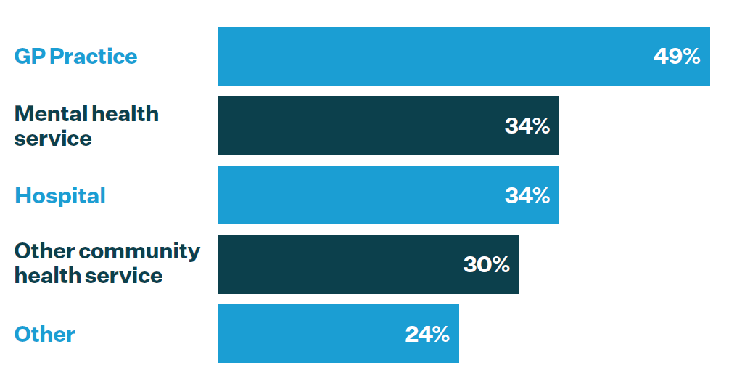

Slide 6
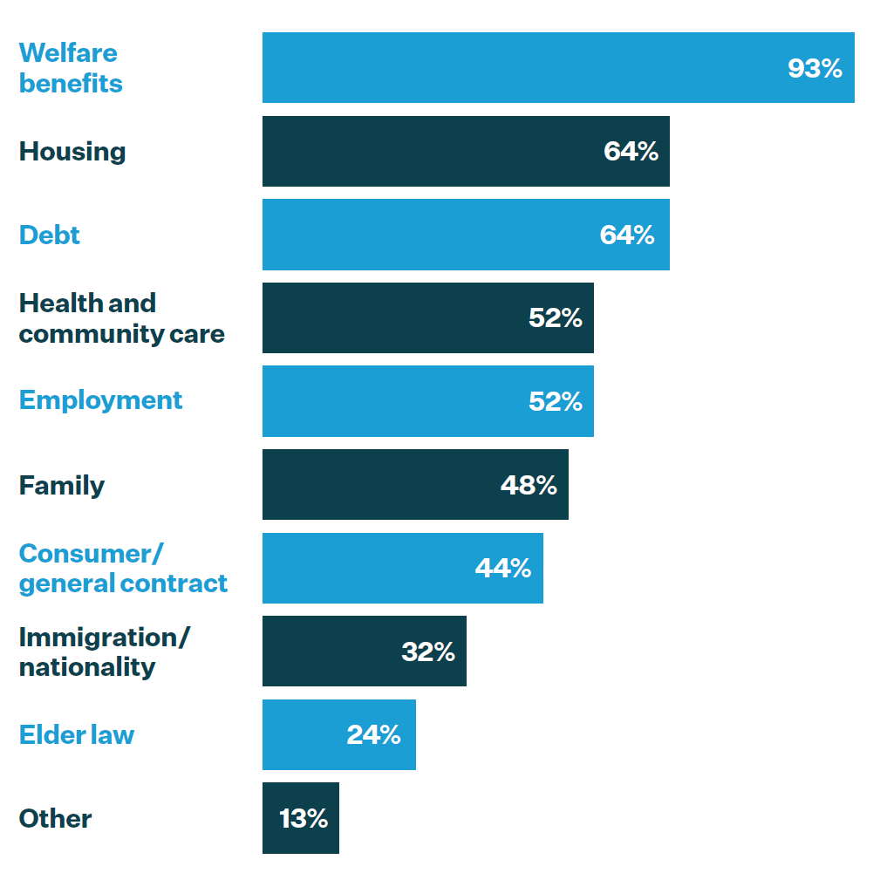

Slide 7

Study focus

Slide 8
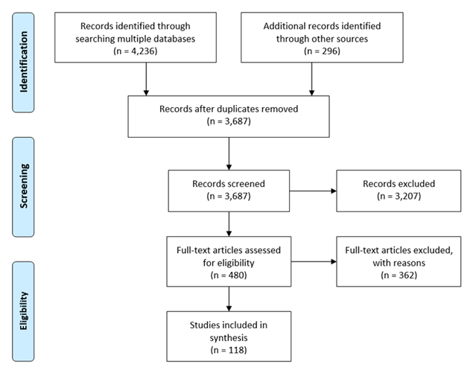
Systematic review
Characteristics of Health-Justice Partnerships
Aims and Outcomes
Evidence on implementation

Slide 9
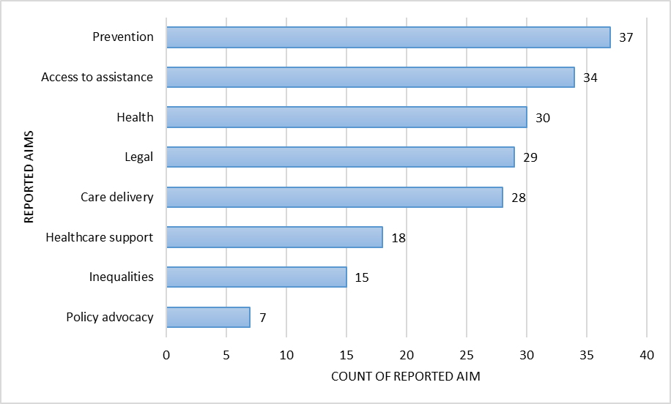
Aims of Health-Justice Partnerships

Slide 10
Implementation evidence

Slide 11

Evidence gap 1: Outcomes of implementation
What is ‘success’?

Slide 12

Evidence gap 2: Processes of implementation
Funding
Leadership
Space
How do they work?
Management
Time
Planning
Staffing
Roles
Attitudes
Responsibilities
Norms
Training
Values
Relationships
Communication
Trust
Awareness

Slide 13

Evidence gap 3: Service models
How do they compare?

Slide 14

Evidence gap 4: Implementation theory
What can it add?

Slide 15
Study focus
Overarching question:
How can partnerships between healthcare and legal services be implemented successfully?
Aims:
1. Exploring aspects of partnership success
2. Exploring factors influencing success in different settings
3. Developing tools/resources to support implementation

Slide 16
Comparative Case Study
Study design:
10 Health-Justice Partnerships across England
Diverse service models
Data collection:
Service records
Interviews

Slide 17

Participatory workshop

Slide 18
~ Thank you ~
Sarah Beardon
sarah.beardon@ucl.ac.uk

