Slide 1

Advising Londoners
An evaluation of the provision of social welfare advice across London
A report commissioned by the Greater London Authority, Equalities and Fairness Team
Annual SCARE Meeting 2019: Mapping Need, Mapping Provision
Friday, 29 November 2019

Slide 2
General update on the research
Research has now concluded. It comprised:
    Desk research
    A general survey - 77 responses
    A call for evidence
    A further funding survey – 17 responses
    Attending meetings and conferences
    Interviews/discussions with around 50 organisations
    Two focus groups: on funding and advice for young people
Report publication held up by the General Election
Publication will include a main report with comprehensive details of findings, case-studies (Enfield, Brent, H&F), quotes from providers and shorter, summary version – expected in January

Slide 3
Need for advice in London
Risen during the past decade, based on predictive demographic and socio-economic changes: population growth, migration, relative youth, benefits, low-incomes (20% below living wage)
Not evenly distributed, with some communities and some areas presenting multiple and complex advice needs
Shifted from inner to outer-London boroughs
Brent, Enfield, Haringey, Newham and Barking are more likely to have a high need for advice than other London Boroughs

Slide 4
Demand for advice services
Advice services over-subscribed
Big increases in enquiries regarding:
    Universal Credit (UC)
    Challenging disability benefit decisions, assessments and sanctions (particularly for sickness and disability benefits)
    General welfare benefits, pensions, health and social care system changes, including digitisation
    ‘Priority debt’ indebtedness
    Housing affordability, security of tenure and homelessness
Rise in hardship and complexity
Drivers: welfare reform, indebtedness, Brexit, digitization, systemic failure

Slide 5
Provision of advice in London
A range of agencies provide advice, but NFP agencies provide the structural core and deal with by far the highest volumes
Provision now includes on-line, web chat, telephone and face to face services
Estimated 870 NFP agencies providing some form of SW advice – most as a secondary activity. Just under 500 are members of advice networks. Most are very small.
Map of NFP providers shows shortages, particularly in outer-London
Pro bono is important and has grown, but access is not consistent
On-line and self-help information and advice has grown (but duplication)

Slide 6
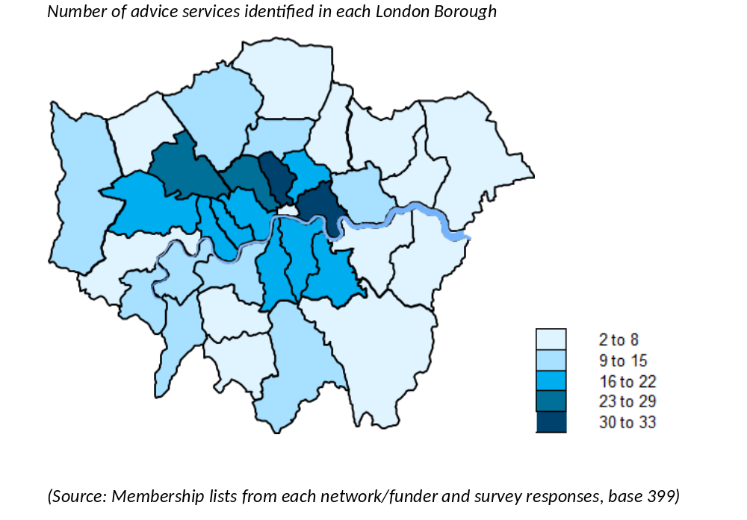
Mapping advice in London

Slide 7
GLA and partner advice initiatives
GLA piloting income maximization work in schools with CPAG
GLA commissions Warmer Homes Advice Service
GLA active on immigration advice, with London Councils, Paul Hamlyn: EU Londoners Hub, pilot triage and referral service – looking for sustainable funding
Trust for London commissioned employment advice research
GLA has launched an employment rights web-hub and directory
All positive but not strategically coordinated

Slide 8
Gaps and shortages
Most acute where professional legal advice and representation is required: immigration, welfare benefits and housing
Gaps in outer-London boroughs
Shortages in advice for young Londoners (16-25), BAME Londoners and disabled Londoners
A focus group was held on advising young Londoners with input from a large group of agencies wishing to address this issue

Slide 9
Changing face of advice
Channel shift from face-to-face drop-in to telephone and web-based services (including web chat)
More use of volunteers to deliver services
More outreach, community-based advice provision
Changes often driven by funding cuts – but few think new methods are cheaper
More health partnerships
Work around use of AI – e.g. Citizens Advice Lab, Etic Lab (Routes to Justice project)

Slide 10
Strategic challenges
Funding – shortfall £13m? (based on Low Commission)
Focus group on funding:
  New network of advice funders, chaired by London Legal Support Trust
  New funding sources? Legal Expenses Insurance
Workforce: recruitment, training, retention: initiatives are small-scale
Infrastructure: little pan-London capacity for networks of agencies, practitioners/advisers
Filling gaps and shortages: young people, disabled people, BAME
Systemic failure

Slide 11
Recommendations for London
Develop a shared vision of increasing access to advice
Target services at those who are most excluded and in need
Facilitate pan-London networking and strategic action across the range of policy areas
Major push to support and engage BAME organisations, particularly in strategic bodies where voice is not heard
More user research, engagement of users in design and delivery

Slide 12
Recommendations for GLA asks of government
Funding action :via new London Funders advice group and Low Commission National Advice and Legal Support Fund
Action to reduce preventable failure through Administrative Justice
GLA engagement with Legal Support Action Plan: e.g. testing holistic legal support hubs
Workforce action to ensure skills developed and retained and that career path defined

