Slide 1
DELIVERING DISPUTE RESOLUTION:
A HOLISTIC REVIEW OF MODELS IN ENGLAND & WALES
Professor Dr Christopher Hodges

Slide 2
Main Types of Disputes
    Business to Business
    SME
    Consumer - Trader
    Property
    Personal Injury
    Family
    Employment
    Citizen - State

Slide 3
Three Dimensions
Information, advice and assistance
Dispute resolution (consensual and imposed)
Identifying data, systemic problems, feedback and intervention to reduce future risk

Slide 4
Principal Themes
The national ‘justice system’ badly needs major reform, and integration
The advice landscape has major gaps and needs to be reconnected.
The adversarial model no longer delivers justice for most people or SMEs. Digitalisation (eg Online Court) is a catalyst for change. Some areas have effective integrated pathways, others do not.
People still need to interact with people: assistance before & during
Affecting behavior: collecting data, feeding back, intervention

Slide 5
The Regulatory Cycle
Establishing clear rules
Monitoring
Identifying problems
Sanctions
Solving disputes
Data: Applying feedback
Making Redress
Data:
Providing information

Slide 6
Mediation
Consumer – Trader In the Ombudsman pathway
Family MIAM
Employment ACAS
Property limited
SMEs SBC, GCA, PCA

Slide 7
Adjudication
binding or non-binding
Investigation/
Mediation/
Conciliation
Refer to Third Party:
Triage
Direct contact
Consumer - trader

Slide 8
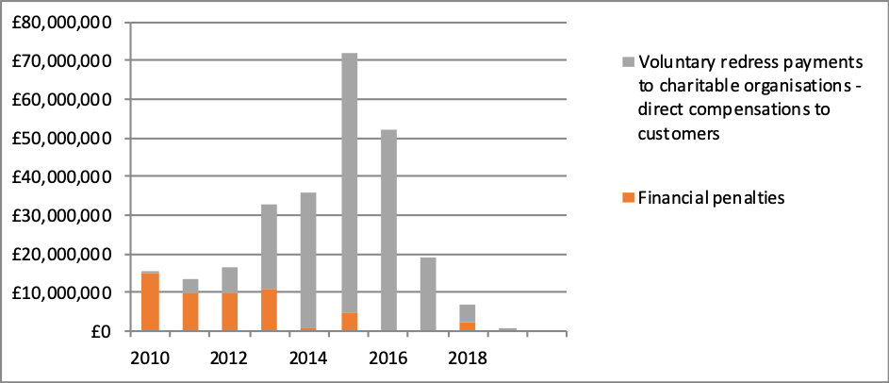
Regulatory Redress:
Ofgem: changes in fines and redress

Slide 9
Thank you

