Slide 1



Independent Lifestyles
Service User Engagement
Jack Jeffery
Project Coordinator
www.ashfordplace.org.uk Tel: 020 8208 8590 Email: john.Doocey@ashfordplace.org.uk

Slide 2

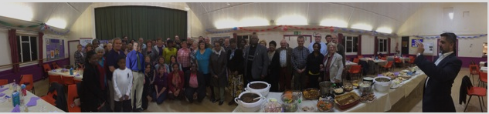
What we do
Ashford place is a local homeless charity and community hub based in Cricklewood, we provide a range of services including:
A night centre for the homeless
One-to-one casework to help vulnerable people move into secure accommodation and employment
Advice and support for those experiencing or at risk of homelessness
In-house GP, mental health and substance abuse services
Community café
Older peoples services including a community café, one to one support for the most vulnerable and a dementia support group
An IT suite and training to help vulnerable people access services

Slide 3

Our approach at Ashford Place
Since 2014 we have been using a Peer based delivery model to design and deliver our services.
Capture peoples skills, passions and talent
Embedded into our organisation
Treated as equals
Put service users at the heart of everything we do

Slide 4
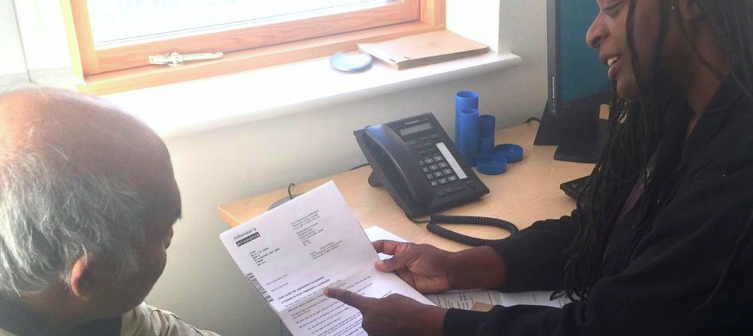
Independent Lifestyles
Addresses the high level of homelessness and crisis in Brent by using the ‘lived experience’ and skills of our Peer Support Network.
Advice and support to prevent and resolve homelessness delivered by Peers overseen by staff.
A focus on drop-in ‘Crisis Clinics’ in community spaces and foodbanks across Brent to allow those in need easy access.
Web based portal for those who are unable to travel

Slide 5
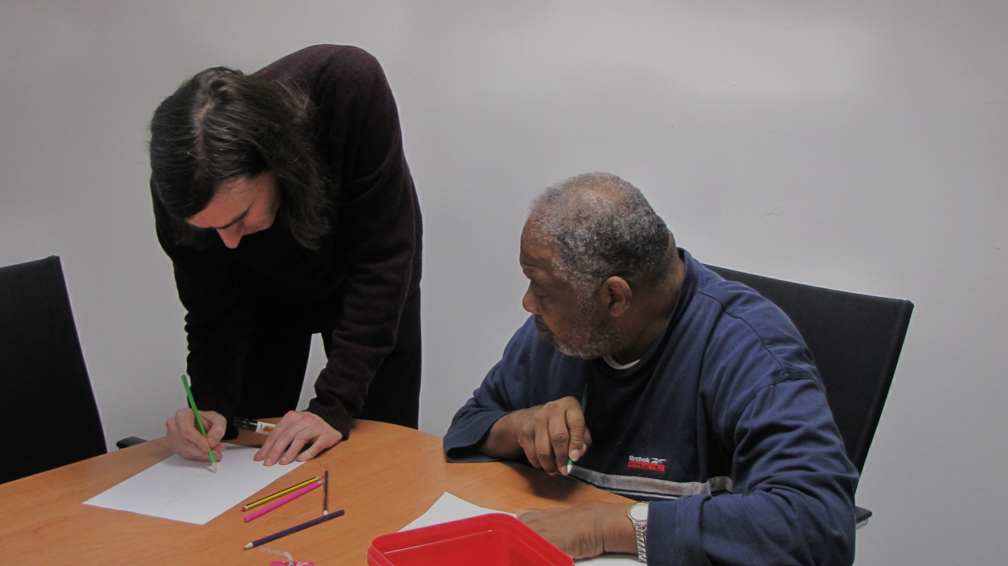
Independent Lifestyles
Those who’ve used a service know how to shape it
Formal accredited training
Involve service users from the beginning
Use ‘lived experience’
Responsibility
In partnership with Southampton University
Support finding work

Slide 6
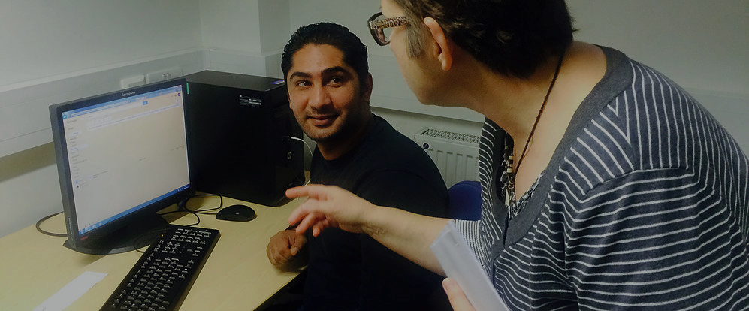
Independent Lifestyles
Current
Trained 54 Peer Supporters in the last 18 months to be able to give advice and support to clients
Running 6 drop-ins at foodbanks and libraries across Brent
Deliver an online portal where for those clients with caring or childcare responsibilities that are unable to reach our drop-in
Run a weekend project providing food and advisers for those who are unable to access our other services.

Slide 7
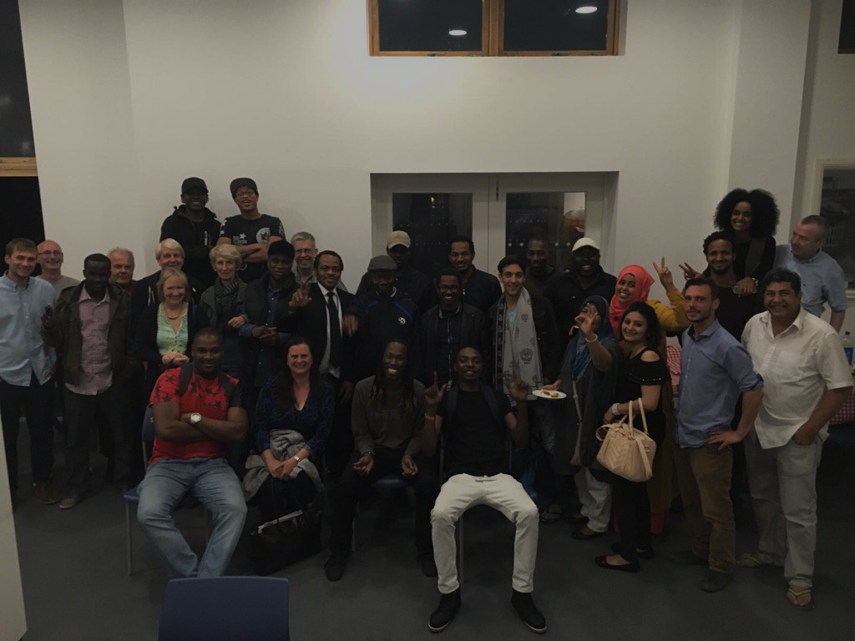
Secrets of successful service user involvement:
Our Peers and service users are our greatest asset
Allow service users the trust, scope and input to design and deliver services.
Involve service users from the very beginning
Place them on an equal footing the same as staff
Reward, train and support those who want to be involved
Accredited training
Pathways into paid employment
Understand they may face barriers to involvement
Be flexible and look for different ways for service users to be involved.

Slide 8
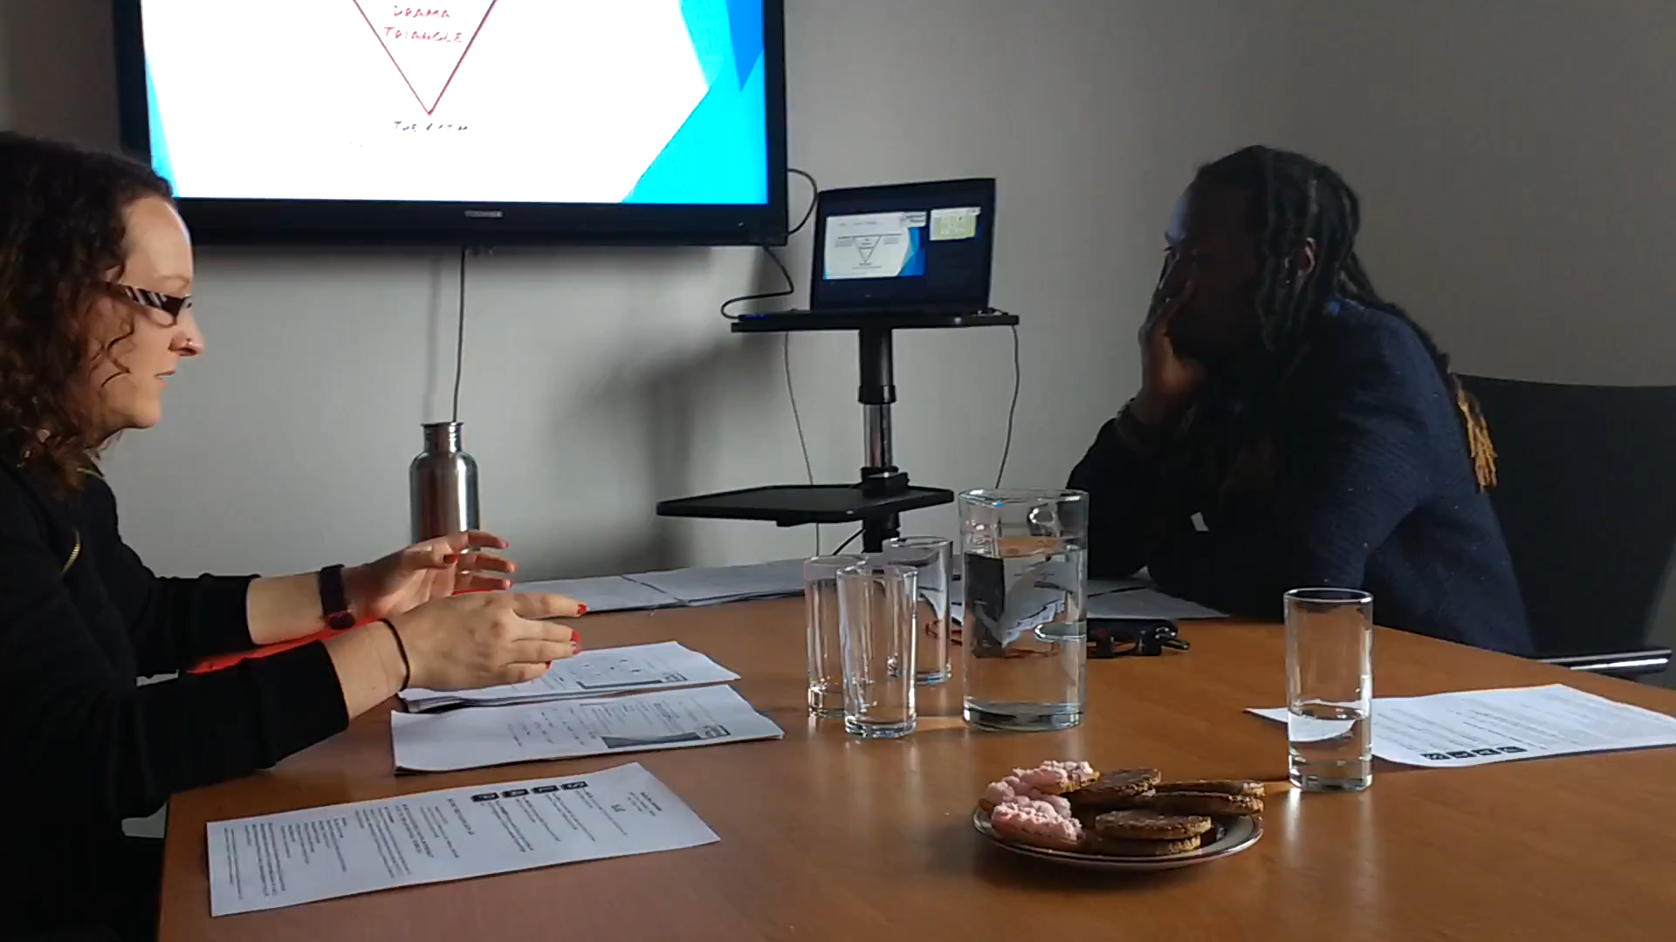
Independent Lifestyles
Video of one of the interviews we held with service users about the project

Slide 9
Further Reading
‘The Four Principles of Involvement’ (2013) by The Network for Mental Health
‘Nothing about us without us: Seven Principles of Leadership and Inclusion of People with Lived Experience of Homelessness ’ (2016) by The Canadian Lived Experience Advisory Council
‘Saving lives Saving Money’ How Homeless Health Peer Advocacy Reduces Health Inequalities, (2015) by The Young Foundation

