Slide 1


The Small Charity Sector
Duncan Shrubsole, Director of Policy, Partnerships & Communications
@duncanshrubsole @LBFEW
#smallbutvital
www.lloydsbankfoundation.org.uk
Follow us on Twitter @LBFEW

Slide 2
The Foundation – Our Model: more than just a Grant-Maker
Influencer
Grantmaker
Development agency

Slide 3
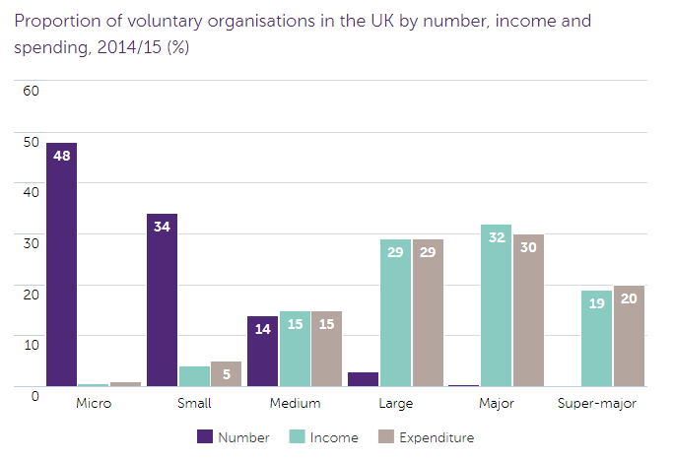
Context: Charities - majority small & local
Notes:
There are 165,801 voluntary organisations in the UK
Voluntary organisations with an annual income of £1m or more account for 80% of the sector’s total income yet make up only 3% of the total number of charities
The majority of the sector continues to consist of small organisations. However, in 2013/14 there was a notable rise in the number of organisations with an income over £100m, this number slightly increased again in 2014/15
The most common charitable activity of voluntary organisations by both number of charities and spending was social service provision, followed by culture and recreation
Voluntary organisations with an annual income of £1m or more account for 80% of the sector’s total income yet make up only 3% of the total number of charities.
In turn organisations with an income of £100,000 or less make up 82% of the sector in terms of the number of charities, but account for less than 5% of the total income. A similar pattern is seen with expenditure.

Slide 4

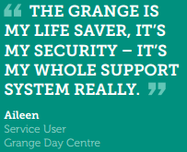


Context: Small & Medium Sized Charities
Smaller charities highly trusted by users & the wider public
Make up 97% of the charity sector (yet only 20% of income)
On the frontline, particularly as the state contracts
Facing increasing demand + funding cuts = capacity crunch
Notes:
Cuts to other services
Welfare reform
Ageing population
More complex needs
Funding harder to secure:
only 46% are confident they
will survive the next five years
Smaller charities are facing a capacity crunch:
Prioritising frontline services
Absorbing cuts through staff and infrastructure reductions
Smaller charities are facing a capacity crunch:
Prioritising frontline services
Absorbing cuts through staff and infrastructure reductions

Slide 5
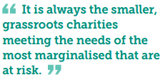

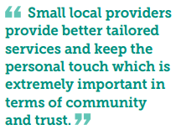
What’s distinctive about small and local charities?
Local knowledge & understanding – rooted/embedded in their communities
Boosting local social capital – building/nurturing networks (from not to the community)
Working with complex needs – foster trust & person-centred
Innovation in service delivery – responsive & adaptive, not one-size fits all
Notes:
services delivered locally by small and medium-sized charities need to be part of society’s wider plan to address disadvantage. Why?
Because they’re the services that are often created in response to problems local people face.
Trusted by communities and run by individuals who work for their community day in, day out, they have the expertise to provide tailored support to the people that need it, for as long as it takes for them to live independent and stable lives.

Slide 6
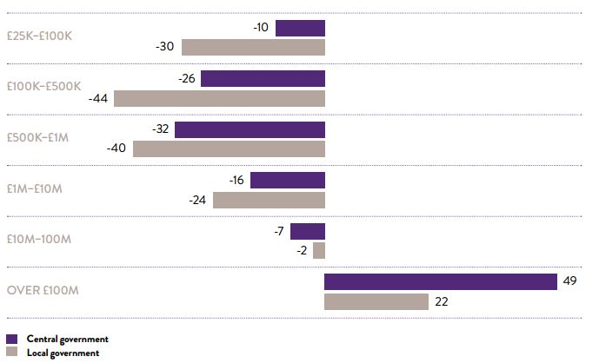

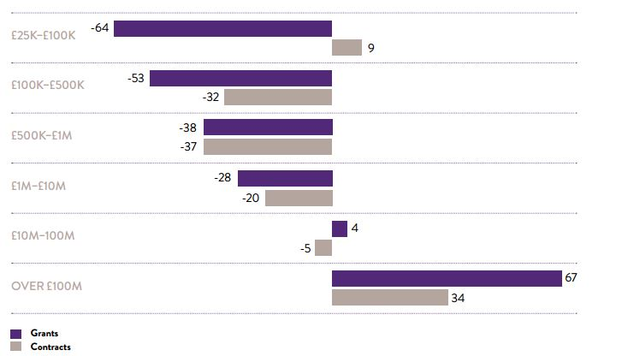
What’s the beef?
Changes in income from local and central government
Change in income (% change) 2008/09 to 2012/13
Changes in income from grants and contracts
Notes:
“Small charities are being told the answer is to change to stay alive. We did, we built, we changed delivery”
Case study: Helping Hands Essex
Approaching local corporates to provides regular income
Fundraising events
Major donor fundraising
Challenge events and individual fundraising
New partnerships to develop services
Reallocation of staff responsibilities to facilitate changes
Building volunteer numbers
Also ref loss of grants
-64% for small charities
+67% for big charities
Smaller charities experience more ‘churn’ than larger organisations, who are more resilient to external change.
Whilst individual charities are weathering the storm and even finding opportunities in the new environment, the overall picture is one where small and medium-sized charities are losing out in comparison to larger organisations.
Small and medium-sized charities have employed a diverse set of strategies to cope with funding changes.
Problem because:
Local knowledge & understanding – rooted/embedded in their communities
Boosting local social capital – building/nurturing networks (from not to the community)
Working with complex needs – foster trust & person-centred
Innovation in service delivery – responsive & adaptive, not one-size fits all

Slide 7
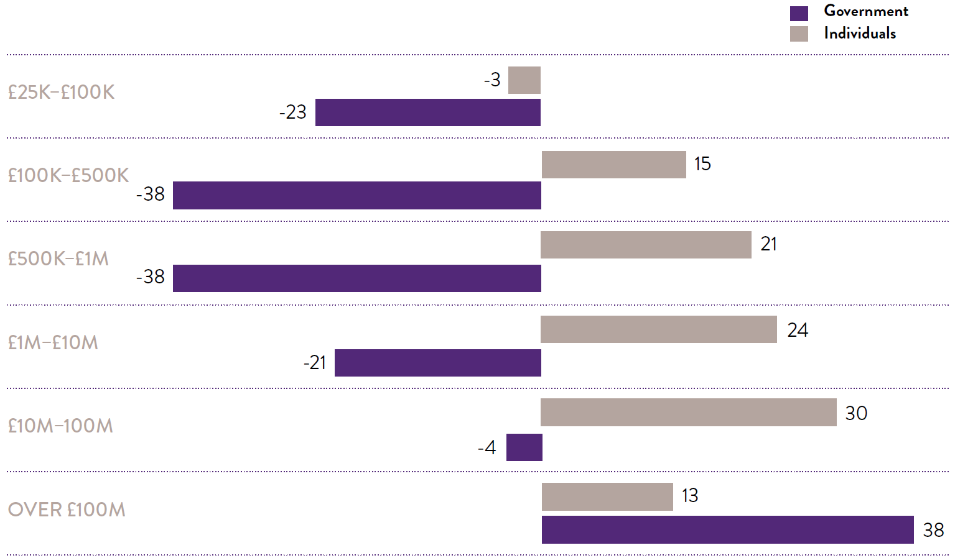
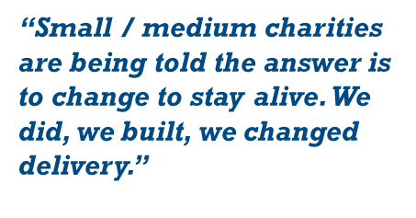
Small charities are changing & trying to adapt….
More lost from government, less gained from individuals: Change in income (% change) 2008/09 to 2012/13

Slide 8

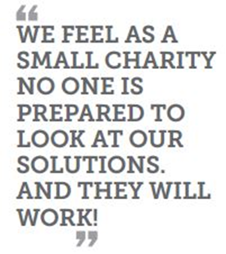
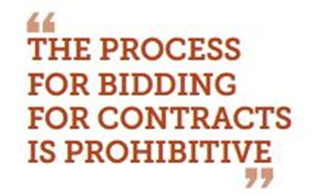
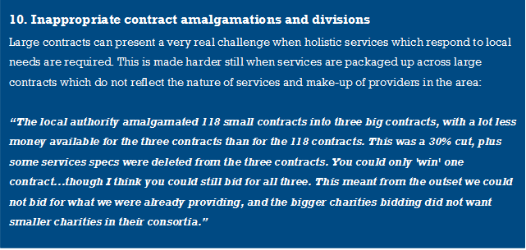
Commissioning isn’t Working

Slide 9
Commissioning problems are far and wide
“We were…at a disadvantage as the existing service provider, already holding the quality mark for high risk services - we couldn't score marks for our transition plan, and (inexplicably!) were not awarded full marks for already holding the required accreditation!”
“The procurement procedure [for mental health support] followed the same mechanism for procuring building work. We were required to evidence our site licences and to send our Health & Safety policies regarding hard hat areas and other safety features to be on site.”
“The [commissioner] decided on "TUPE plus" for any staff transferring with the daycentres. Essentially this meant increasing salaries and benefits for staff in line with Council increases. They also wanted a no redundancy guarantee. They also wanted savings.”

Slide 10
Commissioning - The core challenges
Understanding
Specifications
Processes
Notes:
1. Understanding: lack of knowledge by commissioners about needs, how to meet them and existing services; lack of consultation – results in poor specifications:
Services people need are not included
Existing providers, expertise & insight (specialisms/local) overlooked
Unrealistic expectations are set
Some providers don’t bid because they can’t deliver
Scoring overly weighted on cost
2. Specifications: aspects of contracts and tender specifications can automatically exclude smaller charities:
Contract sizes unrelated/inappropriate to services being commissioned (“diseconomies of scale”)
Disproportionate financial specifications
Inappropriate and restrictive payment mechanisms
Unclear/under funded TUPE specifications
3. Processes: commissioners follow processes which inadvertently prevent small charities from applying or being successful:
Excessive application requirements
Tight timescales
Shifting goalposts and lack of communication

Slide 11
Yet demand for services & support continues to rise
“The Trust has seen a ground-swell of clients presenting with extremely complex needs, particularly around mental ill health.”
Herring House Trust, homelessness, East of England
“We have seen a 71% increase in the number of new clients in the past 12 months.”
Clock Tower Sanctuary, unemployment, South East
Demand is going up and it’s getting more complex
“We have experienced a big increase in demand…over the last two years, and the trend is continuing.”
Women’s Work Derbyshire, substance abuse, East Midlands
“We are seeing increasing demand and increasing complexity of need.”
PATH, homelessness, South West
“We have become the last port of call for people who cannot get the help they desperately need elsewhere”
Brighton Unemployed Centre Families Project
Notes:
an exponential rise in the number of referrals we receive month

Slide 12
& Welfare reform is hitting people and charities hard
“We have seen a significant rise in referrals…an increase of almost 65%. We have experienced a changing trend in which welfare related issues dominate the referral demand, which is in conjunction with the Government Welfare Reform Strategy.”
STAMP, mental health, North East
“The challenges we’re facing are the knock on effects from the cuts to statutory services and welfare benefit reforms”
Top Church Training, homelessness, West Midlands
“The demand has increased, particularly with the introduction of Universal Credit.”
Hartlepool Citizens Advice Bureau, homelessness, North East
“Their main concern is dealing with the changes in benefit systems and proving they are seeking employment.”
View (Dove), unemployment, Wales
benefit sanctions – “lack of support at basic levels can spiral into intensive poverty or socio-economic exclusion within a few weeks”
Angelou Centre, abuse, North East
“a sharp increase in the number of people seeking help with getting into accommodation. This has been linked to issues with Universal Credit, changes to the benefits system and the withdrawal of emergency funds when people's benefits are stopped, leading to losing private tenancies, fuel and food poverty”
Barnabus, homelessness, North West
Notes:
One of the main challenges is the impact of cuts to housing benefit to those who are 18 - 21 years who are not deemed as 'vulnerable'.
Moving On, North East
Changes in benefit legislation: Welfare reform, ESA, PIP – notable decline in people’s mental health because of them; UC means people need weekly support
Welfare reform is creating new challenges; clients struggling to set up UC claims and often wiat weeks / months for payment.
In past years, service users remained on their disability benefits relatively uninterrupted, but with welfare reform came migration from incapacity/income support to Employment and Support Allowance, with continuous assessments, form filling etc. This was followed by a migration from Disability Living Allowance to Personal Independence Payment - these changes have not only increased the need for people with mental health problems to be supported to attend appointments and fill out lengthy forms, but has led to a notable decline in people's mental health due to the anxiety and stress involved. Further more, Universal Credit (an on line benefit) has meant that some of our clients need week on week support to manage their claims, without which they would be heavily sanctioned. The introduction of the bedroom tax further exacerbated the problem, with more and more clients experiencing rent arrears and threats of eviction. The abolition of crisis loans and community grants meant that people transitioning from long term institutions (hospital, care homes and prison) are being denied the necessary funds to establish themselves in new accommodation. Crisis loans and Community funds were relatively simple to apply for and clients were often able to manage this independently. The Discretionary funds are complex and require more 'staff hours' to help with applications. Furthermore, with welfare reform came a huge decrease in government funding, both to the voluntary and statutory sectors. Local councils have had huge reductions in funding and only a limited 'pot' of money for discretionary payments to vulnerable clients. Our service users are not able to 'tap-in' to this support without our help. The difficulties with Universal Credit and delayed payments are leading to rent arrears, threats of eviction notices among our clients. As the pressure on our fellow voluntary sector partners grows, there are less and less organisations willing to take on complex benefits and Tribunal work - the number of clients we are representing at Tribunals is rising week on week

Slide 13
Staff & volunteer recruitment, retention, wellbeing hit
“pressures of the work itself – increasing demands from more increasingly desperate people”
Lambeth Law Centre, abuse
“While we have an excellent staff team, workers are often over stretched and there is often insufficient time to devote to tending to organisational wellbeing: from ensuring our systems are working well to making sure staff wellbeing is supported.”
Calderdale Wellbeing, mental health, Yorkshire & the Humber
“We are defined by our (excellent) staff members but keeping them is ever harder as they make sacrifices to remain with us”
PATH, homelessness, South West
“very real problem of staff retention and recruitment of highly skilled and able people when contracts can be for such short periods with limited ability to reassure staff around future funding.”
A Way Out, abuse, North East

Slide 14
Summary: Tough Climate for Small Charities
Demand for services (level & complexity)
Workload
Competition
Need for specialist skills
Accountability
Resources (partic. public funding)
Time
Staff capacity
Certainty
= need funding + support
+ changes to their environment

Slide 15
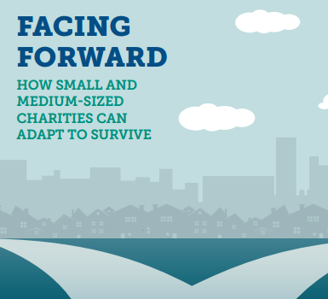
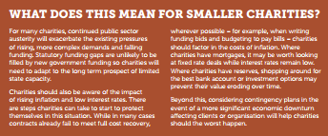
The future context – Facing Forward
10 Trends:
Brexit – road to and implications
Politics
Economy – unpredictable, uneven
Local Government – at tipping point
Reshaping of public services
6. Social Divides
7. The way we work
8. Technological progress
9. Public trust
10. Renewed vision for civil society?
www.lloydsbankfoundation.org.uk
Follow us on Twitter @LBFEW
Notes:
Claire
Published March 2017
Long term trends that will impact small and local charities

Slide 16
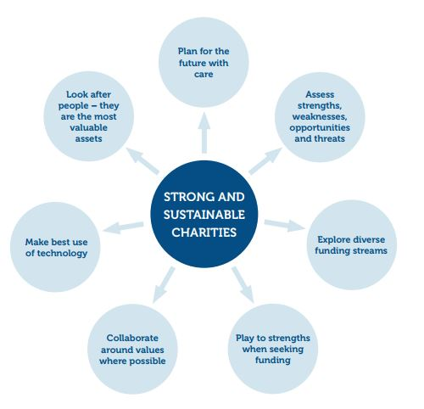
So how might you prepare for the future

Slide 17
But you cannot do it on your own – Govt. must change too
Unrealised potential
Gov reforms commissioning
Charities fail to adapt
Brighter future
Gov reforms commissioning
Charities collaborate and adapt
Government changes
Lose-lose
No policy action
Charities fail to adapt
Some survive
No policy action
Charities collaborate and adapt
Charities change

Slide 18
Small & local charities offer much more – gearing effect
Local re-investment
Volunteers
Income
from
trusts
Statutory income

Slide 19
What’s lost when local charities aren’t funded?
Loss of external investment
Loss of specialisms
Closure of local services
Loss of knowledge & the threads linking people, services, places together
Other services harder to access
Long term costs increase as a result
Notes:
Hampshire County Council divided the county into 3 lots and asked for tenders to provide all DA services within these lots.
FGFA was not a large enough organisation to take part in this process and our work is now done by a larger organisation.
Work ceased on 31st March 2015 (returned final year of grant)
Loss of external investment e.g. Fareham & Gosport Family Aid returned grant
Loss of specialisms e.g. DASH in Slough re-commissioned after commissioned service failed to deliver
Other services harder to access e.g. Lancashire Safer Together Partnership

Slide 20



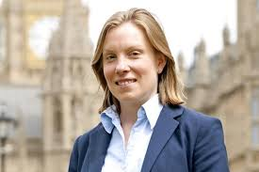


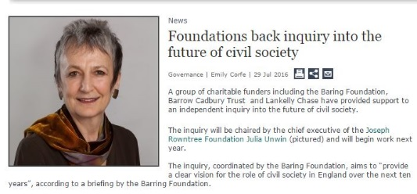


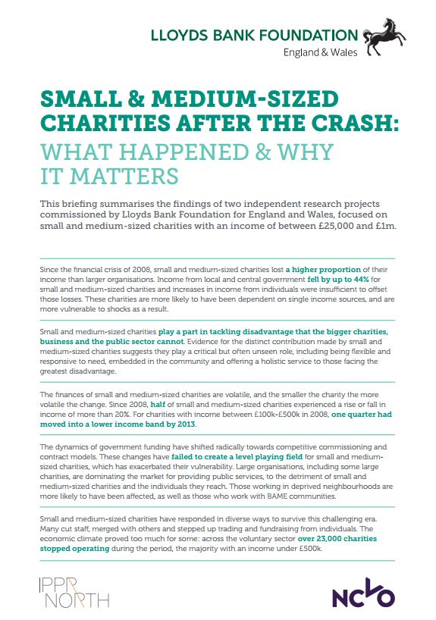

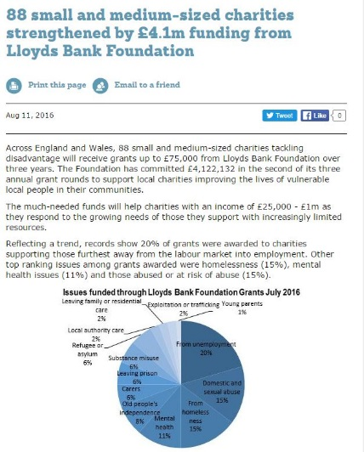

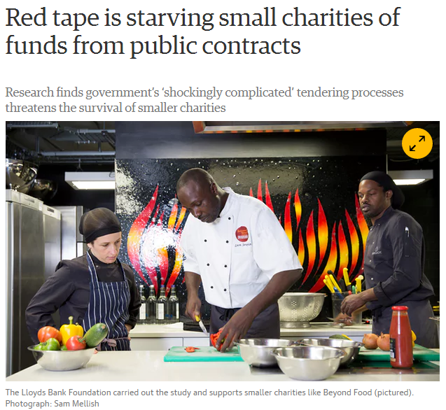


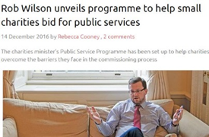

We will be with you: Championing small charities; Pushing for change
Notes:
Also mention:
- Commissioning research
2025
Value of small and local research

Slide 21

Continue the conversation

